Slide 1
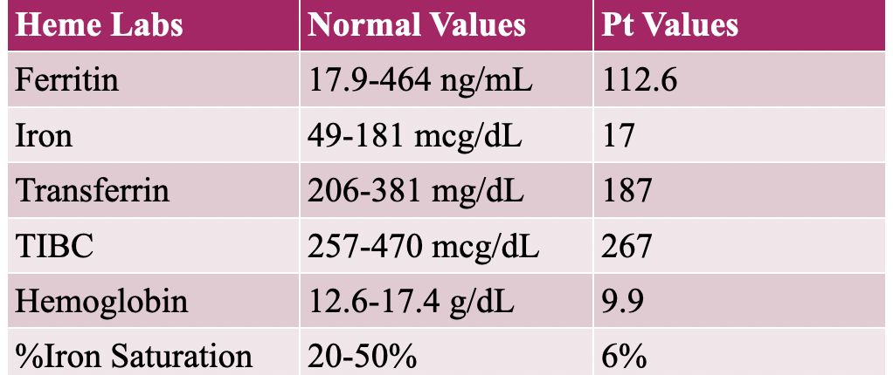
Iron Supplementation in Heart Failure
Shyla Cadogan
Department of Clinical Nutrition
University of Maryland Medical Center (UMMC), Baltimore, MD
Background
Discussion
Patient Case
Heart failure (HF) occurs when the heart fails to pump blood and oxygen to support the needs of the body.¹ Leading causes include coronary artery disease, heart attack, or chronic conditions such as diabetes and hypertension.¹
Iron deficiency with or without anemia independently predicts worse outcomes in patients with HF. Iron deficiency may impair exercise capacity, lower quality of life, and increase hospitalization and mortality risk.² It is estimated that over 50% of ambulatory patients with heart failure are deficient.²
Iron is an essential micronutrient and its metabolism is typically tightly regulated in the body.³ HF can cause iron deficiency and iron deficiency anemia through various pathophysiological mechanisms. Chronic inflammation in patients with HF is associated with lower levels of erythropoietin production and bone marrow hematopoiesis.³ Chronic kidney disease (CKD), a common comorbidity in this population, is also associated with decreased levels of erythropoietin. In addition, fluid retention and the subsequent activation of the renin-angiotensin-aldosterone system may lead to iron deficiency.⁴
No current guidelines exist regarding the optimal approach to treatment of iron deficiency and iron deficiency anemia in patients with HF. The purpose of this case study was to review current research as it relates to a patient case and, if possible, provide evidence-based practice guidelines.
Anker et al conducted a randomized-controlled trial evaluating the impact of intravenous (IV) ferric carboxymaltose on New York Heart Association (NYHA) HF classification and the Patient’s Global Assessment (PGA) in 459 ambulatory patients with HF with reduced left ejection fraction (EF) and iron deficiency. ⁴
Randomized to receive 200 mg IV iron or placebo weekly during correction phases and every 4 weeks during maintenance phases for up to 24 weeks.
Intent to treat analysis was conducted. Power analysis to detect a mean difference of 0.50 in the NYHA class and 0.90 in the PGA ranking determined enrollment 442 subjects. Treatment effect was assessed with polytomous regression modeling
After 24 weeks, NYHA functional class improved by 47% in those who received IV iron, compared to 30% in placebo controls (p: <0.001). Additionally, 50% of patients who received iron reported significant improvement in quality of life.
Ponikowski et al published a randomized-controlled trial investigating the effect of IV ferric carboxymaltose supplementation on clinical outcomes in 1,132 patients stabilized after hospitalization for HF episode. ⁵
Randomized to receive IV iron or a placebo prior to discharge and at week 6 for repletion. Maintenance doses were given at weeks 12 and 24.
Primary outcome: Total HF hospitalizations and cardiovascular (CV) death; Secondary outcomes: Total CV hospitalizations and CV death up to 1 year.
Power analysis determined enrollment of 1,000 subjects to detect a 0.75 difference in rate ratio for a combined endpoint of recurrent HF hospitalization or CV death.
Treatment was not associated with a significant reduction in HF hospitalizations and CV death (p: 0.059); however, significant reductions were noted in all secondary outcomes except for CV death.
Kalra et al conducted a randomized-controlled trial evaluating the effect of IV ferric derisomaltose supplementation on long-term CV events in 1,137 patients with HF.⁶
Randomized to receive IV iron based on hemoglobin status and body weight or placebo. Infusions were every 4 weeks for repletion and then every 4 months.
Power analysis to detect a difference in first event hazard ratio of 0.75 for HF and CV death determined 379 subjects were required.
Treatment impact on the primary outcome was assessed using Rate Ratio analysis. Cox proportional hazard models were used to evaluate secondary outcomes.
Pre-specified COVID-19 sensitivity analysis included all patients randomly assigned through March 31st, 2020 along with two post-hoc sensitivity analyses
Iron supplementation was not associated with a statistically significant reduction in HF and CV death in un-controlled analysis (p: 0.07); however, the relationship was significant after controlling for the impact of the COVID-19 pandemic (p: 0.047).
A 65-year old male presented for acute HF exacerbation.
Past medical history significant for: iron deficiency anemia, stroke, ST-elevated myocardial infarction, ischemic cardiomyopathy, hypertension, type 2 diabetes, and colon cancer.
Reported 10 pounds of unintentional weight loss between August to October 2022, related to reduced appetite that the patient attributed to colon cancer.
His weight had stabilized appetite improved.
The patient received daily ferric gluconate tablets for iron deficiency anemia.
Conclusion
Evidence supports the use of IV iron in ambulatory patients with HF and iron deficiency or iron deficiency anemia to reduce frequency of HF hospitalization and death. The use of IV iron in the inpatient setting or oral iron supplementation have not been adequately studied to support practice recommendations. In studies completed after 2019, the potential impact of the pandemic cannot be ignored.
References
Congestive heart failure (CHF). Better Health Channel. https://www.betterhealth.vic.gov.au/health/conditionsandtreatments/congestive-heart-failure-chf. Published October 28, 2022. Accessed January 21, 2023.
Shore S. Iron deficiency in heart failure. American College of Cardiology. https://www.acc.org/latest-in-cardiology/ten-points-to-remember/2018/12/31/20/40/iron-deficiency-in-heart-failure. Published January 2, 2019. Accessed January 21, 2023.
Naito Y, Masuyama T, Ishihara M. Iron and cardiovascular diseases. J Cardiol. 2021;77(2):160-165. doi:10.1016/j.jjcc.2020.07.009
Vela D. Keeping heart homeostasis in check through the balance of iron metabolism. Acta Physiol (Oxf). 2020;228(1):e13324. doi:10.1111/apha.13324
Anker SD, Comin Colet J, Filippatos G, et al. Ferric carboxymaltose in patients with heart failure and iron deficiency. N Engl J Med. 2009;361(25):2436-2448. doi:10.1056/NEJMoa0908355
Ponikowski P, Kirwan BA, Anker SD, et al. Ferric carboxymaltose for iron deficiency at discharge after acute heart failure: a multicentre, double-blind, randomised, controlled trial [published correction appears in Lancet. 2021 Nov 27;398(10315):1964]. Lancet. 2020;396(10266):1895-1904. doi:10.1016/S0140-6736(20)32339-4
Kalra PR, Cleland JGF, Petrie MC, et al. Intravenous ferric derisomaltose in patients with heart failure and iron deficiency in the UK (IRONMAN): an investigator-initiated, prospective, randomised, open-label, blinded-endpoint trial. Lancet. 2022;400(10369):2199-2209. doi:10.1016/S0140-6736(22)02083-9
Methods
A literature search was conducted using pubMED and identified three primary research articles investigating the impact of iron supplementation on outcomes in patients with HF.
Notes:
.

