Slide 1
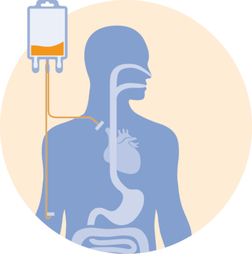
Parenteral Nutrition in the Post-Acute Care Setting
Presented by:
Krista Blackwell, MS, RD, LDN, CNSC

Slide 2
Conflicts of Interest/Disclosures
None

Slide 3
Objectives
Define and review the components of parenteral nutrition (PN)
Learn potential complications of PN
Review the benefits of EN vs. PN
Review how to formulate PN
Describe how to wean residents off PN and when it is appropriate to discontinue PN
Review a case study and calculate a PN formulation
Explain the indications and contraindications for use of PN

Slide 4
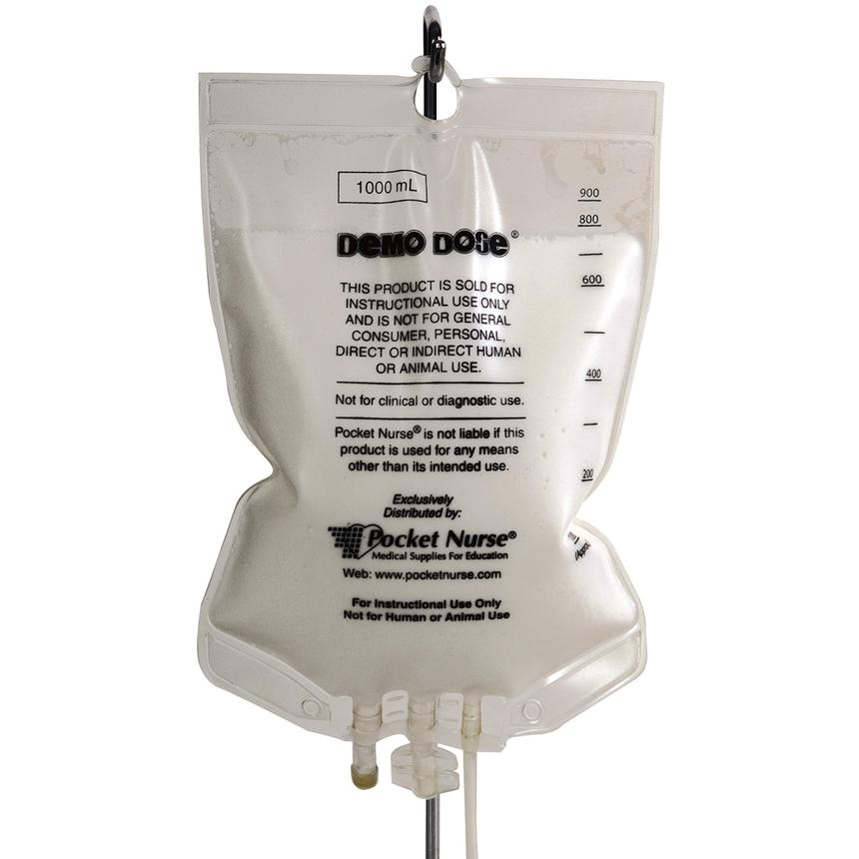
Parenteral Nutrition (PN)
PN is a means of providing protein, carbohydrate, fat, vitamins, minerals, electrolytes, and trace elements through venous access to those unable to ingest or efficiently absorb nutrients through the gastrointestinal tract.

Slide 5
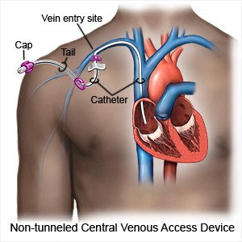
Total Parenteral Nutrition (TPN)
Also known as Central Parenteral Nutrition (CPN)
Access: Central catheters and ports
Rapidly dilutes hypertonic PN solutions
TPN/CPN can be used when:
Peripheral access is limited
Large nutrient needs
Fluid restriction
Duration is >7-14 days

Slide 6
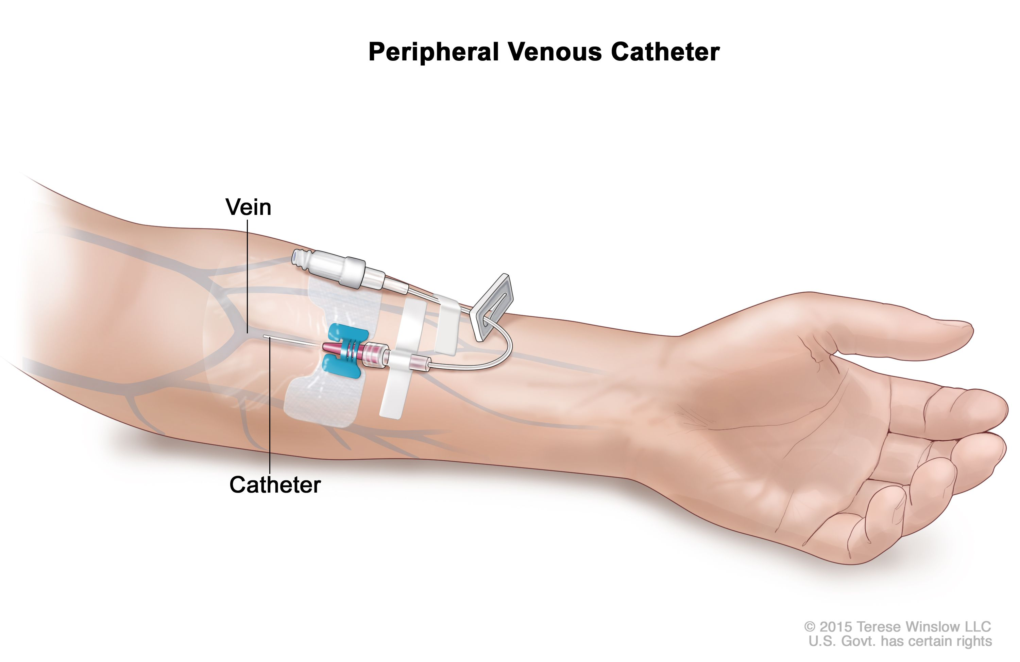
Peripheral Parenteral Nutrition (PPN)
Utilizes the small veins of the extremities
Need good peripheral veins
Not a good option when resident is on a fluid restriction
Osmolarity needs to be <900 mOsm/L
PPN can be used when:
Estimated duration is at least 5 days and less than 2 weeks
14 day maximum

Slide 7
Advantages of Enteral Nutrition vs. Parenteral Nutrition
Cost
Enteral Nutrition (EN) Maintains
Functional integrity of the gut
Normal digestive and absorptive capabilities
Normal gallbladder function
Supports immune function
Maintain gut-associated immune function
Reduce infectious complications (PNA, sepsis, intra-abdominal abscess)

Slide 8
PN Indications
Unable to meet nutrition needs with EN
Nonfunctioning GI tract
Short bowel syndrome, volvulus, high output intestinal fistula, SBO, intractable vomiting or diarrhea
Mechanical bowel obstruction
Bowel Rest
Ischemic bowel, severe pancreatitis
Motility Disorders
Prolonged ileus, scleroderma, severe adhesions
Inability to achieve or maintain EN access

Slide 9
PN- Contraindications
Functioning GI tract
Treatment anticipated for less than 7 days for a well-nourished, stable adult
Hemodynamically unstable
A prognosis that does not warrant aggressive nutritional support
DNR

Slide 10
Key PN Safe Practice Recommendations
Appropriate indication for PN
Documented in medical record and on the PN order sheet
Appropriate IV access
Energy and protein goals determined for the resident’s condition based on published guidelines and evidence
All PN ingredients ordered in amounts per day
https://www.nutritioncare.org/Guidelines_and_Clinical_Resources/Toolkits/Parenteral_Nutrition_Safety_Toolkit/Parenteral_Nutrition_Safety_Consensus_Recommendations_and_Clinical_Guidelines/

Slide 11
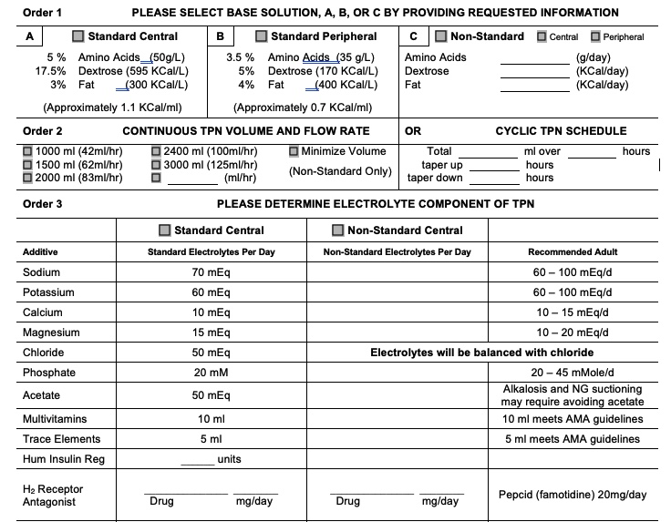
SAMPLE ORDER FORM

Slide 12
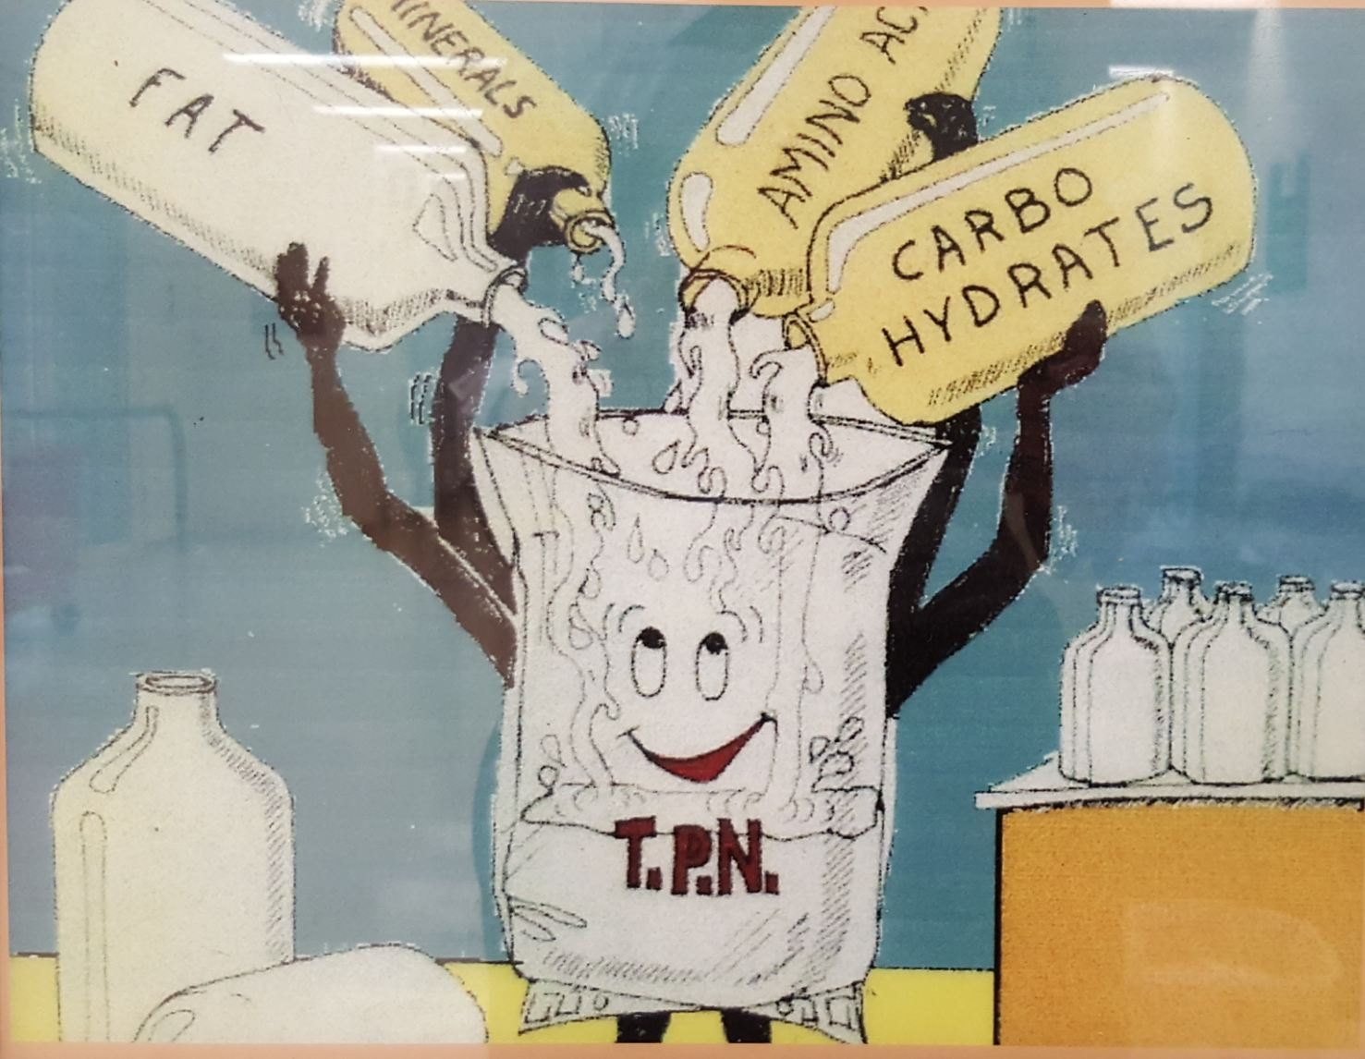
Parenteral Macronutrients: Amino Acids
Function: The body’s structural building blocks
Component of skeletal muscle
Catalyze reactions in cells
Control most cellular processes
4 kcal per gram
Solutions range from 3% to 20%
Most common: 8.5%, 10%, 15%
Modified amino acid formulations

Slide 13
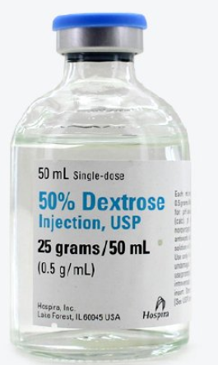
Parenteral Macronutrients: Carbohydrates
Function: Primary energy source
Dextrose:
Most commonly used CHO energy substrate in PN
Provides 3.4 kcal per gram
Available in various concentrations: 2.5% to 70%
Osmolarity depends on concentration

Slide 14
Glucose Infusion Rate (GIR)
High glucose infusion rates can increase risk for fatty liver, overfeeding, elevated triglycerides and poor glycemic control
Glucose infusion rate should not exceed 5 mg/kg/min
Diabetics and critically ill patients may maintain better glucose control with infusion rates of 4-5 mg/kg/min or less
Good blood glucose control (especially in post surgical settings) is associated with decreased morbidity and mortality
Blood glucose concentrations should be monitored every 6 hours or more frequently if indicated for hyperglycemia

Slide 15
Calculating GIR
Grams dextrose X 1000 / weight(kg) / infusion time in minutes = GIR in mg/kg/min
Ex. 150g Dextrose, 60 kg patient, 24-hour infusion
150 g x 1000 = 150000 mg dextrose
150000mg/ 60 kg = 2500
2500/1440 min
GIR= 1.7 mg/kg/min

Slide 16
Parenteral Macronutrients: Lipids
Functions:
Energy source, essential fatty acids, provide structure and function to all biological membranes, building blocks for hormones
Provides 10-11 kcal/gram
10% IVFE 11 kcal/g
20% and 30% IVFE 10 kcal/g
Available in 10%, 20%, 30%
10% IVFE contain 1.1 kcal/mL
20% IVFE contain 2 kcal/mL
30% IVFE contain 2.9-3 kcal/mL
Do NOT add if resident is allergic to eggs or soy

Slide 17
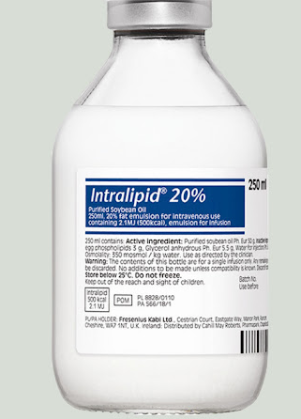
Lipids Continued
If intravenous fat emulsion (IVFE) hanging alone:
12-hour hang time
All-in-one (3-in-1 or Total Nutrient Admixture/TNA): 24-hour hang time
IVFE rate should not exceed 0.11 g/kg/hr or 1g/kg/day
Increased risk of infectious complications and hypertriglyceridemia
Ex. Grams of lipid / wt(kg) / 24 hrs = g/kg/hr
56 gm Lipid, 75 kg patient
56g / 75 kg = 0.746 / 24 = 0.031 g/kg/hr

Slide 18
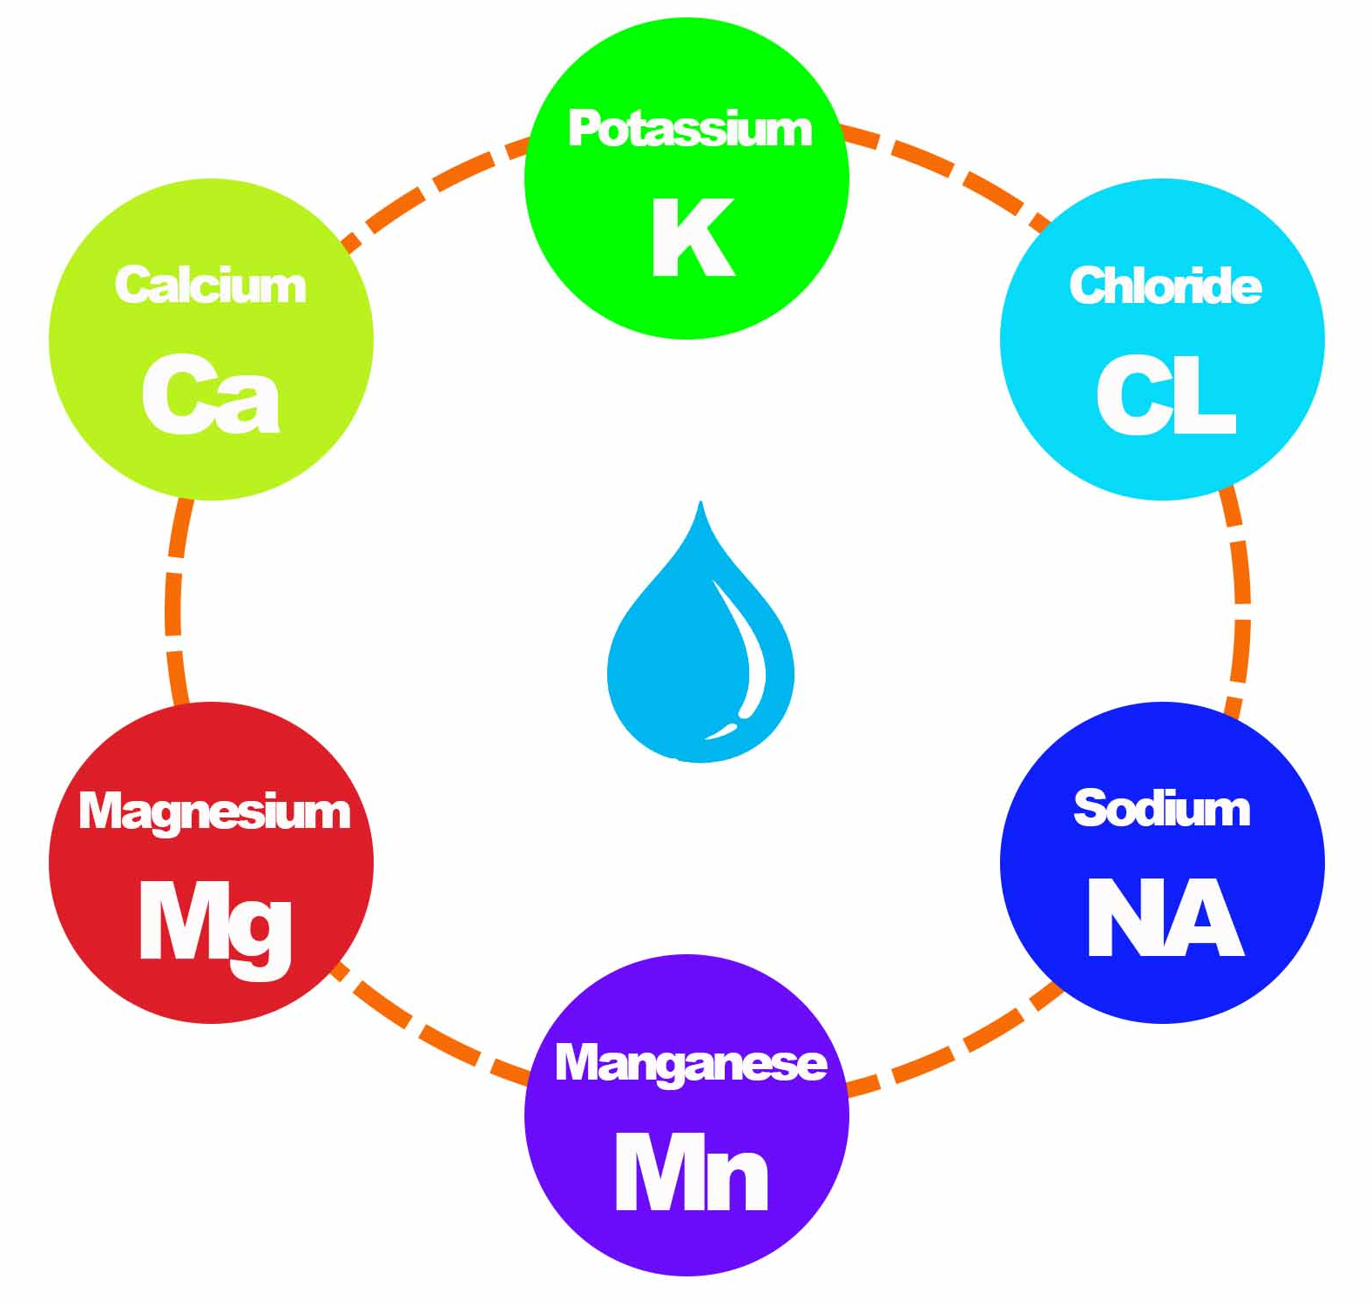
Electrolytes
Standard Daily Electrolyte Requirements
Sodium 1-2 mEq/kg
Potassium 1-2 mEq/kg
Chloride as needed to maintain acid base balance
Acetate as needed to maintain acid base balance
Calcium 10-15 mEq
Magnesium 8-20 mEq
Phosphate 20-40 mmol

Slide 19
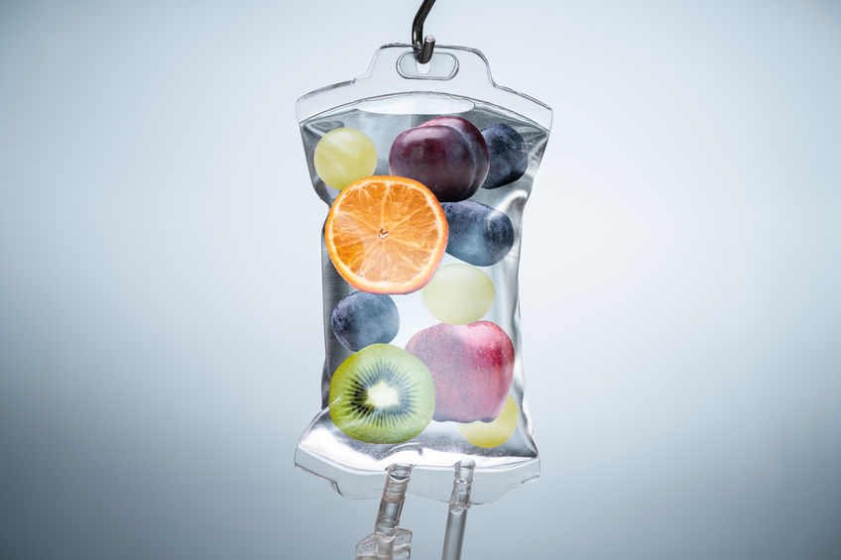
Micronutrients
All Residents should receive a multivitamin infusion (MVI) and trace elements daily in TPN
10ml (injected immediately prior to administration)
5ml with renal failure/ insufficiency
Thiamine and folic acid should be added for residents with alcohol abuse or malnutrition

Slide 20
Premixed PN Formulations
Nutrimix and Clinimix
Concentrations of dextrose 15%-25%
Concentrations of Amino Acids 3.5%, 4.25%, 5%
With or without standard electrolyte packages
All premixed formulas require MVI injection shortly before administration

Slide 21
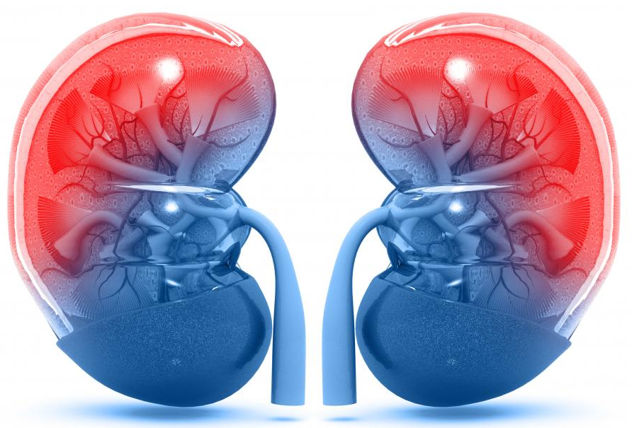
Special Considerations
Fluid Restrictions
Renal failure or heart failure
Renal Failure
Reduce fluid, Mg, Phos, K, protein
Short bowel, ileostomy, fistula
May require more Na, K, Mg, Cl, Zn, fluid
Deficiencies
May require additional vitamins

Slide 22
PN in Acute vs. Post-Acute Settings
More stable patients
Lab frequency
Offsite pharmacy and laboratory
Lack of nutrition support interdisciplinary team (IDT) approach
Older population

Slide 23
Considerations for Older Adults
PN should not be withheld due to age
Older adults are at increased risk of:
Altered serum glucose levels
Fluid and electrolyte abnormalities
Micronutrient complications
PPN may be a poor option due to fragile veins
Not recommended in end-stage diseases or terminal conditions
Advanced dementia

Slide 24
Ethical Considerations
Artificial nutrition and hydration (ANH) can ethically be withheld or withdrawn for a patient at end of life (ASPEN)
Suffering
Providing ANH in the terminally ill can increase complications and discomfort including respiratory distress and fluid retention/edema
Terminal or palliative dehydration
Advanced directives and code status

Slide 25
Monitoring
Labs:
Baseline and Weekly:
CBC with differential
INR, PT, PTT
Serum Triglycerides
Transferrin and prealbumin
1-2 times per week
Electrolytes: Na, K, Cl, CO2, Mg, Ca, Phos, BUN, Cr
Serum Glucose: Baseline, 3x/day until stable then 1-2 x/week (goal 100-200 mg/dL)
Fingerstick: 3x day until stable then PRN
ALT, AST, ALP, T bilirubin: Baseline then monthly once stable
Nitrogen Balance: PRN
Weight

Slide 26
PN Complications
Infections
Metabolic concerns
Hyperglycemia and hypoglycemia
Refeeding Syndrome
Hypertriglyceridemia
Azotemia
Hepatobiliary concerns
Essential Fatty Acid Deficiency
Errors in prescription transcription, preparation

Slide 27
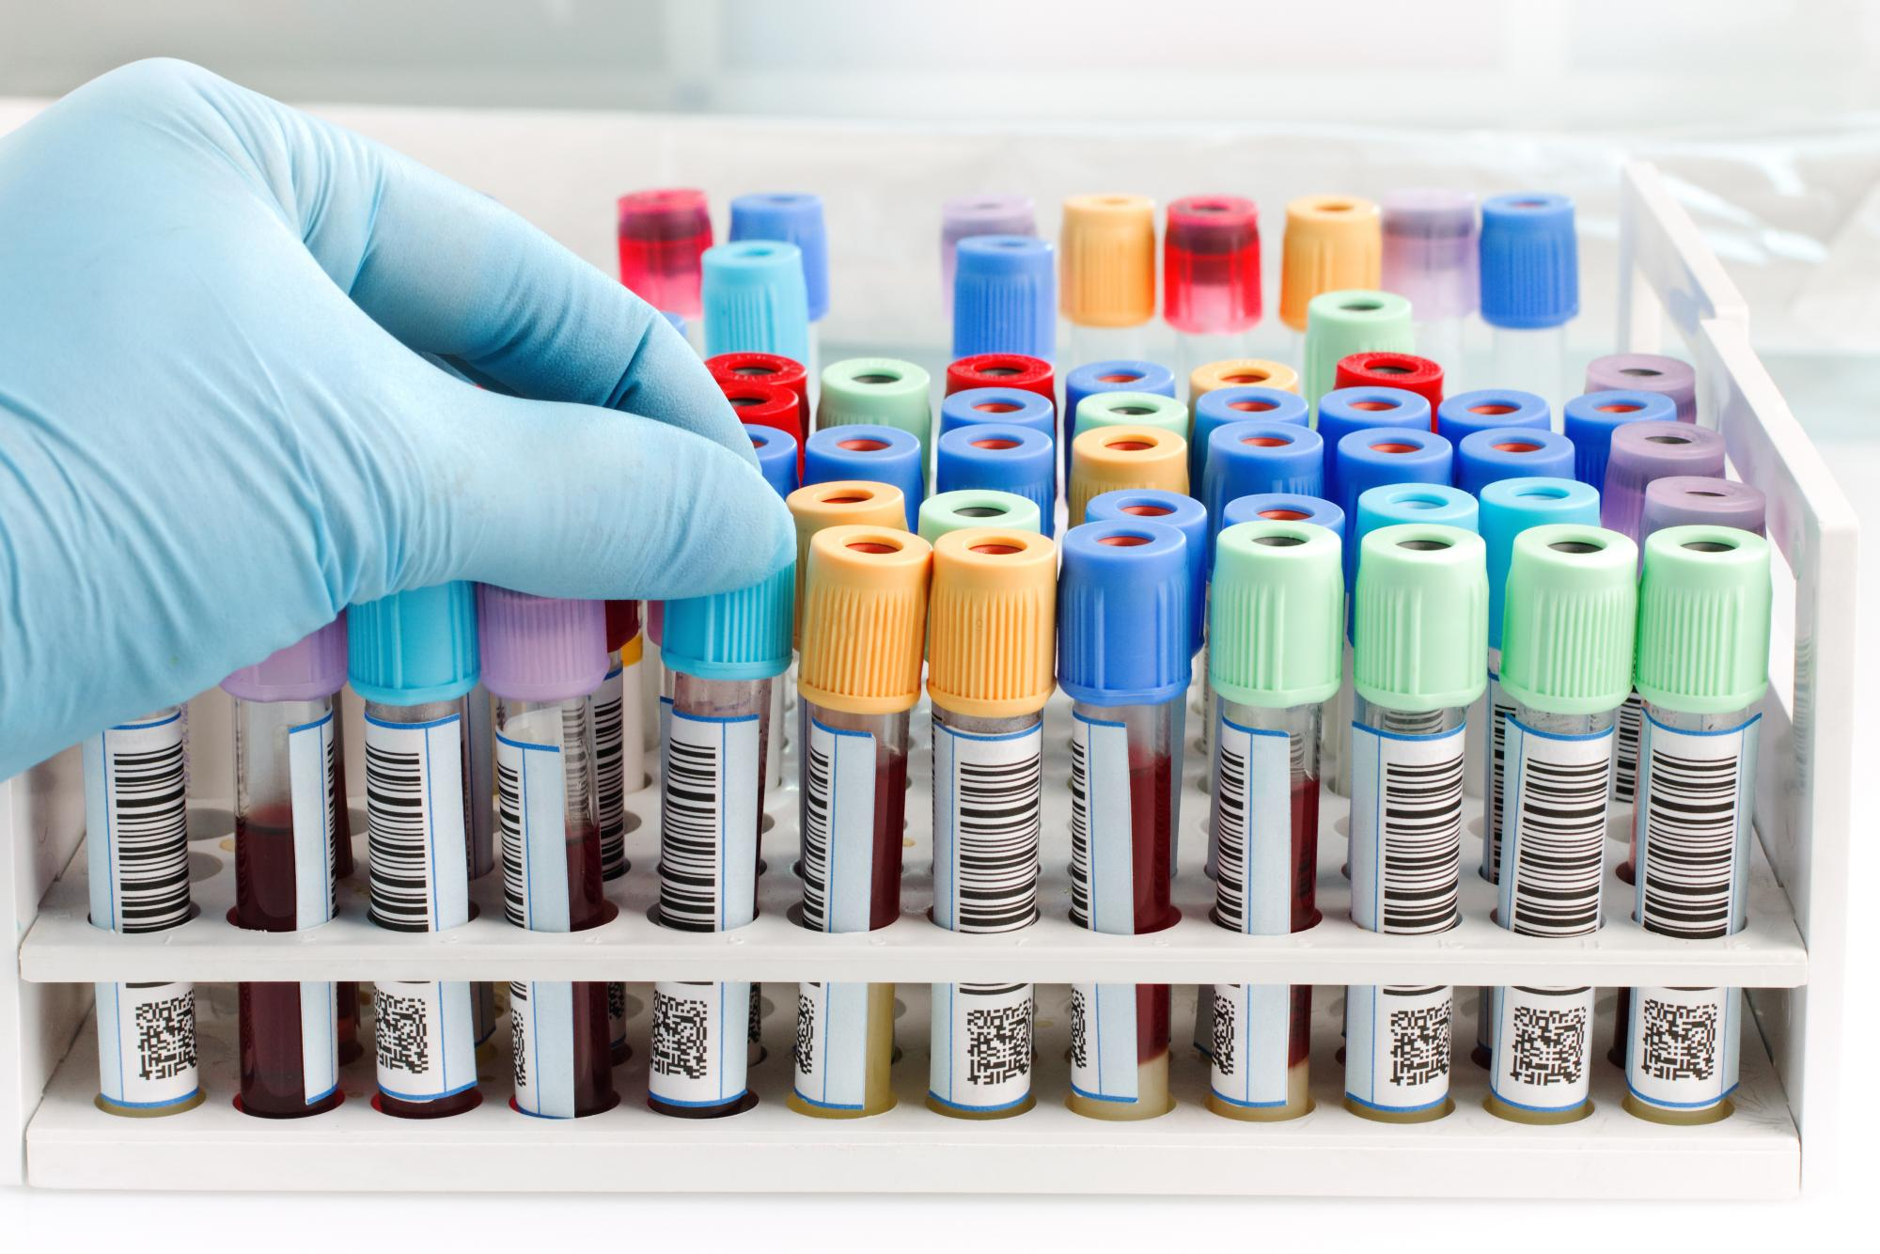
Poor Tolerance of PN
PN should be held or stopped with the following conditions:
Severe fluid and electrolyte disturbances:
Hyperglycemia: Glucose >300 mg/dL
Azotemia: BUN >100 mg/dL
Hypernatremia: Na >150 mEq/L
Hypokalemia: K <3 mEq/L and Severe Hyperkalemia
Hyper and hypo chloremia: Cl >115 and <85 mEq/L
Hypophosphatemia: Phosphorus < 2 mg/dL
Encephalopathy and hyperosmolality

Slide 28
Identifying a Bad Lab Draw
Indications of bad lab draw:
Severely elevated glucose
Elevated K, Mg, Phos, Ca, Na
Look at trends overall
Compare point-of-care/finger stick to laboratory glucose

Slide 29
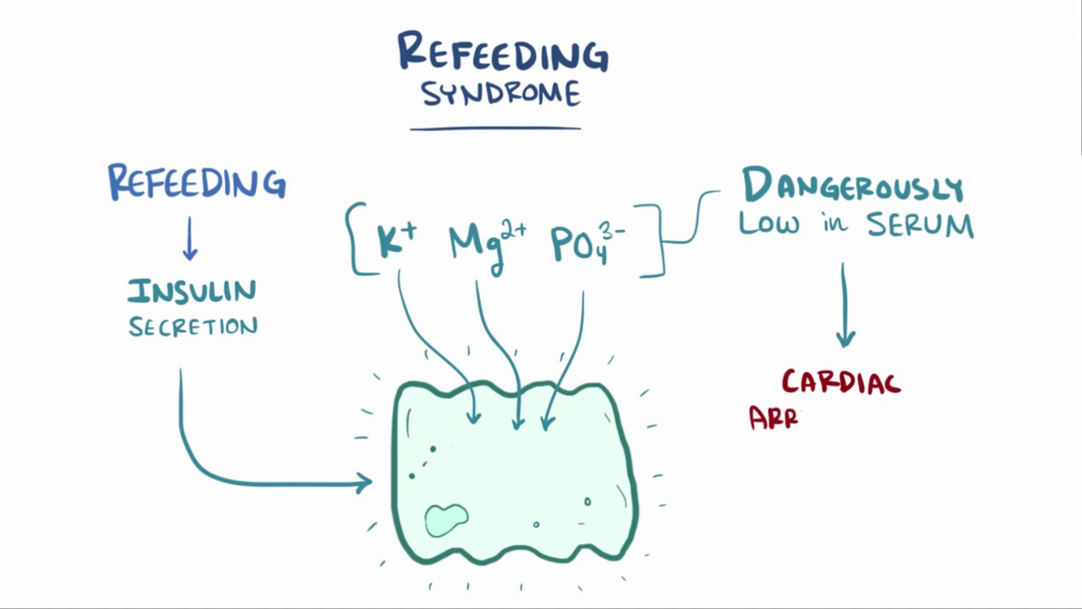
Refeeding Syndrome Recommendations
Due to nutrition repletion in malnourished resident
CHO/ dextrose delivery
PN should be started at 50% of estimated energy needs or 15 kcal/kg/day
Dextrose should not exceed 200 g/day in the first PN bag
GIR should not exceed 2 mg/kg/min initially
Increase slowly to goal with daily lab monitoring
Protein can usually be started at goal for amounts less than or equal to 1.5 g/kg
Initiate fluid at goal volume

Slide 30
PN Complications: Hyperglycemia
Most common complication in TPN administration
Causes:
Excessive CHO administration
Hepatic steatosis
Increased CO2 production
Chromium deficiency (rare)
Initiate at half estimated energy needs or 150-200g dextrose
GIR should not exceed 4-5 mg/kg/min
Monitor blood glucose at least every 6 hours
Do not increase dextrose until blood glucose well controlled
Insulin

Slide 31
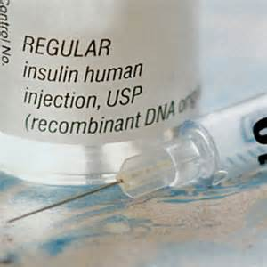
Insulin
Insulin should never be used in the first day’s bag
Initial Regimen:
0.05 to 0.1 units of insulin per gram of dextrose in the PN solution is common
0.15-0.2 units for hyperglycemic patients
Insulin separate from PN formula:
Basal insulin
Fingersticks align with insulin regimen

Slide 32
PN Complications: Hypoglycemia
Causes:
Excess insulin
Taper PN when discontinuing/stopping or cycling
Run at half the rate over 30 min to 2 hours
Check blood glucose within 1 hour of stopping infusion
Treatments:
Dextrose infusion
Stop source of insulin

Slide 33
PN Complications: Essential Fatty Acid Deficiency (EFAD)
Occurs within 1-3 weeks if no lipids are provided
Symptoms: Dermatitis, hair loss (alopecia), hepatomegaly, fatty liver, anemia, thrombocytopenia
Triene:tetraene ratio
To prevent, provide 1-2% daily energy requirements from linoleic acid and 0.5% of daily energy requirements from linolenic acid
Equal to 250 mL of 20% IVFE or 500 mL of 10% IVFE twice a week or 500 mL of 20% IVFE once a week
Egg or soy allergies: Topical skin application or oral oils

Slide 34
PN Complications: Hypertriglyceridemia
Triglyceride goal: <400 mg/dL
Causes:
Dextrose overfeeding
Rapid administration of IVFE (>110 mg/kg/min)
Consequences:
Impaired immune response
Increased risk of pancreatitis
Treatment:
Restrict lipids to <30% of total kcal or 1g/kg/day
Administer lipids over at least 8 hours
If serum triglycerides >400 mg/dL hold IVFE
Reduce dextrose

Slide 35
PN Complications: Azotemia
Increased BUN and creatinine
Causes
Excessive protein administration
Dehydration
Inadequate non-protein calories
Treatment
Reduce amino acids
Increase fluid volume

Slide 36
PN Complications: Hepatobiliary
Steatosis: Fat accumulation in the liver
Due to overfeeding
Cholestasis: Impaired bile secretion
Elevated Alk Phos and direct bilirubin
Gallbladder stasis
Due to lack of enteral nutrition
Treatment:
Cycle TPN

Slide 37
Cycling
Avoid cycling in unstable patients
Can start by reducing the administration time by 4-6 hours each day (or each time you reorder PN)
Caution with:
Hyperglycemia, edema, renal or heart failure
Recalculate GIR
Ramp up
Taper Down:
Preventing rebound hypoglycemia (bigger issue in children than adults): Taper PN over 1-2 hours at the end of the cycle (some sources recommend taper down of 30-60 min)

Slide 38
Weaning
PN can begin to be weaned when solid food is being tolerated orally, or the resident is tolerating tube feeding
If worried about tube feeding tolerance start slowly and slowly taper PN
If eating by mouth, typically wait until patient is consuming >50% of their needs and remainder can be met with nutrition supplements

Slide 39
Transitioning to Home TPN
Assess capabilities of resident/family
Work with IDT
Conditions warranting caution when initiating PN in the home:
Medical Conditions: DM, CHF, pulmonary disease, severe malnutrition, cancer
Electrolyte Disorders: Hypernatremia, hypokalemia, hyperchloremic metabolic acidosis, hypophosphatemia, hypochloremic metabolic alkalosis
Medicare and Medicaid Guidelines for Reimbursement:
Documentation that patient has non-functioning GI tract
Permanent condition (will required TPN >90 days)
Documented inability to tolerate EN

Slide 40
Practical Application: Case Study
RF is a 68 y.o. male admitted from the hospital with enterocutaneous fistula. NPO on TPN, PICC line access. Plan to continue TPN until scheduled colectomy in 1 month. Reports diarrhea x 4 months.
Diet: NPO except sips of water and medications
PMHx: HTN, DM2, CKD3, anemia
Anthropometric Measurement: Ht: 71”, Wt: 63 kg, BMI 19.3.
Wt Hx: UBW 190 lb (86 kg). Total weight loss of 52 lb (27%) due to poor appetite and diarrhea (severe). Pt appears malnourished with visible fat and muscle wasting.

Slide 41
TPN Case Study
Skin: LLQ abdominal fistula drain
Meds: Ferrous Sulfate, Prednisone, Humalog sliding scale, Furosemide, Humulin 7 units q 6 hours, Zofran, Zosyn
Estimated Needs: (63 kg)
Calories: 1575-1890 kcal/day per 25-30 kcal/kg
Protein: 63-76 g/day per 1-1.2 g/kg
Fluid: 1575-1890 mL/d per 25-30 mL/day

Slide 42
TPN Case Study: Labs
Lab | RF’s Lab Value | Normal Range
Na | 133 | 136-145 mEq/L
K | 4.24 | 3.5-5.3 mEq/L
Cl | 101 | 98-110 mEq/L
CO2 | 23 | 21-31 mEq/L
Glucose | 215 | 74-109 mg/dL
BUN | 34 | 7-25 mg/dL
Cr | 1.22 | 0.6-1.3 mg/dL
Ca | 8.7 | 8.6-10.3 mg/dL
ALT | 22 | 7-52 U/L
AST | 38 | 34-39 U/L
Alk Phos | 124 | 34-104 U/L
Total Bilirubin | 0.6 | 0.2-1.2 mg/dL
Mg | 1.6 | 1.9-2.7 mg/dL
Lab | RF | Normal Range
Phos | 3.3 | 2.5-5 mg/dL
Albumin | 2 | 3.5-5.7 g/dL
TG | 129 | <150 mg/dL

Slide 43
Case Study: Hospital TPN Order
Current TPN Formulation: 16-hour cycle
55 g AA (10% solution)
150 g dextrose (50% solution)
150 mL of 20% lipids (30g lipids)
Na Acetate 35mEq
K Acetate 30mEq
K Phos 7.5 mmol
Ca Gluconate 6mEq
Mg Sulfate 3mEq
MVI 10 mL
MTE-5 1 mL

Slide 44
TPN Case Study: Questions
Is the current TPN formulation meeting RF’s needs?
Calculate grams of Protein
Calculate grams of Dextrose
Calculate grams of Lipid
Calculate Volume
Determine if current TPN Order is Appropriate

Slide 45
Case Study: Calculations
Estimated Needs: (63 kg)
Calories: 1575-1890 kcal/day
Protein: 63-76 g/day
Fluid: 1575-1890 mL/d ay
Current TPN Formulation:
1560 mL total volume
150g Dextrose x 3.4 = 510 kcal
55g Amino Acids x 4 = 220 kcal
30g of 20% lipids x 10= 300kcal
Totals: 55g protein, 1030 kcal, 1560 mL total volume
Would you recommend any changes?

Slide 46
Case Study: Recommendations
Estimated Needs: (63 kg)
Calories: 1575-1890 kcal/day
Protein: 63-76 g/day
Fluid: 1575-1890 mL/d ay
Protein
65 g Amino Acids x 4= 260 kcal
Lipids: 30% of total energy needs
1700 x 0.3 = 510 kcal /10 = 50 g lipids (500 kcal)
Goal: <1 g/kg/day = 50/63= 0.79 g/kg/day
Dextrose:
500 lipid kcals + 260 protein kcals = 760 kcal from protein and lipids
1700-760= 940 kcal from dextrose / 3.4 = 276 g dextrose
Totals
65 g protein
500+260+940= 1700 kcal

Slide 47
Case Study: GIR
GIR: Continue 16-hour cycle (960 minutes)
Grams dextrose X 1000 / wt(kg) / 960 =
mg/kg/min
276 x 1000= 276000
224000/63= 4381
4381/960= 4.6 mg/kg/min
Diabetics and critically ill patients may maintain better glucose control with infusion rates no more than 4-5 mg/kg/min

Slide 48
Case Study: Final Recommendations
Estimated Needs: (63 kg)
Calories: 1575-1890 kcal/day
Protein: 63-76 g/day
Fluid: 1575-1890 mL/d ay
Macronutrients:
65 g Amino Acids
276 g Dextrose
50g of 20% lipids
Totals: 1700 kcal, 65g protein, increase to 1800 mL total volume
Other recommendations:
Discuss potential discontinuation of Furosemide with MD due to fistula and elevated BUN
Electrolytes: Address abnormalities
Increase Mg Sulfate in TPN due to low serum Mg level (currently only receiving 3mEq), consider increasing sodium due to low serum level
Increase infusion time due to GIR of 4.6 mg/kg/min and hyperglycemia
Wait until finger sticks and electrolytes are 100-200 mg/dL before increasing dextrose by 75-100g per day

Slide 49
Recommended Resources
American Society of Parenteral and Enteral Nutrition (ASPEN)
ASPEN Parenteral Nutrition Handbook, 3rd ed.
ASPEN Adult Nutrition Support Core Curriculum, 3rd ed.
ASPEN Fluid, Electrolytes, and Acid-Base Disorders Handbook, 2nd ed.
University of Virginia’s Practical Gastroenterology Journal
Academy of Nutrition and Dietetics (AND)
Today’s Dietitian: Fluids, Electrolytes, and Acid-Base Balance
https://www.todaysdietitian.com/pdf/courses/FesslerelecrolytesinPN.pdf

Slide 51
References
ASPEN. Clinical Guidelines: Nutrition Support of Adult Patients With Hyperglycemia. JPEN J Parenteral Nutr. 2013; 37(1)23-36.
ASPEN. Enteral Nutrition Practice Recommendations. JPEN J Parenteral Nutr OnlineFirst, published on January 27, 2009
ASPEN. Standards for Specialized Nutrition Support for Adult Residents of Long-Term Care Facilities. NCP 21:96-104. February 2006.
Mueller CM. The ASPEN Adult Nutrition Support Core Curriculum, 2nd Edition. Kendall/Hunt Publishing; 2012.
ASPEN. What is Parenteral Nutrition http://www.nutritioncare.org/about_clinical_nutrition/what_is_parenteral_nutrition/
Ayers P, Adams S, Boullata J, Gervasio J, Holcombe B, Kraft MD, Marshall N, Neal A, Sacks G, Seres DA, Worthington P. ASPEN Parenteral Nutrition Safety Consensus Recommendations. Journal of Parenteral and Enteral Nutrition. Vol 38. No 3. March 2014; 296-333. https://onlinelibrary.wiley.com/doi/pdf/10.1177/0148607113511992

Slide 52
References continued
Fresenius Kabi Announces U.S. Availability of Omegaven (fish oil triglycerides) Injectable Emulsion. Fresenius Kabi. December 10, 2018. https://www.fresenius-kabi.com/us/news/fresenius-kabi-announces-u-s-availability-of-omegaven-fish
Mundi MS, Salonen BR, Bonnes S. Home Parenteral Nutrition: Fat Emulsions and Potential Complications. Nutrition in Clinical Practice. Vol 31, Issue 5. https://onlinelibrary.wiley.com/doi/abs/10.1177/0884533616663635
Smoflipid is an advancement in U.S. lipid emulsions for adults. Fresenius Kabi. http://smoflipid.com/characteristics-of-smoflipid/smoflipid-composition/
Worthington P, Bechtold M, Bingham A, Chan LN, Jevenn AK, Mascarenhas M. When is Parenteral Nutrition Appropriate? Journal of Parenteral and Enteral Nutrition. Vol 41. No 3. March 2017. https://onlinelibrary.wiley.com/doi/epdf/10.1177/0148607117695251

Slide 53
References Continued
Parenteral Nutrition Safety Consensus Recommendations and Clinical Guidelines. ASPEN. https://www.nutritioncare.org/Guidelines_and_Clinical_Resources/Toolkits/Parenteral_Nutrition_Safety_Toolkit/Parenteral_Nutrition_Safety_Consensus_Recommendations_and_Clinical_Guidelines/. Accessed August 19, 2021.

