Slide 1
Cindy Cysewski, MS.,RD.,LDN
Director of Healthcare
ccysewski@lyonsmagnus.com
252-548-0320
Notes:
Nancy R

Slide 2
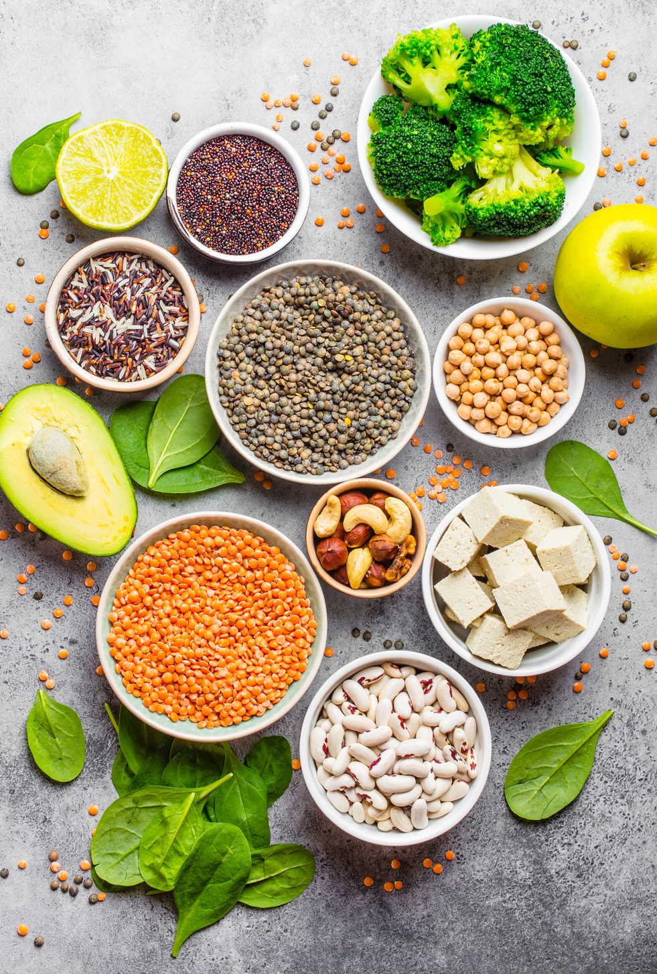
Today’s
Agenda
01
What’s NEW
Innovative Product
02
Cindy’s Favorite Products
Pre-Thickened
03
How We Can Help
Value Added Resources

Slide 3
Innovation

Slide 4
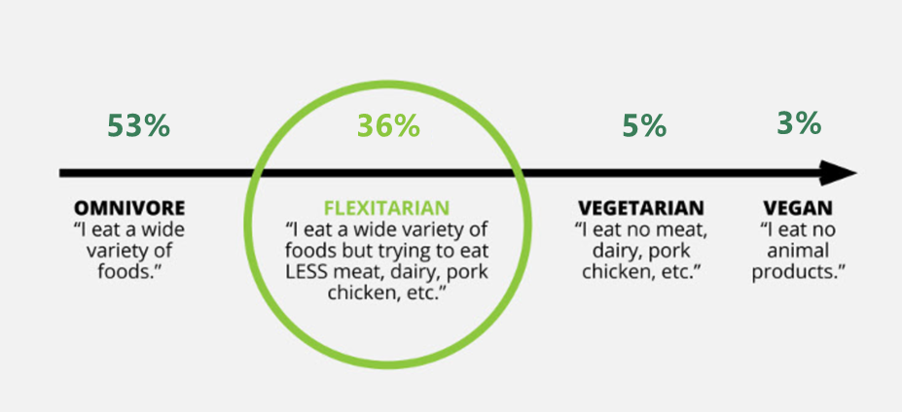
The Plant-Based
Movement
44% of consumers identify as vegan, vegetarian, or flexitarian.
2
$4.8B
was the global plant-based protein supplements market size in 2019 and it is projected to reach $7.1 billion by 2027 (CAGR 5.1%). North America accounts for about half of global sales in 2019.³
82%
of consumers think that plant-based eating is a fundamental change in how we eat that is here to stay. Only 18% think that it is only a trend or fad. ⁴
Notes:
Abbie

Slide 5
Introducing
Now Available

Slide 6
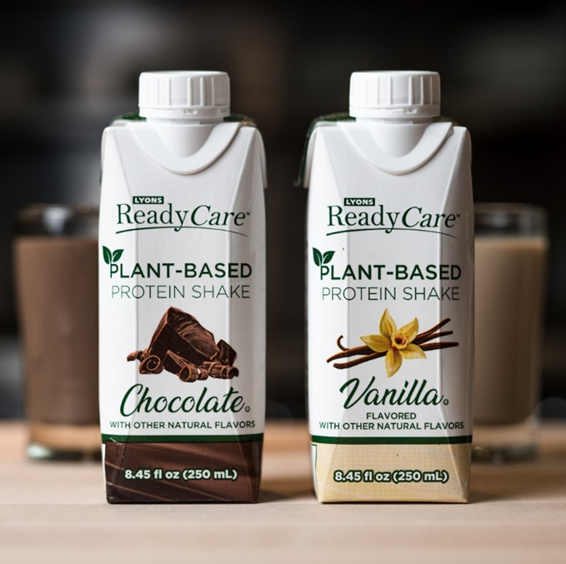
Plant-Based Protein Shakes Features & Benefits
Plant-based & Diet Friendly
Protein blend from yellow pea and brown rice that contains all 9 essential amino acids
Sweetened with sugar and stevia leaf extract – only 8g added sugar, no sugar alcohols
Clean label – no artificial flavors or colors
Dairy free, lactose free
Robust Support for Patients & Residents
Creamy, indulgent flavors to encourage consumption
Suitable for Nectar Consistency / Level 2 Mildly Thick for individuals with dysphagia
Convenient
Shelf stable; simply chill and shake before serving
Single serve packaging
Easy-to-hold cartons with re-closeable caps

Slide 7
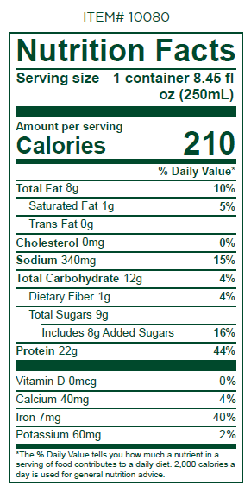
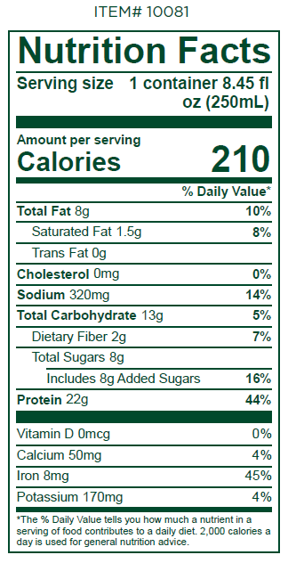
Plant-Based Protein Shakes
INGREDIENTS: WATER, PEA PROTEIN, RICE PROTEIN CONCENTRATE, SUGAR, CONTAINS 2% OR LESS OF SUNFLOWER OIL, NATURAL FLAVORS, SUNFLOWER LECITHIN, GELLAN GUM, XANTHAN GUM, SEA SALT, STEVIA LEAF EXTRACT, CONTAINS SOY
INGREDIENTS: WATER, PEA PROTEIN, RICE PROTEIN CONCENTRATE, NATURAL FLAVORS, CONTAINS 2% OR LESS OF SUNFLOWER OIL, SUGAR, COCOA PROCESSED WITH ALKALI, SUNFLOWER LECITHIN, GELLAN GUM, XANTHAN GUM, SEA SALT, STEVIA LEAF EXTRACT, CONTAINS SOY

Slide 8
Cindy’s Favorites

Slide 9
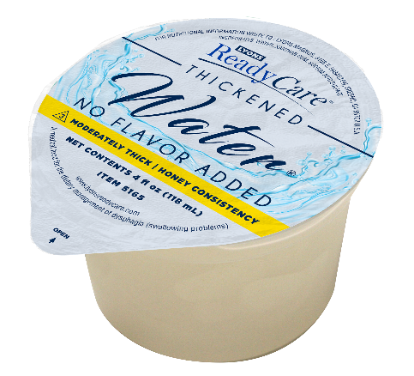
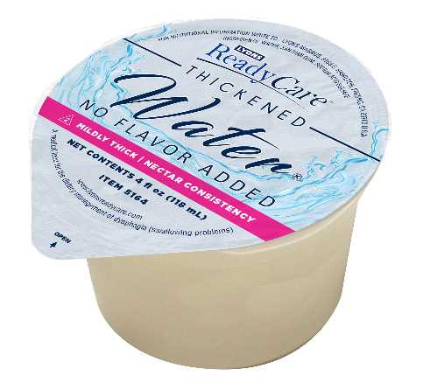
Thickened Water Clear & No Flavor Added
Dysphagia
No Lemon!
Attributes
Clear, No Flavor—tastes like plain water
New portion cup pack size
Pre-thickened in two consistencies:
Nectar Consistency / Level 2 Mildly Thick
Honey Consistency / Level 3 Moderately Thick
Lactose free
Gluten free
Packaging
48/4 fl oz portion cups
6/46 fl oz Combi cartons
Shelf stable
Recipes available for ice cubes, popsicles, and flavored waters!

Slide 10
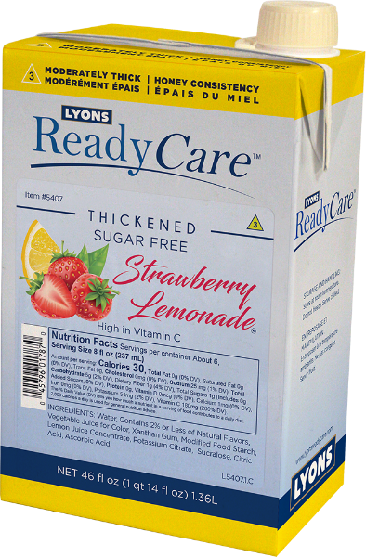
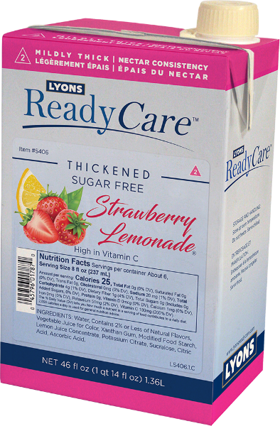
SF Thickened Strawberry Lemonade
Dysphagia
Unique!
Attributes
Pre-thickened in two consistencies:
Nectar Consistency / Level 2 Mildly Thick
Honey Consistency / Level 3 Moderately Thick
Sugar free
Lactose free
Gluten free
Packaging
6/46 fl oz Combi cartons
Shelf stable

Slide 11
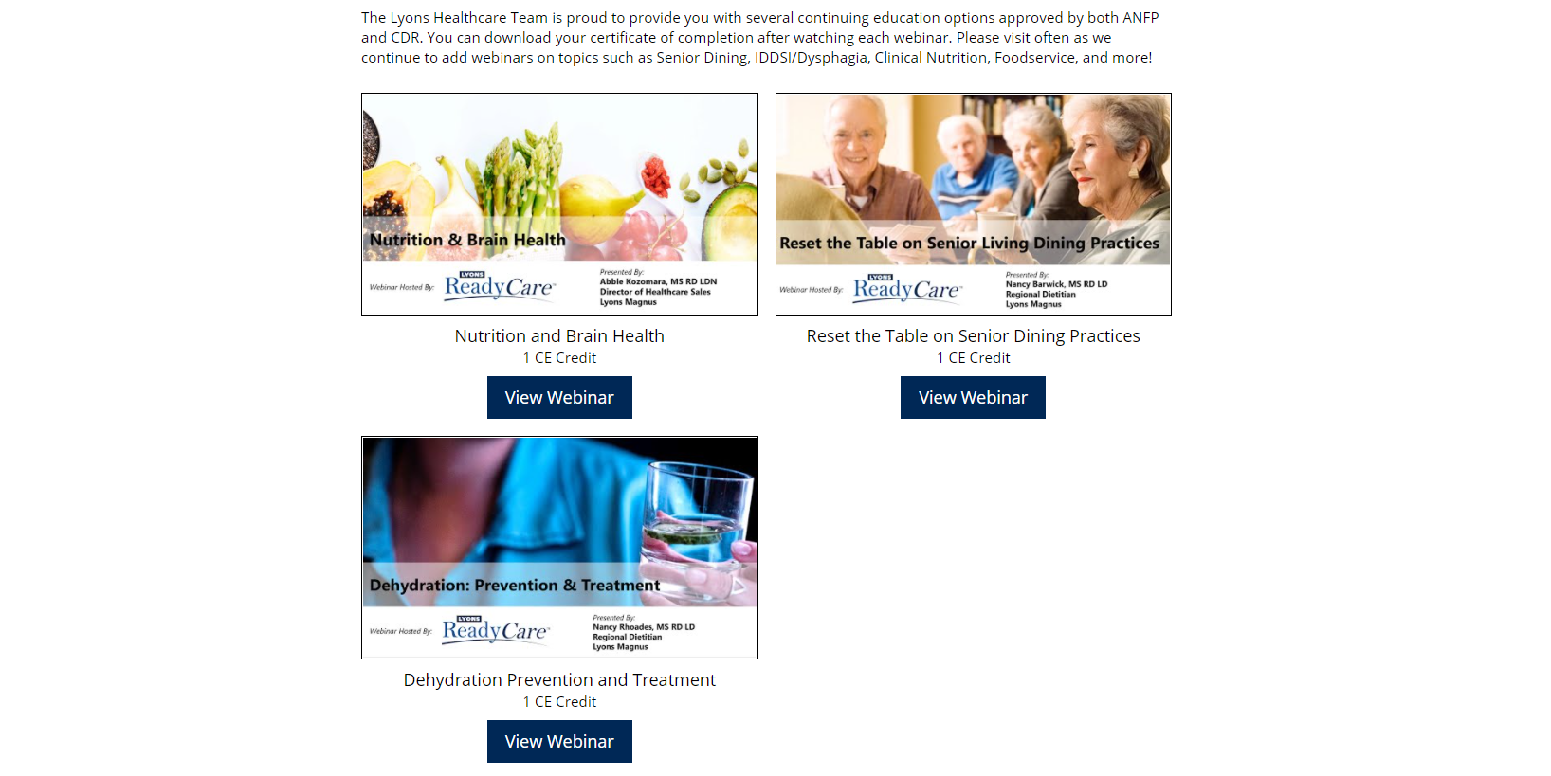
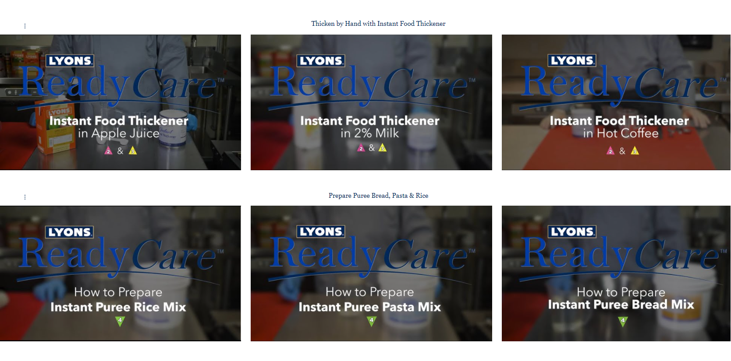
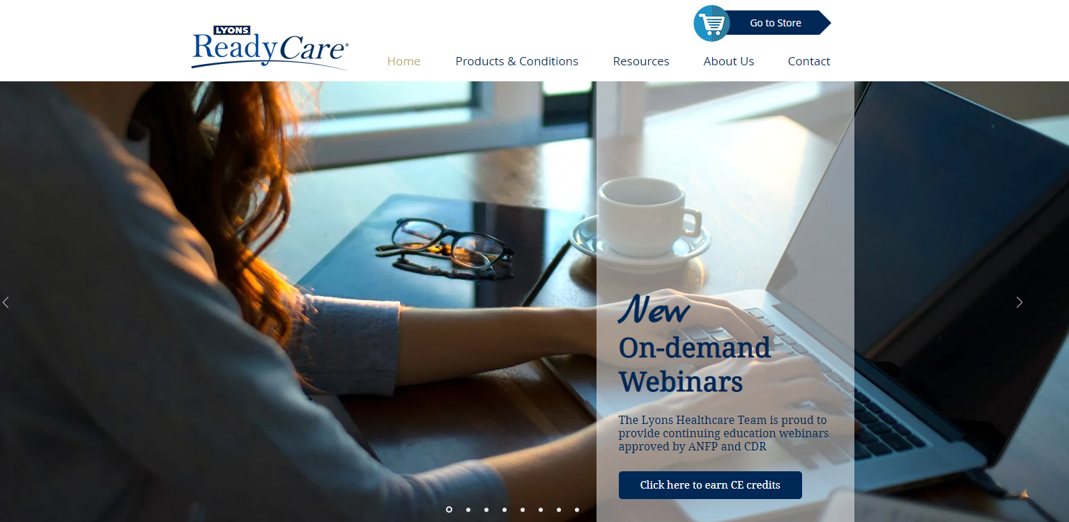
Resources
01
pro.lyonsreadycare.com
Webinars for CE Credits
02
Training Videos
03
IDDSI Support

Slide 12
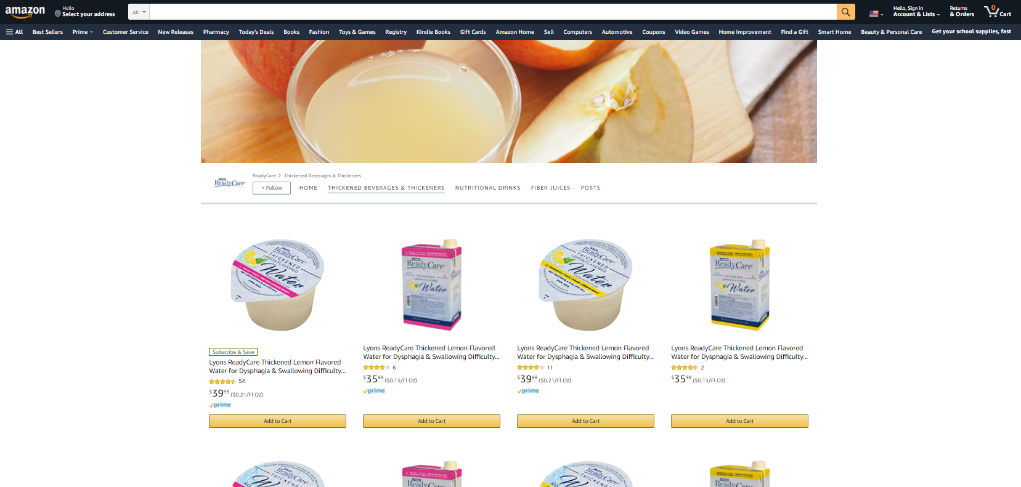
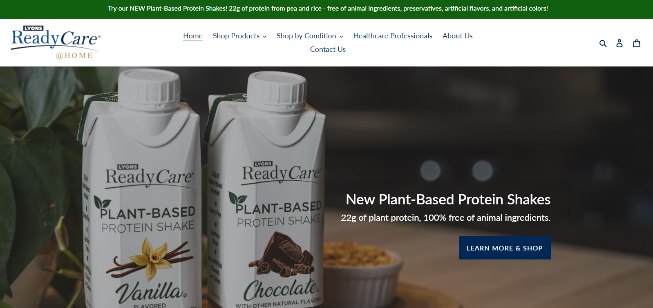
Home Health
lyonsreadycare.com
amazon.com/readycare
Shelf stable products delivered directly to your front door:
Thickened Juices & Waters
Thickened Dairy Drinks
Thickened Hot Beverage Mixes
Instant Food Thickener
2.0
New Shakes
Protein Powders
Fiber Juices
Also available on

Slide 13
More Lyons Healthcare Resources
Website for Healthcare Professionals
pro.lyonsreadycare.com
Home Delivery
store.lyonsreadycare.com www.amazon.com/readycare
Facebook
www.facebook.com/lyonsreadycare
YouTube *includes new training videos*
www.youtube.com/user/LyonsInnovision

Slide 14
Questions?
&
Thank you!
Notes:
Nancy B

