Slide 1
Malnutrition: How do we Diagnose that?
Stacy Pelekhaty MS, RDN, LDN, CNSC

Slide 2
Outline
Consequences and prevalence
Diagnostic paradigms
Case Comparisons

Slide 3
Prevalence
Difficult to assess in the general population
Most published studies focus on specific care areas or patient populations
Hospitalized patients
Older adults
Patients with chronic health conditions

Slide 4
Consequences
Increased:
Hospitalization/re-admission
Morbidity
Mortality
Health care costs

Slide 5
Retrospective review of a national database on healthcare cost and utilization for 2018
ICD-10 codes undernutrition-malnutrition
Excluded maternal and neonatal admissions
Objectives
Assess the prevalence of malnutrition in hospitalized patients
Compare demographics and clinical considerations between well-nourished and malnourished patients
Investigate impacts of malnutrition
30-day readmissions
Costs

Slide 6
27,833,493 non-maternal non-neonatal hospital discharges analyzed
8.9% of discharges included a code for malnutrition
Demographic trends
Older (64.8 vs 59 years, P <0.0001)
Female (51.3% vs 50.8% P <0.0001)
Race (P <0.0001)
Black (16.3 vs 15%)
Other (6.7 vs 4.9%)
Socioeconomic status (P <0.0001)
Lower income
Payer (P <0.0001)
Medicare (63.1% vs 51.1%)
Notes:
Overall mean age 59.6, % female 50.9,
Well nourished patients more likely to be white (68.2% vs 67.7%) or Hispanic (10.9 vs 9.4%)

Slide 7
27,833,493 non-maternal non-neonatal hospital discharges analyzed
8.9% of discharges included a code for malnutrition
Demographic trends
Older (64.8 vs 59 yesr, P <0.0001)
Female (51.3% vs 50.8% P <0.0001)
Race (P <0.0001)
Black (16.3 vs 15%)
Other (6.7 vs 4.9%)
Socioeconomic status (P <0.0001)
Lower income
Payer (P <0.0001)
Medicare (63.1% vs 51.1%)
Notes:
Overall mean age 59.6, % female 50.9,
Well nourished patients more likely to be white (68.2% vs 67.7%) or Hispanic (10.9 vs 9.4%)

Slide 8
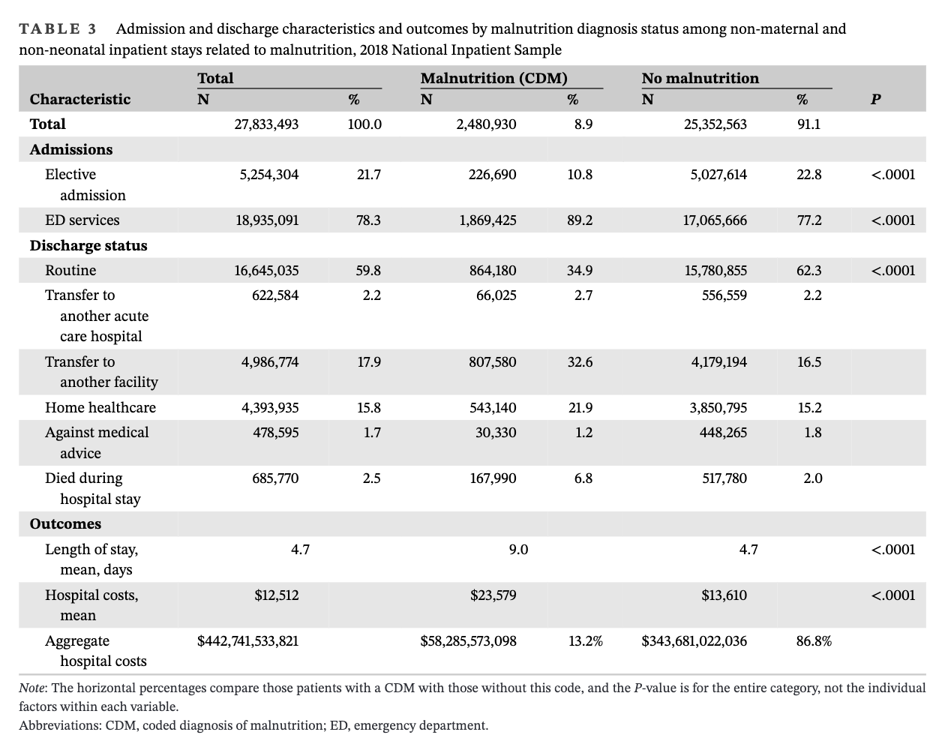

Slide 9
Retrospective review of a large, multi-state database of ED presentations 2006-2014
ICD-9 codes for malnutrition and malnutrition related conditions
Excluded infants and pregnant women
Objectives:
Estimate the prevalence of malnutrition
Evaluate the economic burden
Investigate common diagnoses linked with malnutrition

Slide 10
238,269,616 ED visits analyzed
2,353,145 visits included a diagnosis of malnutrition
Overall prevalence 0.99%
Increased every year of the study period
Overall: 0.7 to 1.15%
Patients age 65 or older: 2.54 to 3.63%
Most common primary diagnoses
Age 1-17 years: nutritional/metabolic/endocrine disorders
>17 years: septicemia
Notes:
Common diagnoses only accounted for up to 15% of presentations

Slide 14
Cross-sectional correlation design with a convenience sample
Adults >70 years of age living in Midwest continuing-care communities
Excluded adults with low cognitive assessment and high geriatric depression scores
Malnutrition assessed with the Mini Nutritional Assessment questionnaire
Sarcopenia was assessed with bio-electrical impedence, handgrip strength and gait speed
Objectives
Determine the prevalence of malnutrition-sarcopenia syndrome in this population
Examine the relationship between malnutrition-sarcopenia syndrome and self-management
Self-efficacy
Aging expectations
Sedentary and physical activity
Protein and Calorie intake
Notes:
Self efficacy – how confident is an individual that they can perform their usual physical activities?
Aging expectations – how much does an individual expect to experience age-associated decline (higher score = positive expectations, lower scores = more negative expectations)
Power anaylsis – 122 responants required

Slide 15
96 participants
Mean age 82.5 $±$ 7.4 years
BMI 26.1 $±$ 6.1 kg/m²
82.3% female
Prevalence
Sarcopenia – 37.5%
Risk of malnutrition – 21.9%
Malnutrition – 13.4%
Malnutrition-sarcopenia syndrome – 12.5%
Notes:
Did not meet power analysis enrollment targets

Slide 16
Notes:
Only sedentary time was independently associated with MSS.
Participants with MSS were less likely to have a positive outlook on aging than those without MSS

Slide 17
Retrospective, propensity-matched analysis of the CMS claims database from 1999-2014
ICD-9 codes for malnutrition and malnutrition associated diseases
Outcomes
Examine the impact of malnutrition on survival and healthcare utilization in elderly Medicare beneficiaries with diabetes
Investigated impact of malnutrition on life expectancy with commonly co-occurring disease states
Acute MI
Chronic kidney disease
COPD
Heart failure
Ischemic heart disease
Lung cancer
Stroke or TIA

Slide 18
15,121,131 participants included
801,272 malnourished and 14,319,859 without malnutrition
After propensity matching:
36,067 in each group
Normalized age, gender, race, and comorbid condition distributions between groups
After propensity matching
Age: 75 $±$ 13 years
57% female
76% white, 17% black, 3% Hispanic, 2% Asian
High burden of comorbidities

Slide 19
Notes:
Participants who were malnourished at the time of DM diagnosis spent more on inpatient and outpatient medical care, were 3x as likely to have higher acute inpatient care days, twice as likely to have higher non-acute inpatient care days, as well as lmore likelihood of having higher SNF stays, hospice care and hospital readmissions.

Slide 20
Notes:
Malnutrition at the time of DM diagnosis was associated with increased risk of death in isolated DM and across all comorbid conditions, and resulted in nearly a 3 year difference in survival time.

Slide 21
So How do we diagnose malnutrition?

Slide 22
Malnutrition Diagnosis
Multiple paradigms
ICD codes
Mini-nutrition assessment (MNA)
Subjective Global Assessment (SGA)
ASPEN and the Academy of Nutrition and Dietetics Consensus Criteria (AACC)
Global Leadership Initiative on Malnutrition (GLIM)
Notes:
Focusing on the bolded paradigms. The MNA is primarily used in outpatient and community dwelling populations as it requires a high level of responsiveness from the patient/client.
SGA , AACC, and GLIM can be seen as a an evolution of the diagnostic concepts that malnutrition has a cause beyond just inadequate oral intake, with a range of physical and physiological manifestations that requires a holistic assessment by a trained clinician.

Slide 23
Subjective Global Assessment
Published in 1982, revised in 1987
First diagnostic paradigm to combine nutrition history, clinical status and physical exam
Widely validated against clinical outcomes associated with malnutrition
Notes:
Moderate and Severe malnutrition both associated with increased infectious morbidity and antibiotic use during hospitalizations, while severe malnutrition has been associated with increased hospital length of stay

Slide 24
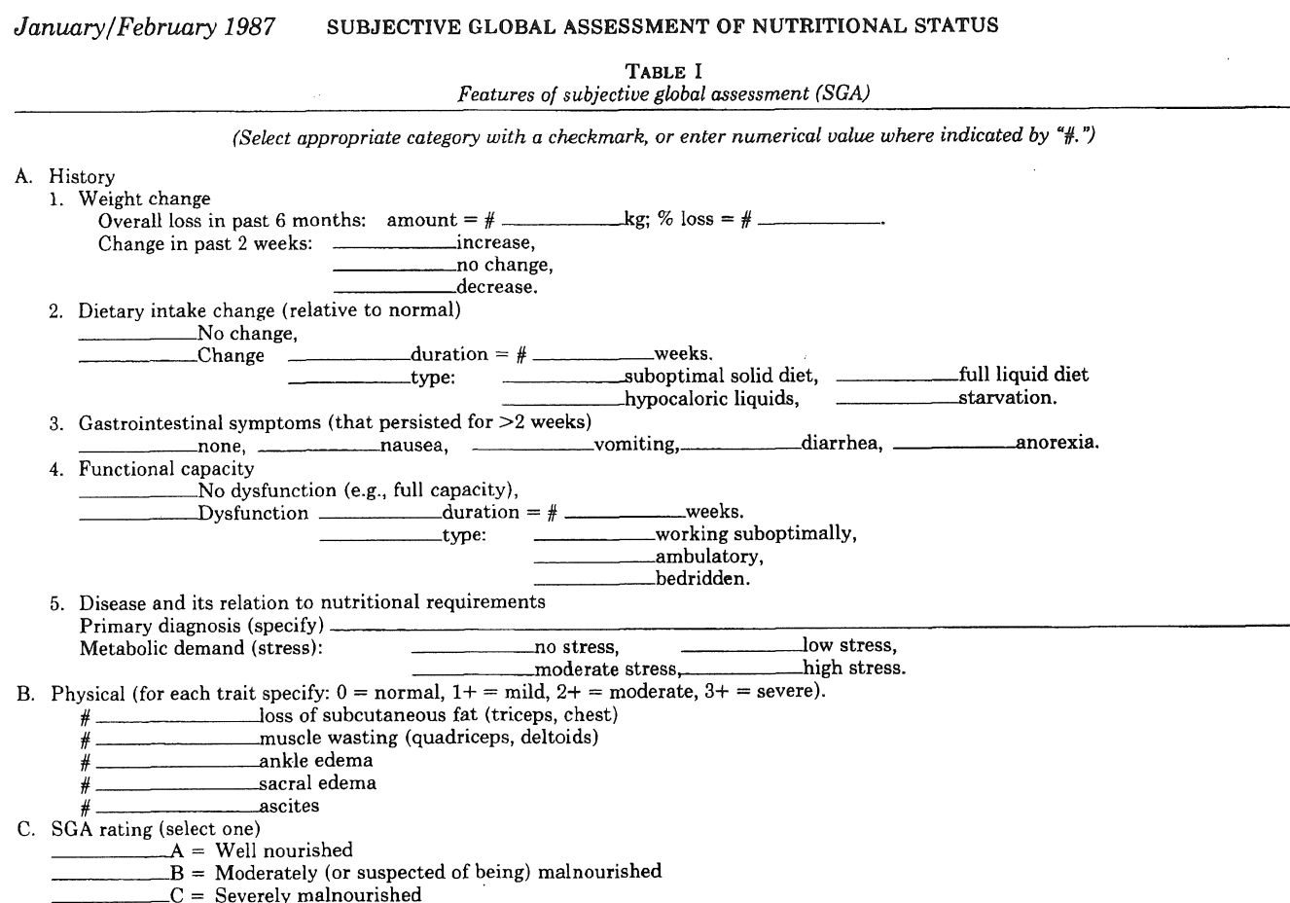
Notes:
Practitioner selects a finial rating based after completing the interview and exam. With training, SGA has been shown to be easy to implement with acceptable inter- and intra-rater reliability, however there are not defined criteria for SGA class A, B or C.

Slide 25
AND/ASPEN Consensus Characteristics
Joint task for from the Academy of Nutrition and Dietetics and the American Society for Parenteral and Enteral nutrition convened in 2009
Purpose: to develop consistent criteria for diagnosing malnutrition in adults across all care settings
Eliminate use of acute phase reactant proteins
Improve diagnostic capture
Increase reliability
Sensitvity
Specificity
Inter and intra-rater reliability

Slide 26
AND/ASPEN Consensus Characteristics
Published in 2012
Builds off of SGA
Separates etiology and clinical characteristics
Requires nutrition screening for nutrition risk prior to assessment for malnutrition

Slide 27
AND/ASPEN Consensus Characteristics
White, 2012
Notes:
First an etiology or clinical cause of malnutrition is identified using this decision tree. Chronic versus acute illness is determined by time with a duration of <3 months being considered acute and a duration >3 months considered chronic

Slide 28
AND/ASPEN Consensus Characteristics
White, 2012
Notes:
After the clinical scenario for malnutrition is determined, the clinican evaluates the patient/client for the 6 clinical characteristics of malnutrition. 2 characteristics, are required in addition to a clinical scenario, for diagnosis. As with SGA, there is no differentiation between mild and moderate malnutrition despite the presence of ICD-9 and 10 codes for mild malnutrition. Studies have found handgrip strength reliability to be suboptimal during acute/critical illness, therefore it is not widely used in those populations

Slide 29
AND/ASPEN Consensus Characteristics
Small pilot studies suggest acceptable inter- and intra-rater reliability
Correlates with diagnosis from SGA
Malnutrition diagnoses are associated with malnutrition-related clinical outcomes
Notes:
Hipskind et al in 2018 showed that AACC malnutrition diagnoses to data derived SGA scores were highly correlated in 225 patients. Coltman and colleagues found that in 1009 patients, 32 diagnosed with malnutrition by SGA but not by AACC based on the presence of GI symtpoms. For the 176 patients diagnosed by AACC but not by SGA, the majority of patients had reduced handgrip strength but were not found to have functional impairement when using SGA, again highlighting the potential limitations of handgrip strength dynomometry.

Slide 30
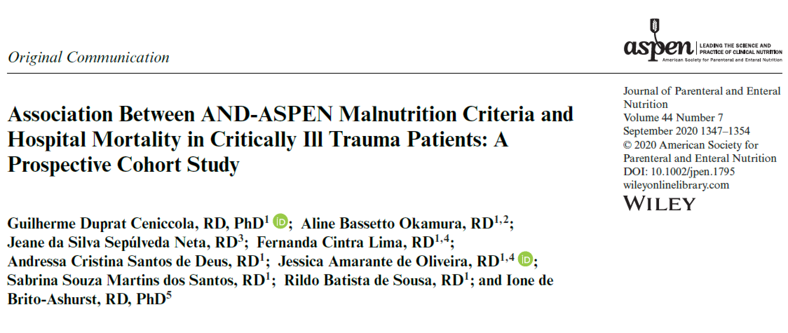
Notes:
Cenicolla conducted a prospective observational study investigating the association between. Malnutritiona s diagnosed by AACC and mortality in trauma patients in Brazil. The study included 414 traumatically injured adults for analysis, and found that while no malnutrition characteristic was associated with mortality, a diagnosis of malnutrition using the AACC was independently associated with a nearly 2-fold increase in risk of death after controlling for gender, APACHE II, presence of head injury and hospital LOS. The authors also showed a high level of concordance between SGA and AACC malnutrition diagnoses

Slide 31
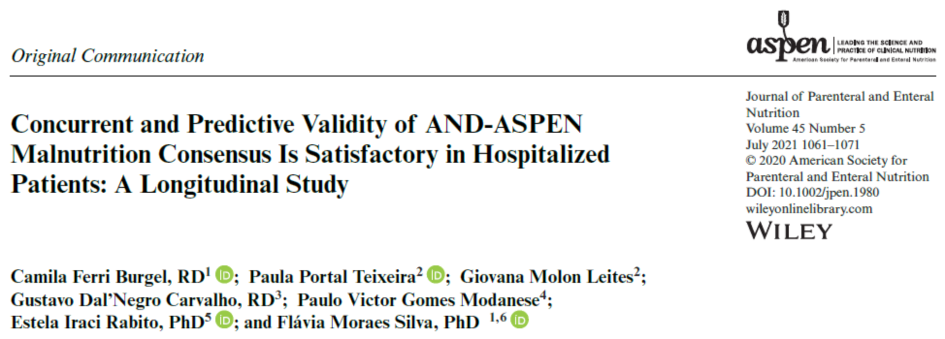
Notes:
Burgel and colleagues conducted a multi-center study in Brazil investigating the validity of AACC paradigm, as well as the utility of handgrip strength in hospitalized adults. They enrolled 600 patients across 5 hsopitals, and found that malnutrition was independently associated with all major outcomes, regardless of wether HGS was used or omitted.

Slide 32
Notes:
They also found a high level of concordance with SGA malnutrition diagnosis, again regardless of whether HGS was incorporated

Slide 33
Global Leadership Initiative on Malnutrition
2016: the Global Leadership Initiative on Malnutrition convened
Representatives from ESPEN, ASPEN, FELANPE and PENSA
Purpose: to standardize malnutrition diagnosis clinical practice internationally
Evidence-based criteria which can be utilized in all healthcare settings with diverse global populations
Simplify the approach to malnutrition diagnosis and ensure it can be applied by all health professionals
Notes:
Interestingly, Australasia (AuSPEN) and Africa (Waspen, SASPEN) not mentioned in the text, though the authors list does include 1 rep from South Africa and 1 from the Alfred in Australia (both are dietitians)
Consensus statement published in 2019

Slide 34
Global Leadership Initiative on Malnutrition
Continues two-step process
Recommends screening method validated for setting
Screening Tool | Setting | Population | Validated against | Level of evidence
Malnutrition screening tool (MST) | Ambulatory, outpatient, inpatient | All adults | SGA | Strong
Malnutrition Universal Screening Tool (MUST) | Inpatient | Younger and middle aged adults | SGA | Fair
Nutrition risk screening (NRS-2002) | Inpatient | All adults | SGA, MNA, RD | Fair
Mini nutrition assessment – short form (MNA-SF) | Ambulatory and sub-acute | Older adults | MNA | Fair
Adapted from the AND-EAL on nutrition screening tools, 2009
Notes:
MST Study populations ranged from average age of 45 to 85 years
Youngest adult populations were average age in the mid 40s
The 2018 preliminary update on malnutrition screening in adults and pediatrics also found fair evidence for the Short nutrition assessment questionnaire (SNAQ) for in- and outpatient adults

Slide 35
Global Leadership Initiative on Malnutrition
Changes from AACC
Inadequate oral intake changed from clinical characteristic to clinical cause
Fluid accumulation, fat wasting, and hand-grip strength eliminated from clinical characteristics
Hand grip strength can be used to support an assessment of reduced muscle mass
BMI added as a clinical characteristic
Only one clinical cause and one clinical characteristic required for diagnosis
Severity
Diagnosed based on defined thresholds within clinical characteristics
Notes:
Similar to SGA and AACC, no thresholds for mild malnutrition

Slide 36
Global Leadership Initiative on Malnutrition
Notes:
GLIM does recommend the use of validated body composition measures, however this is slightly aspirational as there is not yet global consensus, consistent study availability, or adequate supporting evidence making these evaluations feasible in a range of settings

Slide 37
Global Leadership Initiative on Malnutrition
Notes:
Recommended thresholds from European working group on sarcopenia in older people, the Asian working group for sarcopenia in Asians, and NIH. These can be implemented when using validated body composition tool such as dual-energy absorptiometry (DXA), bioelectrical impedence analysis, computed tomography composition analysis (most validated slice is the 3rd lumbar level). However, there is not general consensus on how to incorporate body composition analysis to routine clinical practice, and these studies are not routinely available or appropriate in many care settings, therefore standard anthropometric measures and nutrition focused physical exam for muscle wasting can be used in place of these.

Slide 38
Global Leadership Initiative on Malnutrition
Notes:
In addition to acknowledging that the recommendation for use of validated body composition analysis tools was aspirational, the workgroup identified that more work was needed to determine the validity and applicability of BMI thresholds in Asian populations

Slide 39
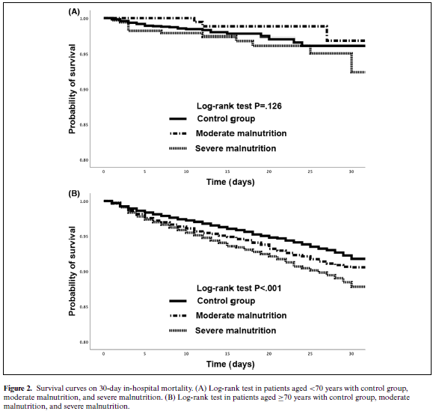
Notes:
Retrospective database analysis of patients >/= 65 years admitted to a hospital in Japan for treatment of pneumonia between 4/2014 and 11/2017 to investigate the association of severity of malnutrition based on GLIM BMI ranges with 30-day in-hospital mortality, hospital LOS and 30-day readmissions
Malnutrition diagnoses were based not based on diagnoses during hospitalization, rather all patients were assumed to have an inflammatory illness as a potential clinical cause and BMIs were abstracted as a potential phenotypic criterion – problematic as under this method, BMI and pneumonia are unlikely to be temporally related
Analyzed 26,098 patients. For patients <70 years, 12.8% met BMI thresholds for moderate malnutrition and 14.7% for severe. In patients age 70 years or older, 21.6% met moderate and 27.1% met severe malnutrition BMI thresholds – these are very high rates of malnutrition
No statistical difference in 30-day in hospital mortality for adults <70 years of age, however for older adults patients meeting severe malnutrition BMI thresholds had significantly lower probability of survival compared to moderately malnourished and non-malnourished groups

Slide 40
Notes:
On multivariate analysis, malnutrition in adults <70 years was not independently associated with mortality, however severe malnutrition in the older cohort was independently associated with a 1 fold increase in risk of mortality

Slide 41
Notes:
BMIs consistent with moderate and severe malnutrition in the older cohort only were independently associated with increased risk of 30-day readmission; however, moderate and severe malnutrition were independently associated with Increased length of stay across age groups
So, the BMIs thresholds appear reasonable for older adults, but more investigation is needed into the thresholds for adults < age 70

Slide 42
Global Leadership Initiative on Malnutrition
Many studies have been published in the past three years assessing the validity of GLIM and component characteristics in a range of settings
Limits of evidence
Sample size
Use of retrospective review applying GLIM to extracted medical records
Limits of GLIM identified in body of evidence
Range of applications of recommendations for assessing muscle wasting
Unclear guidance on determining presence of inflammation
Overall GLIM has strong predictive validity for outcomes across studies
Mortality
Increased length of stay
Physical function
Correlation with SGA varies
Notes:
A pubmed search of GLIM criteria generates 171 results, when limited to a combination of GLIM criteria and outcomes the search generates 65 results
One study from Japan comparing the ESPEN and GLIM criteria in 921 patients with cardiovascular disease with a follow-up period of 2.3 years found that malnutrition diagnosed by GLIM was associated with low physical function, while both criteria were associated with an increase in all-cause mortality. Another study in Japan found that malnutrition diagnosed by GLIM was independently associated with reduced ADL performance and lower odds of being discharged home in stroke patients

Slide 43
Nutrition status was determined by a designated service-line RD using the GLIM criteria.
Inflammation was determined by CRP level, WBC, and fibrinogen level.
Body composition was assessed with BIA
53 patients were included
Crohn’s disease 38
Ulcerative Colitis 15
Prevalence of malnutrition in the cohort was 43%
Higher than using ESPEN 2015 criteria
Given risk of surgical complications with malnourished IBD patients, a diagnostic paradigm with greater sensitivity is preferred over one with greater specificity

Slide 44
Notes:
Post hoc analysis of a cohort study, analyzed 574 patients, Published in JAND
FFM assessed with BIA
Suboptimal agreement between the two methods Kappa coefficient = 0.22, P = 0.00 (kappa 0.21-0.4 = weak agreement)

Slide 45
1 year mortality risk after adjusting for age, department and planned vs emergency admission
GLIM: hazard ratio 2.68, 95% CI 1.33-5.41
PG-SGA: hazard ratio 1.36, 95% CI 0.65-2.83
Notes:
Malnutrition diagnosed by GLIM was indepenantly associated with a greater than 2fold increase in risk of 1-year mortality after adjusting for potential confounders, so while there was low concordance, it appears to be because in this cohort GLIM was identifying those patients in whom nutrition status was correlating with negative outcomes

Slide 46
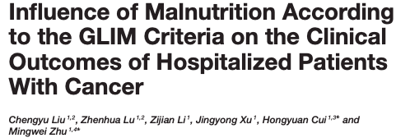
Notes:
Published in frontiers in nutrition, multi-center retrospective analysis of 2388 patients with cancer. Screening with NRS 2002, compared SGA and GLIM.
Kappa coefficient was 0.426 – moderate agreement
Again, GLIM was associated with complications while SGA was not – complications defined as “any deviation from the ideal course of treatment during hospitalization, excluding failure to cure”
Another larger retrospective by Poulter and colleagues compared GLIM to ESPEN and ICD-10 malnutrition diagnoses and found the while GLIM detected the highest prevalence of malnutrition, it was also the strongest predictor of mortality and unplanned 30-day admission/readmission

Slide 47
Key take aways
GLIM consensus criteria builds upon Subjective Global Assessment and the AND/ASPEN Consensus Characteristics
GLIM has a significant body of validation evidence, despite being the newest paradigm
Validation of GLIM using nutrition-focused physical exam has not yet been investigated
BMI thresholds may not be as strongly correlated with outcomes in Asian populations under 70 years of age
GLIM is a streamlined diagnostic framework

Slide 48
Case comparisons

Slide 49
Case #1
60 YO community dwelling male being seen in cardiac rehab 1-month after acute myocardial infarction
Anthropometrics
Height: 70” Weight: 85.5 kg BMI: 27 kg/m²
UBW: 90 kg %UBW: 95%
Nutrition focused physical exam
No muscle wasting
Mild fat wasting at triceps, peri-orbital region
Patient interview:
Denies difficulty ambulating or completing ADLs
Confirms weight loss of ~10 lbs related to acute MI related to poor appetite during hospitalization, frequent NPO status. States appetite has improved since discharge.
Denies Nausea, vomiting, diarrhea, constipation, difficulty chewing or swallowing

Slide 50
Case #3
45 year old male patient with colon cancer seen in ambulatory infusion clinic related to positive MST screening for report of poor appetite >1 week and 10 lb weight loss.
Anthropometrics
Height: 72” Weight: 77 kg BMI: 23 kg/m²
UBW: 85 kg %UBW: 91%
Nutrition focused physical exam
Mild muscle wasting at quadriceps and calves, moderate at deltoids
Mild fat wasting at triceps
Patient interview:
Denies difficulty ambulating or completing ADLs
Confirms weight loss of 15-20 lbs over past 6 weeks, attributes to nausea and vomiting after chemotherapy sessions, poor appetite, tolerating roughly 50% of normal intake
Reports nausea and vomiting, occasional diarrhea
Denies difficulty chewing or swallowing

Slide 51
Case #2
75 YO female admitted to the hospital with COPD exacerbation
Anthropometrics
Height: 64” Weight: 48 kg BMI: 18 kg/m²
UBW: 48 kg %UBW: 100%
Nutrition focused physical exam
Slim without overt wasting or fluid accumulation
Patient interview:
Reports mild difficulty ambulating and completing ADLs, becomes easily fatigued
Reports appetite is stable, drinks 2 oral nutrition shake supplements daily (Breakfast and HS snack) and eats two meals daily each providing about 350 kcals and 20 g protein each – total intake 1400 kcal (29 kcal/day) 80 g Pro (1.7 g/kg)
Denies Nausea, vomiting, diarrhea, constipation, difficulty chewing or swallowing

Slide 52
Case #4
20 year female patient admitted after motor vehicle collision with b/l femur fractures, multiple rib fractures with a segment of flail chest, diffuse axonal injury, subdural hemorrhage, seatbelt sign with retroperitoneal hematoma. Following findings on hospital day #20, has been tolerating >80% goal nutrition support with enteral nutrition since hospital day #3.
Anthropometrics
Height: 65” current weight: 56 kg BMI: 20 kg/m²
UBW PTA: 61 kg %UBW: 92%
Nutrition focused physical exam
Limited by diffuse fluid accumulation
Per interview with family, patient unable to participate in interview related to level of consciousness:
No difficulty with ambulation or ADLs PTA to their knowledge
Mother reports patient appears thinner since admission, UBW PTA per mother based on recent pre-hospitalization conversation with daughter

Slide 53
Guenter P, Abdelhadi R, Anthony P, et al. Malnutrition diagnoses and associated outcomes in hospitalized patients: United States, 2018. Nutr Clin Pract. 2021;36(5):957-969. doi:10.1002/ncp.10771
Lanctin DP, Merced-Nieves F, Mallett RM, et al. Prevalence and Economic Burden of Malnutrition Diagnosis Among Patients Presenting to United States Emergency Departments. Acad Emerg Med. 2021;28(3):325-335. doi:10.1111/acem.13887
Taani MH, Apchemengich I, Sima CD. Malnutrition-Sarcopenia Syndrome and Self-Management Behaviors in Continuing-Care Retirement Community Residents. Geriatrics (Basel). 2021;7(1):9. Published 2021 Dec 31. doi:10.3390/geriatrics7010009
Ahmed N, Choe Y, Mustad VA, et al. Impact of malnutrition on survival and healthcare utilization in Medicare beneficiaries with diabetes: a retrospective cohort analysis. BMJ Open Diabetes Research and Care 2018;6:e000471. doi: 10.1136/bmjdrc-2017-000471
Malone A, Mogensen KM. Key approaches to diagnosing malnutrition in adults. Nutr Clin Pract. 2022;37(1):23-34. doi:10.1002/ncp.10810
Detsky AS, McLaughlin JR, Baker JP, et al. What is subjective global assessment of nutritional status?. JPEN J Parenter Enteral Nutr. 1987;11(1):8-13. doi:10.1177/014860718701100108
White JV, Guenter P, Jensen G, et al. Consensus statement: Academy of Nutrition and Dietetics and American Society for Parenteral and Enteral Nutrition: characteristics recommended for the identification and documentation of adult malnutrition (undernutrition). JPEN J Parenter Enteral Nutr. 2012;36(3):275-283. doi:10.1177/0148607112440285
Ceniccola GD, Okamura AB, Sepúlveda Neta JDS, et al. Association Between AND-ASPEN Malnutrition Criteria and Hospital Mortality in Critically Ill Trauma Patients: A Prospective Cohort Study. JPEN J Parenter Enteral Nutr. 2020;44(7):1347-1354. doi:10.1002/jpen.1795
Burgel CF, Teixeira PP, Leites GM, et al. Concurrent and Predictive Validity of AND-ASPEN Malnutrition Consensus Is Satisfactory in Hospitalized Patients: A Longitudinal Study. JPEN J Parenter Enteral Nutr. 2021;45(5):1061-1071. doi:10.1002/jpen.1980
Cederholm T, Jensen GL, Correia MITD, et al. GLIM criteria for the diagnosis of malnutrition - A consensus report from the global clinical nutrition community. J Cachexia Sarcopenia Muscle. 2019;10(1):207-217. doi:10.1002/jcsm.12383
Shimizu A, Maeda K, Wakabayashi H, et al. Predictive Validity of Body Mass Index Cutoff Values Used in the Global Leadership Initiative on Malnutrition Criteria for Discriminating Severe and Moderate Malnutrition Based on In-Patients With Pneumonia in Asians. JPEN J Parenter Enteral Nutr. 2021;45(5):941-950. doi:10.1002/jpen.1959
Fiorindi C, Luceri C, Dragoni G, et al. GLIM Criteria for Malnutrition in Surgical IBD Patients: A Pilot Study. Nutrients. 2020;12(8):2222. Published 2020 Jul 25. doi:10.3390/nu12082222
IJmker-Hemink V, Heerschop S, Wanten G, van den Berg M. Evaluation of the Validity and Feasibility of the GLIM Criteria Compared with PG-SGA to Diagnose Malnutrition in Relation to One-Year Mortality in Hospitalized Patients. J Acad Nutr Diet. 2022;122(3):595-601. doi:10.1016/j.jand.2021.07.011
Liu C, Lu Z, Li Z, Xu J, Cui H, Zhu M. Influence of Malnutrition According to the GLIM Criteria on the Clinical Outcomes of Hospitalized Patients With Cancer. Front Nutr. 2021;8:774636. Published 2021 Dec 24. doi:10.3389/fnut.2021.774636
Poulter S, Steer B, Baguley B, Edbrooke L, Kiss N. Comparison of the GLIM, ESPEN and ICD-10 Criteria to Diagnose Malnutrition and Predict 30-Day Outcomes: An Observational Study in an Oncology Population. Nutrients. 2021;13(8):2602. Published 2021 Jul 28. doi:10.3390/nu13082602

