Slide 1
Healthcare Services Group (HCSG) Clinical Services
Lauren Weber, RDN, LDN
Director of Clinical Operations, Maryland

Slide 2
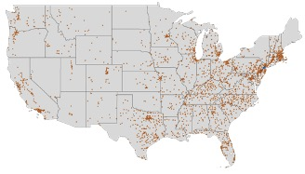
ABOUT HCSG
Founded in 1976
Headquarters: Bensalem, PA (Greater Philadelphia Area)
Publicly Traded (NASDAQ: HCSG)
Delivering Essential Services
Environmental
Dining
Registered Dietitian
Supporting an ever-evolving Healthcare Market
Over 45,000 employees supporting 5,000 accounts across the US
2

Slide 3
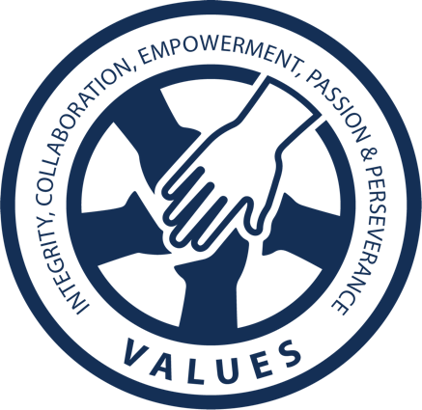
COMPANY CULTURE
A roadmap for directing our continued path of success and dedication are our company Purpose, Vision and Values.
Our Purpose, Fostering Fulfillment In Communities, connects every employee in our organization to something bigger than themselves. This creates unity from line staff all the way up to our executive leadership teams. We foster fulfillment in communities in a number of ways, from offering great experiences in the facilities we manage for our clients and their residents to creating rewarding jobs nationwide for future employees.
Our Vision is To Be The Choice For Our Customers. To do this, we must offer exceptional services to everyone we touch, from our employees and clients to our vendors and shareholders. Our Vision for the future motivates us to do our best every day, making our careers at HCSG meaningful and impactful.
We have a set of Values that are the binding forces of HCSG, including Integrity, Collaboration, Empowerment, Passion and Perseverance. These values influence the decisions we make, how we represent ourselves and how we represent the company.
3

Slide 4
COMPANY CULTURE
Going Beyond
Our company is built on employees who aren’t afraid to roll up their sleeves to get the job done, no matter the circumstances. This grit helps us in our ongoing devotion of being the best and Going Beyond for our clients, residents, patients and one another.
All in all, our Purpose, Vision and Values dictate the upward trajectory of success for the future of HCSG. Our employees tenacity is the driving force behind our achievements!
4

Slide 5
Nutritional Services
HCSG is one of the largest employers of Registered Dietitians in the industry, with approximately 900 professionals spanning 48 states
As a Registered Dietitian with our company, you will be able to work one-one with residents, patients and the nursing staff to cultivate and implement custom diets based on unique nutritional needs.
We offer all of our Registered Dietitians training, resources and the support they need to succeed.
Responsibilities include:
Planning, organizing, developing and directing the nutritional care of the residents in accordance with current federal, state and local guidelines and regulations.
Work effectively with others to ensure the quality nutritional services are being provided on a daily basis.

Slide 6
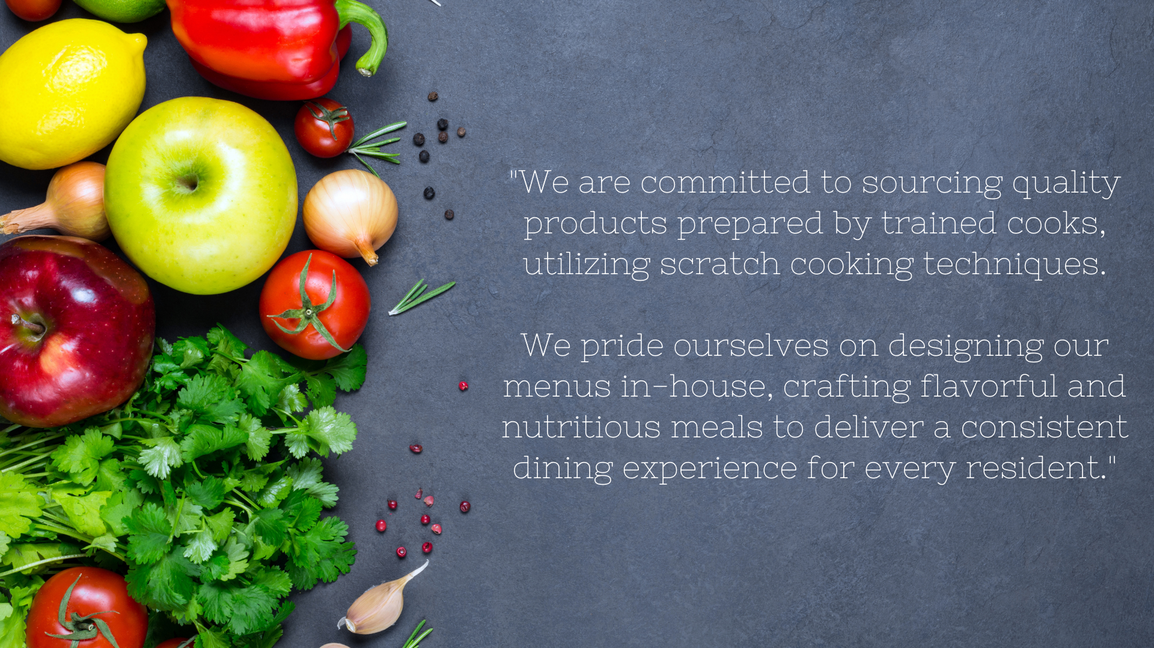
FOOD FIRST PHILOSOPHY
6

Slide 7
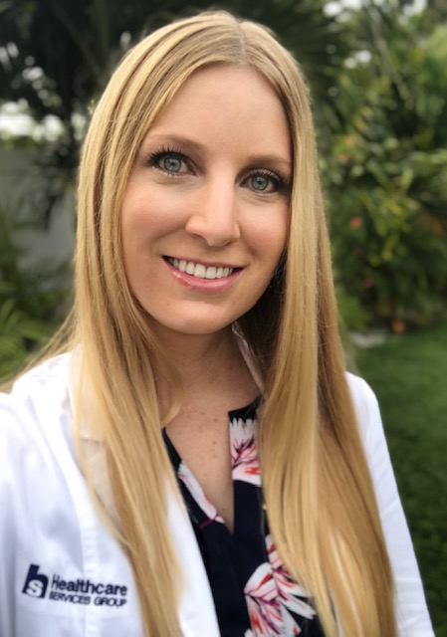
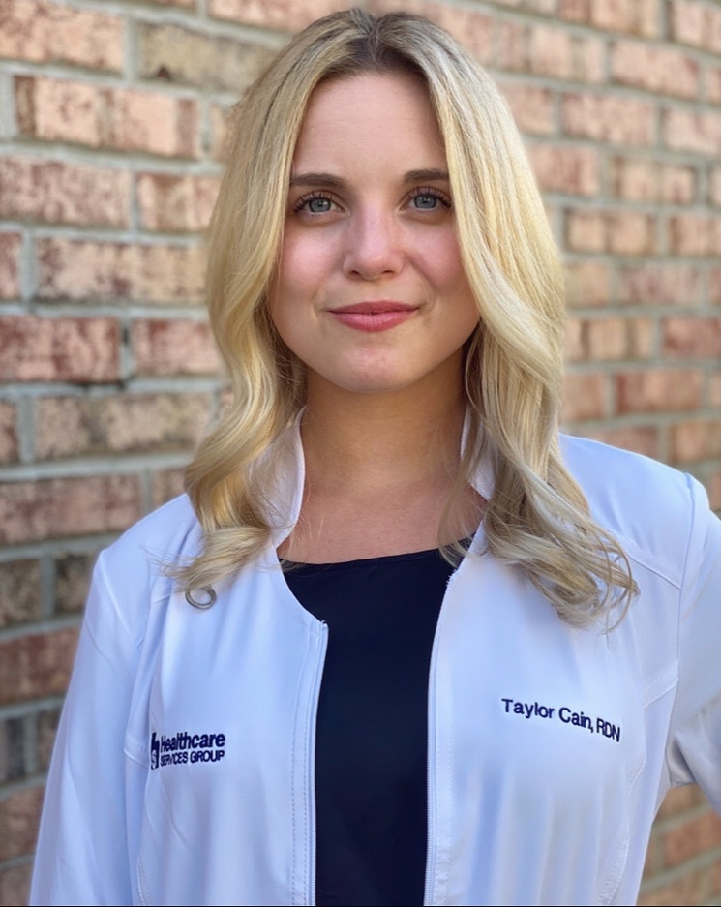
Great RDs!
"I love working as an RD for HCSG because they encourage us to learn and grow through continuous training along with opportunities to immerse ourselves with national nutrition organizations. That enables me to learn even more and become a better asset to my team and the residents we serve."
Michelle, MS, RDN, LDN, CNSC
"I love being an RD with HCSG because the residents become my extended family! Not only do I get to teach something I am passionate about, but I get to promote longevity and quality of life through nutrition."
Taylor, RDN
7

Slide 8
Opportunities Available!
Full-time, part-time, PRN opportunities available throughout the state of Maryland !
RD.Careers
Lauren Weber, RDN, LDN, Director of Clinical Operations, Maryland
lauren.weber@hcsgcorp.com

Slide 9
THANK YOU

