Slide 1
Our Journey to PU4
Puree standards and elevating the dining experience

Slide 2
Objectives
Team dynamics for success
Essential Equipment for preparation
Menu planning and food preparation techniques

Slide 3
Teams Needed
RD Team lead
Speech Therapy & Nursing Liaison
Production Staff /Team Leader
Team Dynamics
RD
Speech Therapy & Nursing Liaison
Production Staff, Lead

Slide 4
RD Lead
It’s important to have a team leader
* be the expert of the standards
* keep team on task
* be the auditor of progress

Slide 5
Team(cont.)
Speech /Nursing
Production
Speech is needed to help with resident needs/requirements
Keep consistencies correct through audits
Nursing – if care givers are helping with meals
Having proper equipment
Trained to proper sizes
Audits others on team

Slide 6
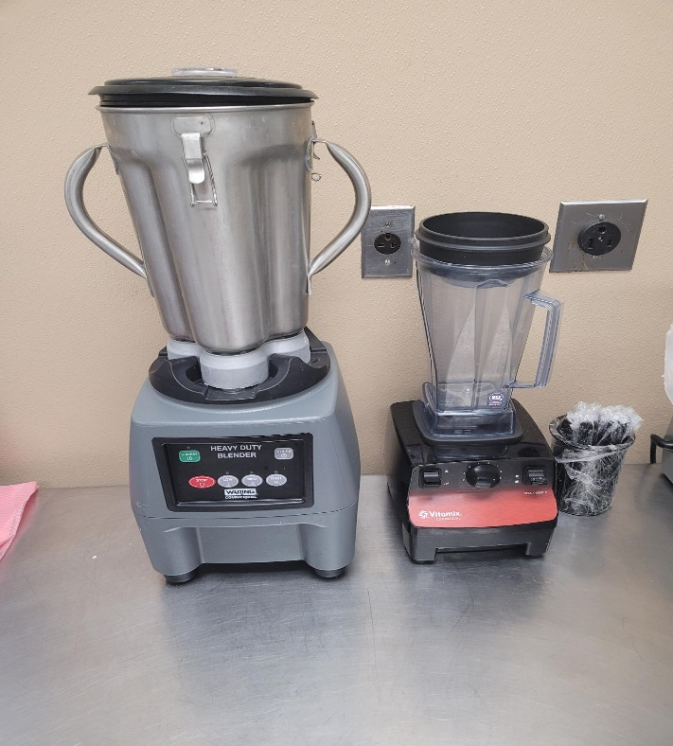
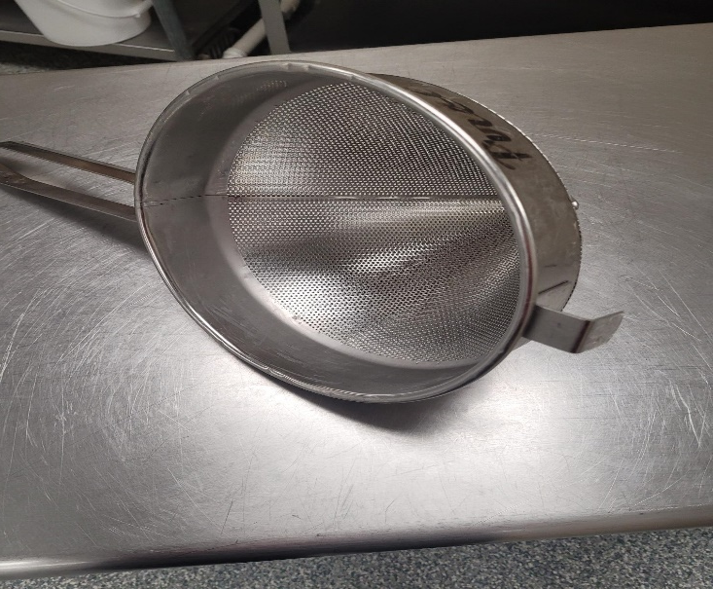
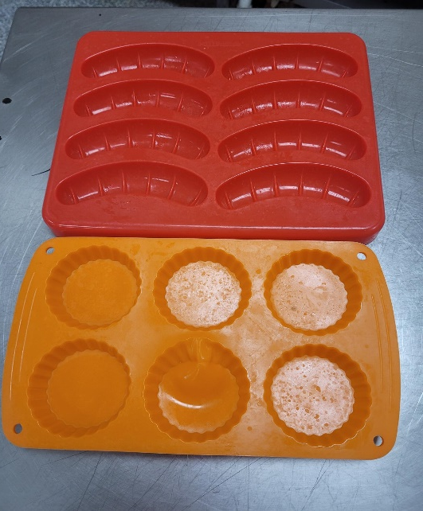
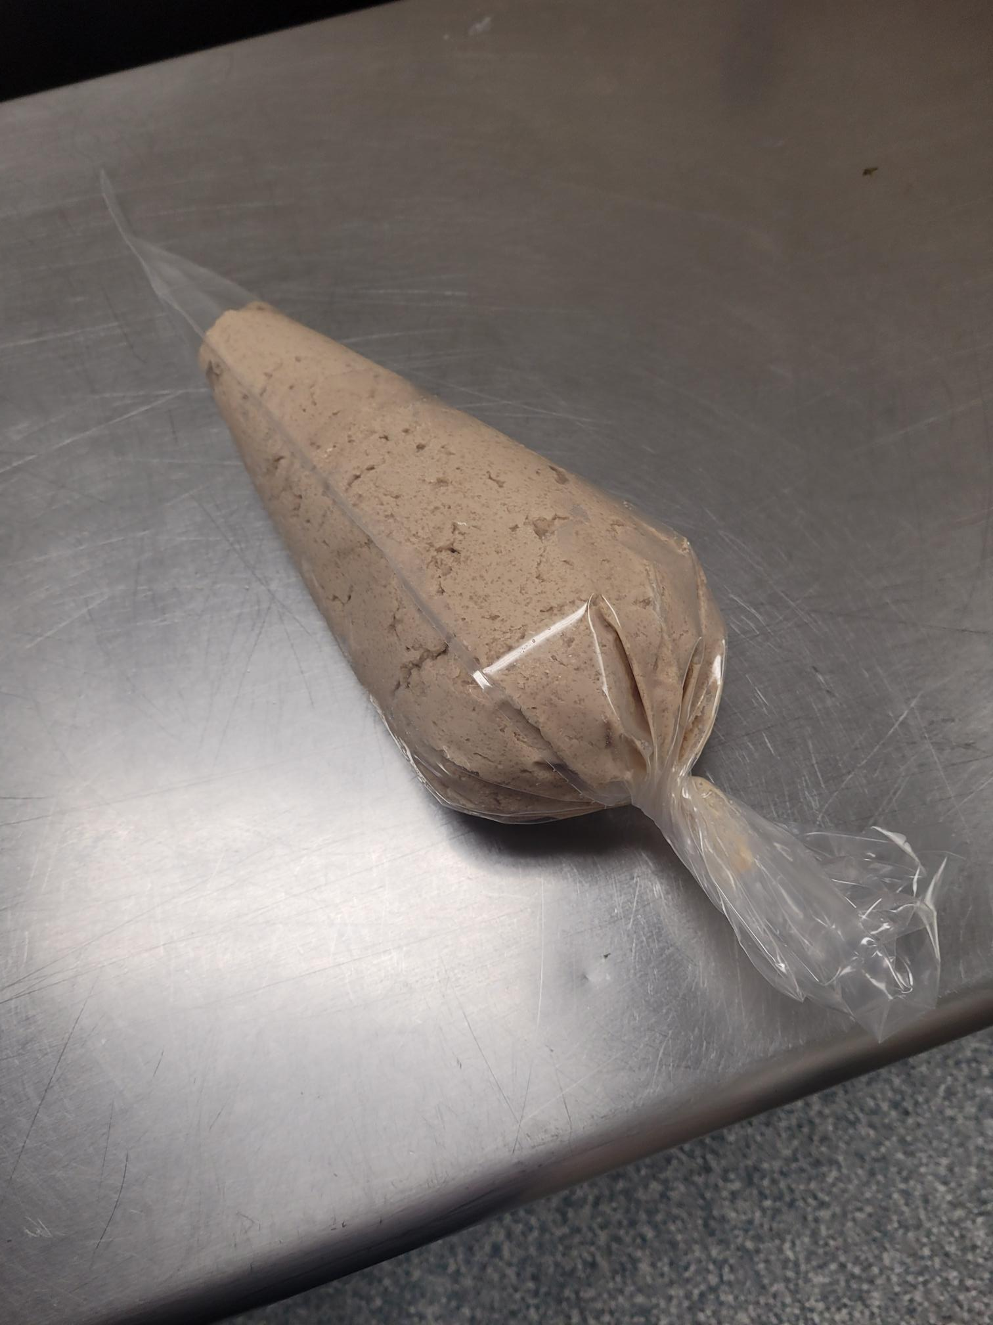
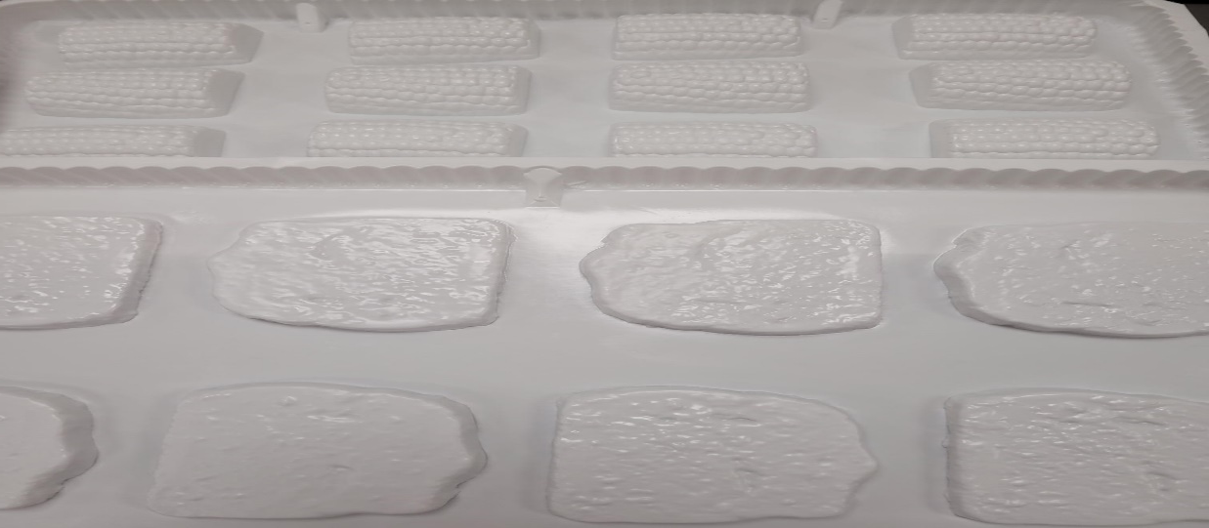
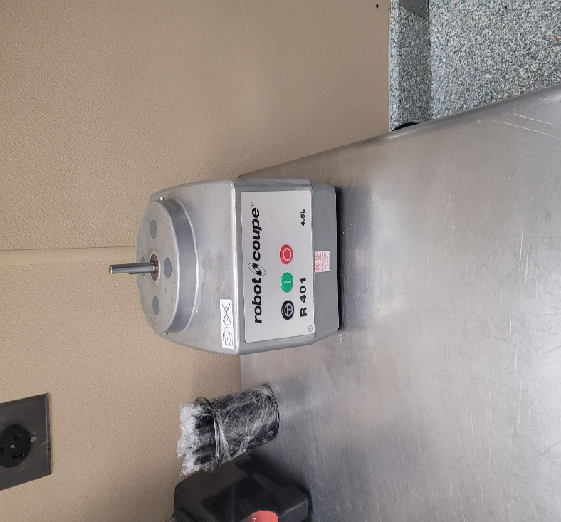
Equipment Needs

Slide 7
Menu Planning- Preparation Techniques
Review menu
Items can be pureed
7-10 days ahead
Resident
Dislikes
Allergies
Preparation
Spice Blends
Labeling

Slide 8
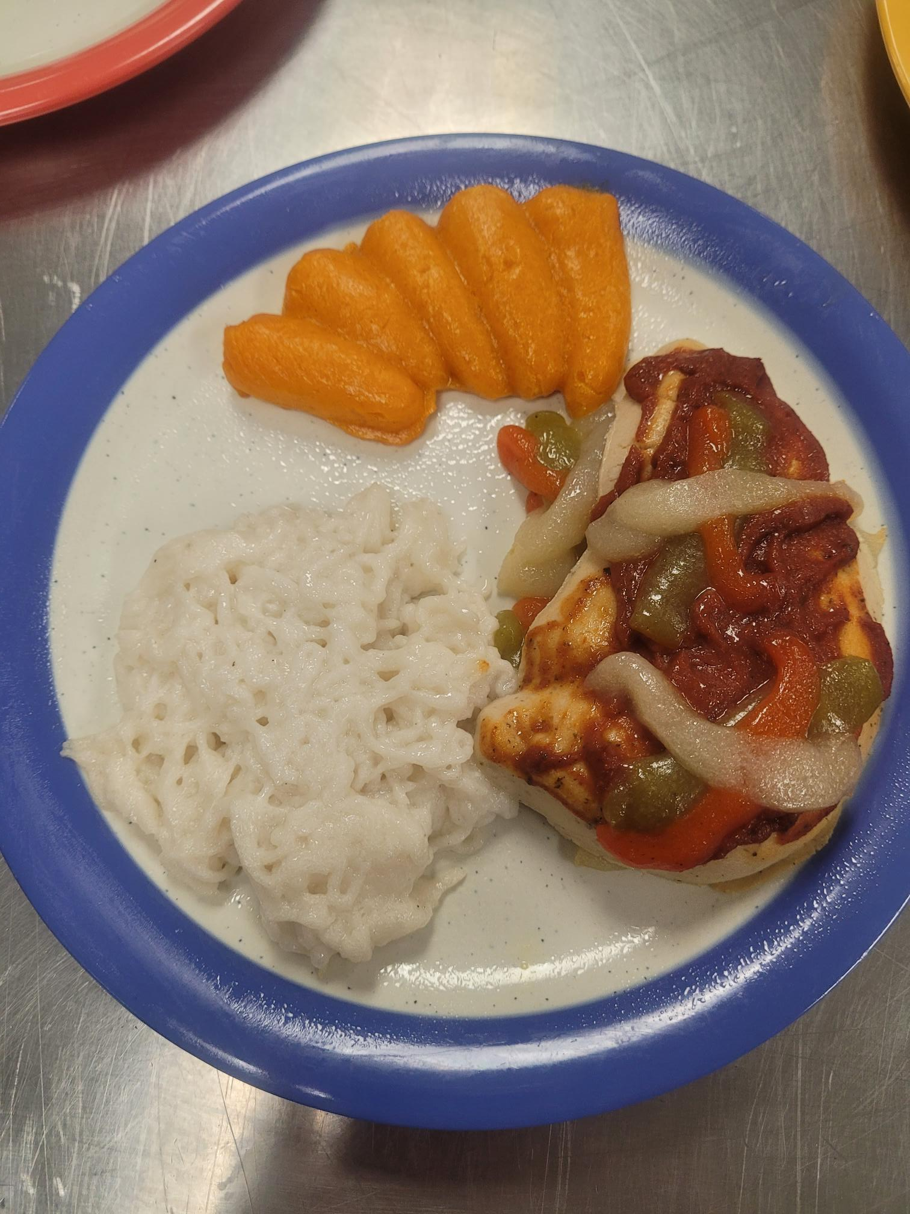
Chicken Cacciatore
Rice
Carrots

Slide 9
BBQ Chicken Macaroni & Cheese Stewed Tomatoes

Slide 10
Cheese Ravioli with Marinara

Slide 11
Sausage w/Peppers & Onions Mashed Potatoes Carrots

Slide 12
Assorted Desserts

