Slide 1
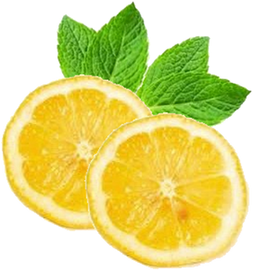
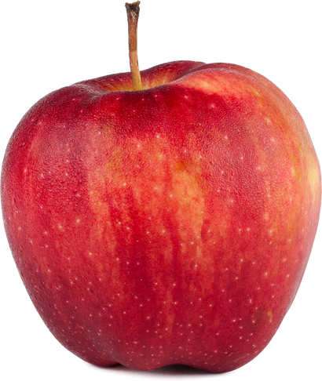
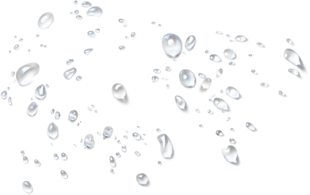
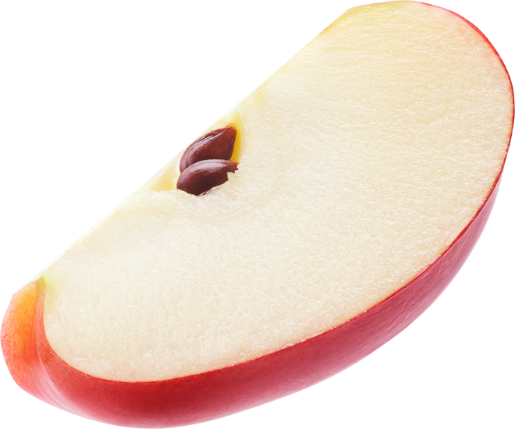
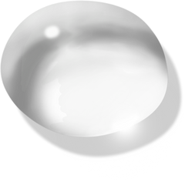
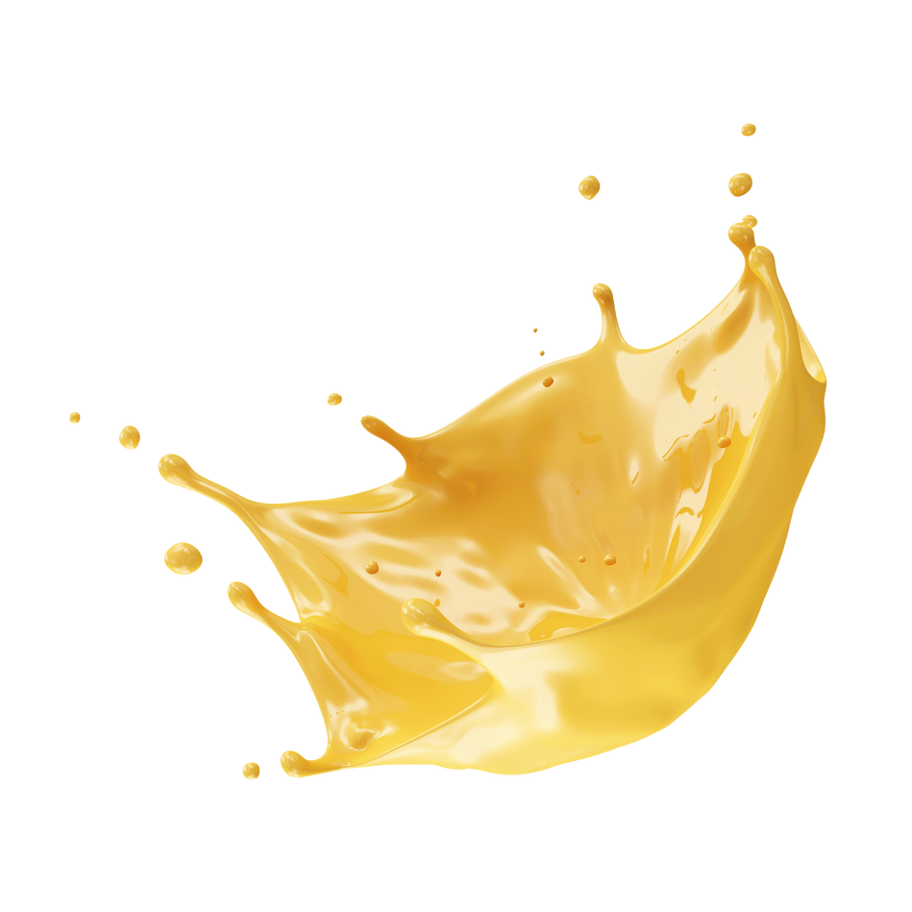
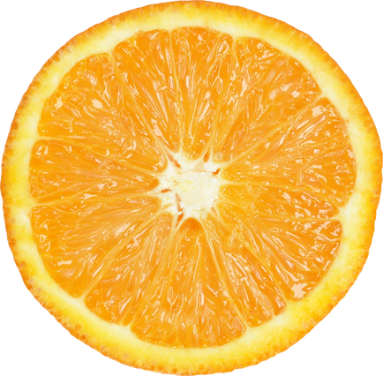
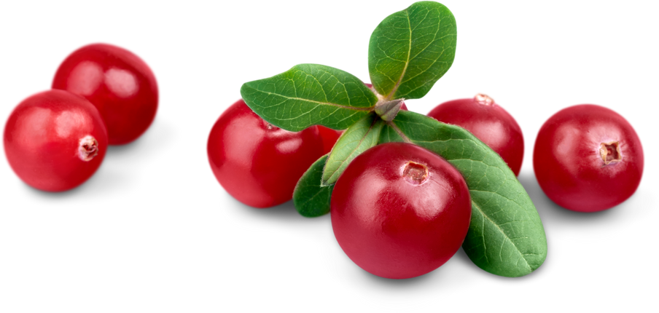
THICKENED JUICE, WATER & TEA

Slide 2
Current Modified Food Starch
Current Formula Objections
Cloudy appearance can be unappetizing
Does not maintain viscosity within spec across a wide temperature range
Does not maintain viscosity once frozen
Does not mix with MiraLAX
Modified food starch will begin to break down if it is held in the mouth for too long
Speech-language pathologists have perception that modified food starch is an outdated thickener

Slide 3
THICKENED JUICE, WATER & TEA
New & Improved
Cleaner Labels
Improved clarity – Clear Choice!
Combination of xanthan and guar gum thickeners – no starch
Enhanced flavor
Better temperature resiliency
Can be used with PEG laxatives (e.g. MiraLAX)
Replaced aspartame with sucralose
Replaced Artificial Red 40 with fruit and/or vegetable juices for color
Replaced HFCS with sugar

Slide 4
Old Item Code | New Item Code | New Item Description
5164 |  | Thickened Unflavored Water Level 2 Mildly Thick
5165 |  | Thickened Unflavored Water Level 3 Moderately Thick
1946 | 5629 | Thickened Lemon Flavored Water Level 2 Mildly Thick
1939 | 5630 | Thickened Lemon Flavored Water Level 3 Moderately Thick
1944 | 5631 | Thickened Apple Juice Level 2 Mildly Thick
1936 | 5632 | Thickened Apple Juice Level 3 Moderately Thick
1943 | 5641 | Thickened Orange Juice Level 2 Mildly Thick
1935 | 5642 | Thickened Orange Juice Level 3 Moderately Thick
1945 | 5729 | Thickened Cranberry Cocktail Level 2 Mildly Thick
1938 | 5730 | Thickened Cranberry Cocktail Level 3 Moderately Thick
3563 | 5731 | Thickened Sweet Tea Lemon Flavored Level 2 Mildly Thick
3564 | 5732 | Thickened Sweet Tea Lemon Flavored Level 3 Moderately Thick
THICKENED JUICE, WATER & TEA
48/4 fl oz cups
Same case pack, pallet configuration, and shelf life
Transition has started on the 4 fl oz items
46 fl oz items transitioning Summer 2023
Price has stayed the same with new ingredients

Slide 5
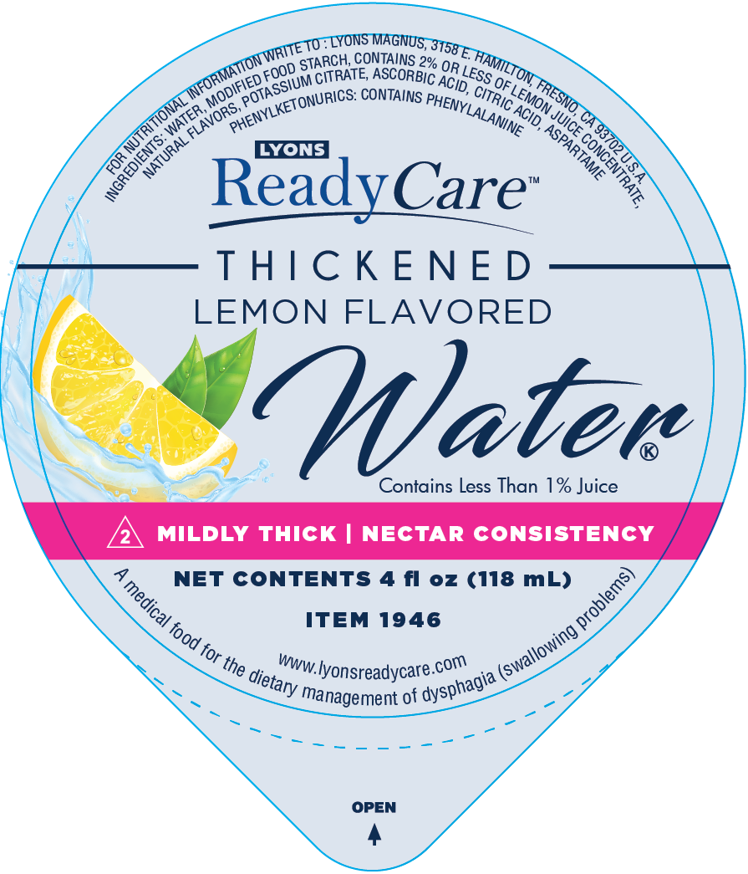
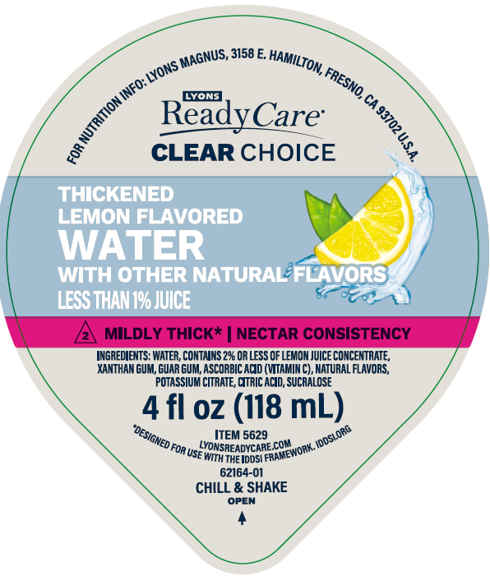
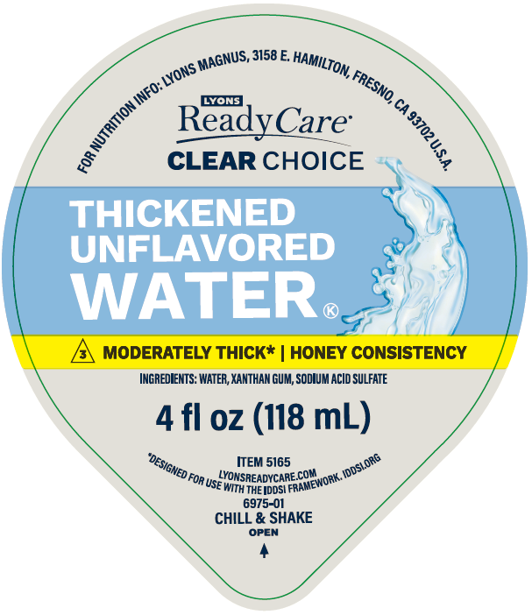
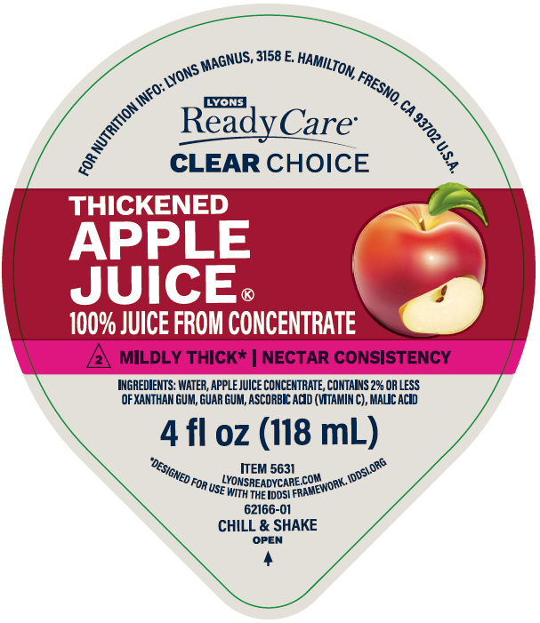
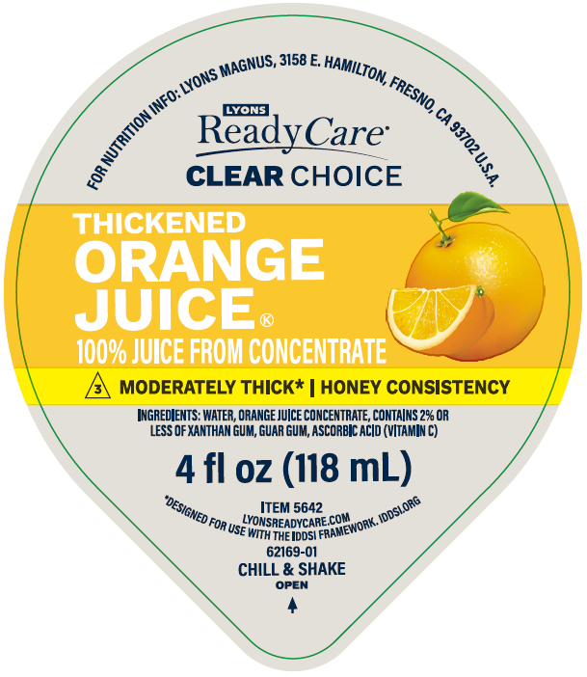
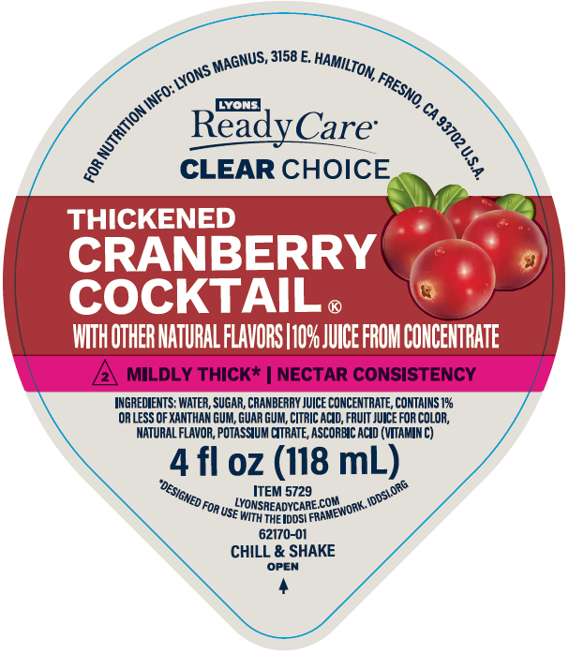
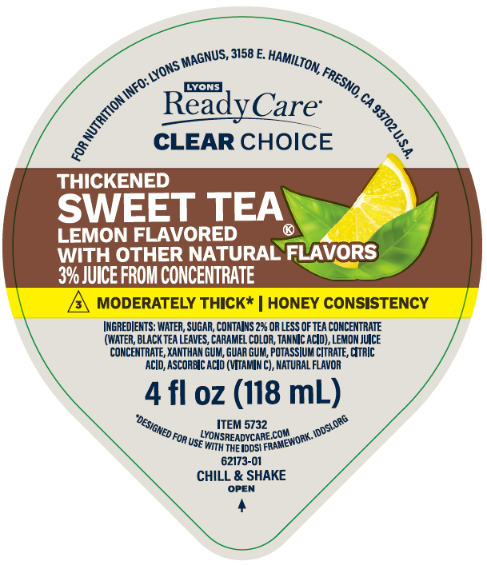
OLD
NEW
NEW name for product line
SAME IDDSI descriptors
NEW reference to IDDSI framework and iddsi.org
NEW serving instructions

Slide 6
Sensory Evaluations
Sensory Evaluation Setup
Conducted blind sensory evaluations with large pre-thickened beverage users.
Test group consisted of current and potential Lyons customers.
Sampled current formula, new Clear Choice, and competition.
Used QR codes to allow participants to report results and preferences in real-time.
Sensory Evaluation Results
Overwhelmingly positive results for Clear Choice compared to current and competition.
Ex. Thickened Lemon Flavored Water Level 2
Rank | Current | Clear Choice | Competition | P-Value
 | Frequency
1 | 6 (13%) | 24 (52%) | 16 (35%)
2 | 8 (17%) | 19 (41%) | 19 (41%)
3 | 32 (70%) | 3 (7%) | 11 (24%)
Mean (n=46) | 2.57^{b} | 1.54ª | 1.89ª | <0.0001

Slide 7
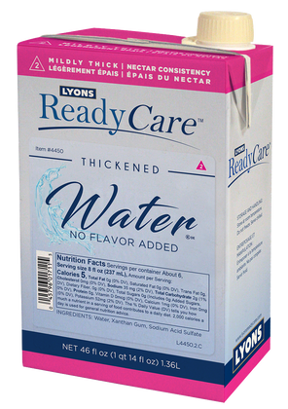
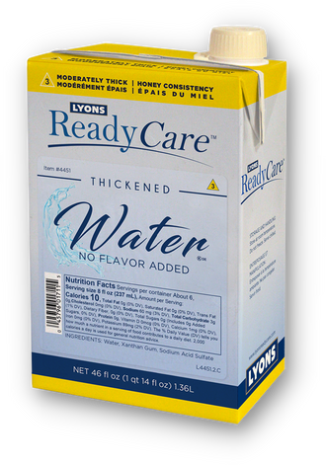
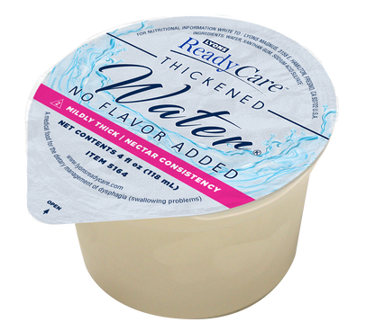
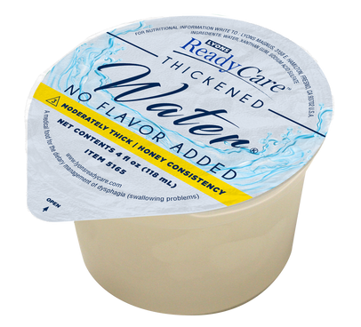
RECIPES
HYDRATION
SOLUTIONS
HOT COFFEE,
THICKENED WATER
ICE CUBES
TEA & COCOA
Pour No Flavor Added Thickened Water into ice cube trays.
Place in freezer for 4 hours or until frozen.
Remove from freezer and place into glass.
Pour thickened beverage of the same consistency over ice cubes and serve.
Pour one serving of your favorite instant coffee, tea, or hot cocoa powder into a cup.
Read the label to determine the recommended amount of water you should add to the product.
Heat the specified amount of No Flavor Added Thickened Water in the microwave until hot. Heating time depends on the microwave (45-60 seconds or until approximately 140°F).
Add the hot No Flavor Added Thickened Water to the cup and stir until powder dissolves.
Allow to cool to a drinkable temperature (100-120°F) and enjoy!
NO FLAVOR ADDED
RELIABLE & VERSATILE
ReadyCare® No Flavor Added Thickened Water is the
ultimate hydration solution for those with dysphagia.
FLAVORED
Pre-thickened to Level 2 Mildly Thick and Level 3 Moderately Thick
No flavor or sweetener added
Available in portion and bulk formats
POPSICLES
Pour 46 fl oz carton of No Flavor Added Thickened Water into pitcher.
Measure 1 tbsp of your favorite powder beverage mix and add to pitcher.
Mix vigorously with a wire whisk.
Pour into popsicle trays.
Place in freezer for 4 hours or until frozen.
Remove when frozen and serve!
ADD FLAVOR
Pour 46 fl oz carton of No Flavor Added Thickened Water into pitcher.
Measure 1 tbsp of your favorite powder beverage mix and add to pitcher.
Mix vigorously with a wire whisk.
LEARN MORE AND EARN CEUS!
Watch our on-demand webinar on
Dehydration Prevention and Treatment
at webinars.lyonsreadycare.com
WATCH RECIPE TUTORIAL VIDEOS AT PRO.LYONSREADYCARE.COM

