Slide 1
Innovations that nourish from preterm neonates to toddlers to teenagers
Advancements in pediatric lipids
Notes:
Speaker Notes:
Welcome to today’s presentation on innovations that nourish from preterm neonates to toddlers to teenagers: advancements in pediatric lipids

Slide 2
Agenda
01
About Fresenius Kabi Nutrition
02
Omega-3 fatty acids and the evolution of lipid injectable emulsions (ILEs)
03
Clinical guidelines and parenteral nutrition (PN)
04
SMOFlipid® Lipid Injectable Emulsion, USP 20%
05
Omegaven® (fish oil triglycerides) injectable emulsion
06
Ordering information
07
Important Safety Information
Notes:
Speaker Notes:
Review the agenda

Slide 3
Established leadership in pediatric PN
We ensure the utmost in quality and safety because PN is a critical component of care for adults, children, and infants who are unable to receive nutrition enterally or orally.
We are the U.S. market leader in ILEs¹ committed to delivering safe PN options to the healthcare community and their patients.
We are pioneers in pediatric PN as the ONLY provider of fish oil-containing ILEs (a good source of omega-3 fatty acids) for pediatric patients of all ages.
1. Data on File; 8/1/22; calculation includes: all ILEs approved in the US.
Notes:
Speaker Notes:
PN is important for patients of all ages who need it
Fresenius Kabi Nutrition is the U.S. market leader in ILEs¹
We are pioneers in PN as the only provider of fish-oil containing ILEs
Reference:
1. Data on File; 8/1/22; calculation includes: all ILEs approved in the US.

Slide 4
The omega-3 family of fatty acids
©2022 Fresenius Kabi USA, LLC. All Rights Reserved. 3094-SMF-08-08/22
4
Notes:
Speaker Notes:
The omega-3 family of fatty acids comprises ALA, EPA, and DHA

Slide 5
Omega-3 fatty acids: DHA and EPA
Considered to be important for the healthy development of infants due to their special physiological roles^{1,2}:
May be considered conditionally essential for growth and development^{3,4}
Important structural elements of cell membranes²
DHA is necessary for the normal development of the central nervous system and retina^{2,3}
Primary precursors of the very-long-chain fatty acids synthesized in the retina²
1. Agostoni C. Role of long-chain polyunsaturated fatty acids in the first year of life. J Pediatr Gastroenterol Nutr. 2008;47(suppl 2):S41-S44. 2. Cetin I, Koletzko B. Long-chain omega-3 fatty acid supply in pregnancy and lactation. Curr Opin Clin Nutr Metab Care. 2008;11(3):297-302. 3. Lapillonne A, Groh-Wargo S, Gonzalez CH, Uauy R. Lipid needs of preterm infants: updated recommendations. J Pediatr. 2013;162(3 Suppl):S37-47. 4. Bistrian B. Clinical aspects of essential fatty acid metabolism: Jonathan Rhoads Lecture. JPEN J Parenter Enteral Nutr. 2003;27(3):168-175.
Notes:
Speaker Notes:
Review DHA and EPA with audience
DHA and EPA (omega-3 fatty acids) are considered to be important for the healthy development of infants due to their special physiological roles^{1,2}
Discuss their importance in terms of healthy development of infants
References:
Agostoni C. Role of long-chain polyunsaturated fatty acids in the first year of life. J Pediatr Gastroenterol Nutr. 2008;47(suppl 2):S41-S44.
Cetin I, Koletzko B. Long-chain omega-3 fatty acid supply in pregnancy and lactation. Curr Opin Clin Nutr Metab Care. 2008;11(3):297-302.
Lapillonne A, Groh-Wargo S, Gonzalez CH, Uauy R. Lipid needs of preterm infants: updated recommendations. J Pediatr. 2013;162(3 Suppl):S37-47.
Bistrian B. Clinical aspects of essential fatty acid metabolism: Jonathan Rhoads Lecture. JPEN J Parenter Enteral Nutr. 2003;27(3):168-175.

Slide 6
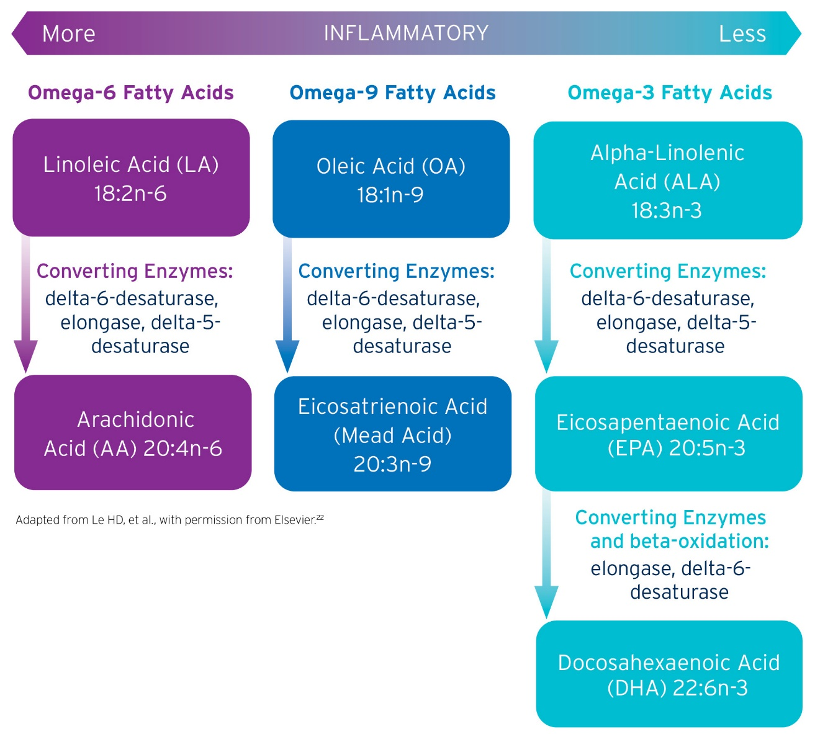
Omega-3 fatty acid pathways
¹
1. Le HD, Meisel JA, de Meijer VE, Gura KM, Puder M. The essentiality of arachidonic acid and docosahexaenoic acid. Prostaglandins Leukot Essent Fatty Acids. 2009;81(2-3):165-170.
Notes:
Speaker Notes:
This graph shows 3 families of polyunsaturated fatty acids derived from food sources, omega-6, omega-9, and omega-3¹:
All of these fatty acids are metabolized by the same group of enzymes to form lipids of different lengths depending on the needs of the body
In the omega-6 family, linoleic acid can be converted to arachidonic acid. In the omega-3 family, alpha linolenic acid can be converted to EPA and DHA. These downstream lipids are thought to serve various functions including mediating the inflammatory response by acting as precursors to eicosanoids. Arachidonic acid can act as a precursor to proinflammatory eicosanoids, where EPA and DHA can act as a precursor to less proinflammatory eicosanoids
References:
Le HD, Meisel JA, de Meijer VE, Gura KM, Puder M. The essentiality of arachidonic acid and docosahexaenoic acid. Prostaglandins Leukot Essent Fatty Acids. 2009;81(2-3):165-170.

Slide 7
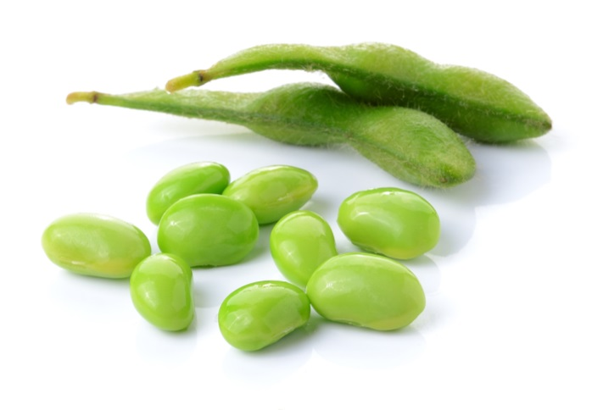
Lipid source matters
omega-6
MORE INFLAMMATORY
Expert recommendation suggests a potential benefit of balanced omega-6:omega-3 ratio in ILE.²
Safflower Oil
Soybean Oil
Lipid Emulsion | omega-6:omega-3 Ratio
SO | 7:1
MCT/LCT | 7:1
SO/OO | 9:1
FO | 1:8
SO/MCT/OO/FO | 2.5:1
MCTs
Olive Oil
Fish Oil
omega-3
LESS INFLAMMATORY
1. Figure Adapted from Vanek VW, Seidner DL, Allen P, et al. A.S.P.E.N. position paper: Clinical role for alternative intravenous fat emulsions. Nutr Clin Pract. 2012;27(2):150-192. 2. Grimble RH. Fatty acid profile of modern lipid emulsions: Scientific considerations for creating ideal composition. Clin Nutr Suppl. 2005;1(3):9-15.
Notes:
Speaker Notes:
Different oils have been shown to have an impact on the inflammatory process¹
Oils containing omega-6 fatty acids may have more proinflammatory properties than those containing omega-3s¹
Expert recommendation suggests a potential benefit of balanced omega-6:omega-3 ratio in ILE²
References:
Figure Adapted from Vanek VW, Seidner DL, Allen P, et al. A.S.P.E.N. position paper: Clinical role for alternative intravenous fat emulsions. Nutr Clin Pract. 2012;27(2):150-192.
Grimble RH. Fatty acid profile of modern lipid emulsions: Scientific considerations for creating ideal composition. Clin Nutr Suppl. 2005;1(3):9-15.

Slide 8
ILE composition comparison
 | Intralipid¹ 20% Emulsion | Nutrilipid² 20% Emulsion | SMOFlipid³ 20% Emulsion | Omegaven⁴ 10% Emulsion
Manufacturer | Fresenius Kabi/Baxter* | B. Braun | Fresenius Kabi | Fresenius Kabi
Oil Source | Soybean Oil | Soybean Oil | Soybean Oil 30% MCT 30% Olive Oil 25% Fish Oil 15% | Fish Oil
Indication | Adults & Pediatrics | Adults & Pediatrics | Adults & Pediatrics | Pediatrics
Fat Composition (Mean value or range % by weight )¹⁻⁷ | Fat Composition (Mean value or range % by weight )¹⁻⁷
Linoleic (omega-6) | 44-62 | 48-58 | 17.5 | 1.5
Αlpha-Linolenic (omega-3) | 4-11 | 4-11 | 2.25 | 1.1
Eicosapentaenoic (EPA omega-3) | 0 | 0 | 1-3.5 | 13-26
Docosahexaenoic (DHA omega-3) | 0 | 0 | 1-3.5 | 14-27
Oleic (omega-9) | 19-30 | 17-30 | 23-35 | 4-11
Arachidonic (omega-6) | 0 | ND | 0.5 | 0.2-2
Alpha-Tocopherol (mg/L) | 38 | ND | 163-225 | 150-300
Phytosterol Content⁷ mcg/mL | 381 ± 28.9† | ND | 165 ± 10.4† | 3.66 ± 0.59
*Distributed by; †Internal Data ND=No Data
1. Intralipid 20% Prescribing Information. Fresenius Kabi USA, LLC. 2022. 2. Nutrilipid Prescribing Information. B. Braun Medical Inc. 2014. 3. SMOFlipid Prescribing Information, Fresenius Kabi USA, LLC. 2022. 4. Omegaven Prescribing Information, Fresenius Kabi USA, LLC. 2020. 5. Le HD, Meisel JA, de Meijer VE, Gura KM, Puder M. The essentiality of arachidonic acid and docosahexaenoic acid. Prostaglandins Leukot Essent Fatty Acids. 2009;81(2-3):165-170. 6. Vanek VW, Seidner DL, Allen P, et al. A.S.P.E.N. position paper: Clinical role for alternative intravenous fat emulsions. Nutr Clin Pract. 2012;27(2):150-192. 7. Vanek VW, Seidner DL, Allen P, et al. Update to A.S.P.E.N. position paper: clinical role for alternative intravenous fat emulsions. Nutr Clin Pract. 2014;29(6):841.
Notes:
Speaker Notes:
Here you can see the composition of the current pediatric ILEs on the market in the U.S.
I’d like to call your attention to the fatty acids EPA and DHA, which can only be found in the ILEs that contain fish oil
References:
Intralipid 20% Prescribing Information. Fresenius Kabi USA, LLC. 2022.
Nutrilipid Prescribing Information. B. Braun Medical Inc. 2014.
SMOFlipid Prescribing Information, Fresenius Kabi USA, LLC. 2022.
Omegaven Prescribing Information, Fresenius Kabi USA, LLC. 2020.
Le HD, Meisel JA, de Meijer VE, Gura KM, Puder M. The essentiality of arachidonic acid and docosahexaenoic acid. Prostaglandins Leukot Essent Fatty Acids. 2009;81(2-3):165-170.
Vanek VW, Seidner DL, Allen P, et al. A.S.P.E.N. position paper: Clinical role for alternative intravenous fat emulsions. Nutr Clin Pract. 2012;27(2):150-192.
Vanek VW, Seidner DL, Allen P, et al. Update to A.S.P.E.N. position paper: clinical role for alternative intravenous fat emulsions. Nutr Clin Pract. 2014;29(6):841.

Slide 9
Total phytosterol content^{1,2}
700
Phytosterols are plant-based sterols that are structurally similar to cholesterol but cannot be metabolized by the human body.
600
500
400
Phytosterols (µg/mL)
300
200
100
0
Lipofundin N* (100% Soy)
Intralipid 20%³
Structolipid* 20%
50% MCT/ 50% LCT*
Clinolipid 80% Olive/ 20% Soybean
SMOFlipid Soybean Oil 30%
MCT 30%
Olive Oil 25%
Fish Oil 15%³
Omegaven 100% Fish Oil
*Not available in the U.S.
1. Xu Z, Harvey KA, Pavlina T, et al. Steroidal compounds in commercial parenteral lipid emulsions. Nutrients. 2012;4(8):904-921. 2. Harvey K, Xu Z, Walker C, et al. Parenteral lipid emulsions in guinea pigs differentially influence plasma and tissue levels of fatty acids, squalene, cholesterol, and phytosterols. Lipids. 2014;49(8):777-793. 3. Data on File.
Notes:
Speaker Notes:
Review phytosterol content of current ILEs as seen in chart
Omegaven has the lowest phytosterol content of current ILEs
Total phytosterol content of the lipid emulsions varies greatly and per mL
References:
Xu Z, Harvey KA, Pavlina T, et al. Steroidal compounds in commercial parenteral lipid emulsions. Nutrients. 2012;4(8):904-921.
Harvey K, Xu Z, Walker C, et al. Parenteral lipid emulsions in guinea pigs differentially influence plasma and tissue levels of fatty acids, squalene, cholesterol, and phytosterols. Lipids. 2014;49(8):777-793.
Data on File.

Slide 10
Guidelines on lipids in pediatric PN¹
In pediatric patients, intravenous lipid emulsions (ILEs) should be an integral part of parenteral nutrition (PN) either exclusive or complementary to enteral feeding (LoE 1-, RG A, strong recommendation for).¹
In preterm infants, lipid emulsions can be started immediately after birth and no later than on day two of life and for those in whom enteral feeding has been withdrawn, they can be started at time of PN initiation (LoE 1-, RG A, strong recommendation for).
Markers of liver integrity and function, and triglyceride concentrations in serum or plasma should be monitored regularly in patients receiving ILEs, and more frequently in cases with a marked risk for hyperlipidemia (e.g., patients with high lipid or glucose dosage, sepsis, catabolism, extremely low birth weight infants) (LoE 2-, RG B, strong recommendation for).
1. Lapillonne A, Fidler Mis N, Goulet O, et al. ESPGHAN/ESPEN/ESPR/CSPEN guidelines on pediatric parenteral nutrition: Lipids. Clin Nutr. 2018;37:2324-2336.
Notes:
Speaker Notes:
Discuss ESPEN guidelines on pediatric PN and lipids
Review statements with audience
Reference:
1. Lapillonne A, Fidler Mis N, Goulet O, et al. ESPGHAN/ESPEN/ESPR/CSPEN guidelines on pediatric parenteral nutrition: Lipids. Clin Nutr. 2018;37:2324-2336.

Slide 11
The same product you’ve trusted for adults is now approved for children aged 17 and under who require PN, including the most vulnerable preterm babies.
Please see Brief Summary of Prescribing Information on Slides 28-35.
Notes:
Speaker Notes:
Review SMOFlipid’s new expanded indication
The same product you've trusted for adults is now approved for children aged 17 and under who require PN, including the most vulnerable preterm babies

Slide 12
Indication
SMOFlipid is indicated in adult and pediatric patients, including term and preterm neonates, as a source of calories and essential fatty acids for parenteral nutrition (PN) when oral or enteral nutrition is not possible, insufficient, or contraindicated.¹
SMOFlipid is the only ILE in the U.S. that delivers a blend of 4 oils to patients at every age and stage of life who require PN.¹
1. SMOFlipid Prescribing Information, Fresenius Kabi USA, LLC. 2022.
Notes:
Speaker Notes:
Review indication
Point out that that boxed warning and limitations of use have been removed by FDA
Reference:
1. SMOFlipid Prescribing Information, Fresenius Kabi USA, LLC. 2022.

Slide 13
SMOFlipid is a unique blend of 4 oil sources¹
Soybean oil 30% (omega-6)
Medium-chain triglycerides (MCT) 30%
Olive oil 25% (omega-9)
Fish oil 15% (omega-3)
Provides essential fatty acids.
Supplies monounsaturated fatty acids.
A source of EPA and DHA.³
A source of rapidly available energy.²
1. SMOFlipid Prescribing Information, Fresenius Kabi USA, LLC. 2022. 2. Deckelbaum RJ, Hamilton JA, Moser A, et al. Medium-chain versus long-chain triacylglycerol emulsion hydrolysis by lipoprotein lipase and hepatic lipase: implications for the mechanisms of lipase action. Biochemistry. 1990;29(5):1136-1142. 3. Kalish BT, Fallon EM, Puder M. A tutorial on fatty acid biology. JPEN J Parenter Enteral Nutr. 2012;36(4):380-388.
Notes:
Speaker Notes:
Discuss the unique 4-oil blend
References:
SMOFlipid Prescribing Information, Fresenius Kabi USA, LLC. 2022.
Deckelbaum RJ, Hamilton JA, Moser A, et al. Medium-chain versus long-chain triacylglycerol emulsion hydrolysis by lipoprotein lipase and hepatic lipase: implications for the mechanisms of lipase action. Biochemistry. 1990;29(5):1136-1142.
Kalish BT, Fallon EM, Puder M. A tutorial on fatty acid biology. JPEN J Parenter Enteral Nutr. 2012;36(4):380-388.

Slide 14
Proven safety and tolerability^{1,2}
SMOFlipid is the first and only 4-oil ILE with demonstrated safety and tolerability^{1,2} in more than 7 million patients worldwide.³
The safety and efficacy of SMOFlipid compared to soybean oil in pediatric patients of all groups, including term and preterm neonates, was evaluated in 333 pediatric patients in four randomized, active-controlled, double-blind, parallel-group controlled clinical studies.⁴
1. Klek S, Chambrier C, Singer P, et al. Four-week parenteral nutrition using a third-generation lipid emulsion (SMOFlipid)--a double-blind, randomised, multicentre study in adults. Clin Nutr. 2013;32(2):224-231. 2. Mertes N, Grimm H, Fürst P, Stehle P. Safety and efficacy of a new parenteral lipid emulsion (SMOFlipid) in surgical patients: a randomized, double-blind, multicenter study. Ann Nutr Metab. 2006;50(3):253-259. 3. Data on file. 4. SMOFlipid Prescribing Information, Fresenius Kabi USA, LLC. 2022.
Notes:
Speaker Notes:
SMOFlipid is the first and only 4-oil ILE with demonstrated safety and tolerability^{1,2} in more than 7 million patients worldwide³
Safety and efficacy were evaluated in more than 300 pediatric patients (170 SMOF and 163 SO ILE patients) in 4 randomized, active-controlled, double-blind, parallel-group controlled clinical studies⁴
References:
Klek S, Chambrier C, Singer P, et al. Four-week parenteral nutrition using a third-generation lipid emulsion (SMOFlipid)--a double-blind, randomised, multicentre study in adults. Clin Nutr. 2013;32(2):224-231.
Mertes N, Grimm H, Fürst P, Stehle P. Safety and efficacy of a new parenteral lipid emulsion (SMOFlipid) in surgical patients: a randomized, double-blind, multicenter study. Ann Nutr Metab. 2006;50(3):253-259.
Data on file.
SMOFlipid Prescribing Information, Fresenius Kabi USA, LLC. 2022.

Slide 15
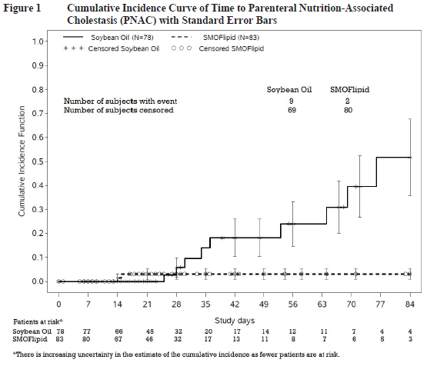
Parenteral nutrition-associated cholestasis (PNAC)
PNAC, a precursor to parenteral nutrition-associated liver disease (PNALD), developed less frequently in SMOFlipid-treated patients than in 100% soybean oil lipid emulsion-treated patients.¹
1. SMOFlipid Prescribing Information, Fresenius Kabi USA, LLC. 2022.
Notes:
Speaker Notes:
In a randomized study of neonates and infants expected to be treated with PN for at least 28 days, parenteral nutrition-associated cholestasis (PNAC), a precursor to PNALD, developed less frequently in SMOFlipid-treated patients than in 100% soybean oil lipid emulsion-treated patients¹
Prospective, RCT, double-blind, parallel-group study comparing preterm/term neonates (n=152) and infants (n=9) requiring PN for 28 days¹
Other findings include¹:
SMOFlipid-treated patients showed increases in the median body weight, height/length, and head circumference comparable to the SO ILE-treated patients
No significant difference in mean triglyceride (TG) levels; TG levels were within normal range
Pediatric Study 1 also compared the incidence of PNAC (direct bilirubin >2mg/dL with a second confirmed direct bilirubin >2 mg/dL at least 7 days later) in both groups¹:
PNAC mostly occurred in patients who received treatment for more than 28 days
2.4% (2/83) of SMOFlipid-treated patients developed PNAC
11.5% (9/78) of soybean oil lipid emulsion-treated patients developed PNAC
The estimated cumulative incidence of PNAC is shown in this Kaplan-Meier cumulative incidence curve¹
Reference:
1. SMOFlipid Prescribing Information, Fresenius Kabi USA, LLC. 2022.

Slide 16
Pediatric dosing and administration
Please see Brief Summary of Prescribing Information on Slides 28-35.
Notes:
Speaker Notes:
Let’s review the specific dosing specifications for SMOFlipid

Slide 17
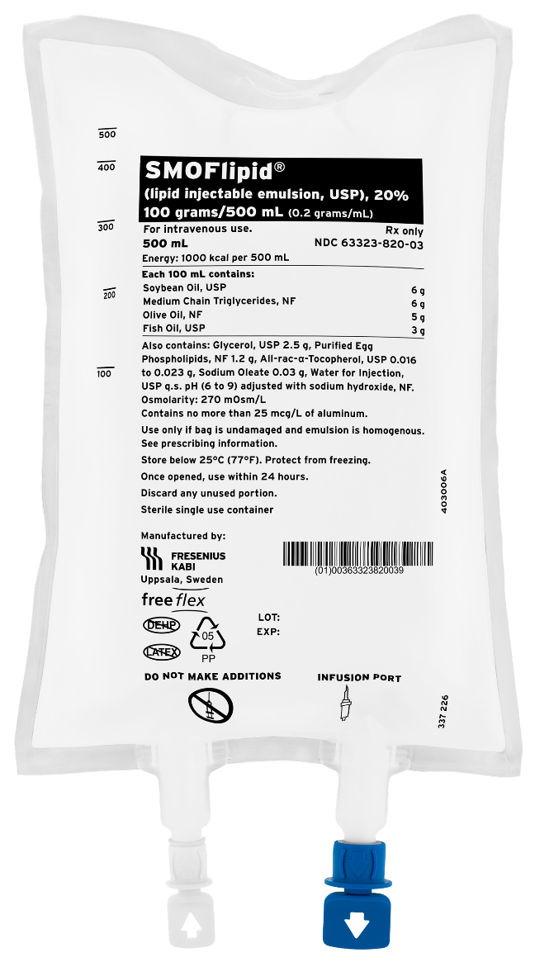
Recommended pediatric dosing and administration¹
The dosing of SMOFlipid, among other factors, depends on the patient’s individual energy requirements influenced by age, body weight, tolerance, clinical status, and the ability to metabolize and eliminate lipids
The dosing of SMOFlipid varies in neonates and pediatrics; each patient group has its own unique dosing specifications so it’s critical to be aware of the differences for safe administration
The duration of infusion will vary depending on the clinical situation but infuse SMOFlipid over a longer duration in neonates as shown in the table on the next slide
Do not exceed an infusion rate of 0.15 g/kg/hour
The administration flow rate is determined by dividing the volume of lipid by the duration of the infusion
1. SMOFlipid Prescribing Information, Fresenius Kabi USA, LLC. 2022.
Notes:
Speaker Notes:
Review dosing specifics
Reference:
1. SMOFlipid Prescribing Information, Fresenius Kabi USA, LLC. 2022.

Slide 18
Recommended pediatric dosing and administration¹
Pediatric Age Group | Initial Dose | Maximum Dose | Duration of Infusion
Birth to 2 years (including preterm and term neonates) | 0.5 to 1 g/kg/day Increase the dose by 0.5 to 1 g/kg/day | 3 g/kg/day | 20 to 24 hours for preterm and term neonates 12 to 24 hours for patients 1 month to 2 years
2 to <12 years | 1 to 2 g/kg/day Increase the dose by 0.5 to 1 g/kg/day | 3 g/kg/day | 12 to 24 hours
12 to 17 years | 1 to 2 g/kg/day | 2.5 g/kg/day | 12 to 24 hours
Protect the admixed PN solution from light
Use a non-vented, non-DEHP 1.2 micron in-line filter set during administration
1. SMOFlipid Prescribing Information, Fresenius Kabi USA, LLC. 2022.
Notes:
Speaker Notes:
Review dosing specifics
Reference:
1. SMOFlipid Prescribing Information, Fresenius Kabi USA, LLC. 2022.

Slide 19
The only 100% fish oil ILE for pediatric patients with PNAC¹
Please see Brief Summary of Prescribing Information on Slides 36-41.
1. Omegaven Prescribing Information, Fresenius Kabi USA, LLC. 2020.
Notes:
Speaker Notes:
Now, let’s discuss Omegaven, the only 100% fish oil ILE for pediatric patients with parenteral nutrition-associated cholestasis (PNAC)¹
Reference:
1. Omegaven Prescribing Information, Fresenius Kabi USA, LLC. 2020.

Slide 20
Omegaven is indicated as a source of calories and fatty acids in pediatric patients with parenteral nutrition-associated cholestasis (PNAC)¹
Limitations of Use¹
Omegaven is not indicated for the prevention of PNAC. It has not been demonstrated that Omegaven prevents PNAC in parenteral nutrition (PN)-dependent patients
It has not been demonstrated that the clinical outcomes observed in patients treated with Omegaven are a result of the omega-6: omega-3 fatty acid ratio of the product
Contra-indications¹
Known hypersensitivity to fish or egg protein or to any of the active ingredients or excipients
Severe hemorrhagic disorders
Severe hyperlipidemia or severe disorders of lipid metabolism with serum triglycerides greater than 1,000 mg/dL
Please see Brief Summary of Prescribing Information on Slides 36-41.
1. Omegaven Prescribing Information, Fresenius Kabi USA, LLC. 2020.
Notes:
Speaker Notes:
Omegaven is indicated as a source of calories and fatty acids in pediatric patients with parenteral nutrition-associated cholestasis (PNAC)¹
Limitations of Use¹
Omegaven is not indicated for the prevention of PNAC. It has not been demonstrated that Omegaven prevents PNAC in parenteral nutrition (PN)-dependent patients
It has not been demonstrated that the clinical outcomes observed in patients treated with Omegaven are a result of the omega-6: omega-3 fatty acid ratio of the product
Contraindications¹
Known hypersensitivity to fish or egg protein or to any of the active ingredients or excipients
Severe hemorrhagic disorders
Severe hyperlipidemia or severe disorders of lipid metabolism with serum triglycerides greater than 1,000 mg/dL
Reference:
Omegaven Prescribing Information, Fresenius Kabi USA, LLC. 2020.

Slide 21
What is PNAC?
PNAC is the onset of liver disease in the context of the administration of PN in patients with temporary or permanent intestinal failure.¹
Commonly known as¹:
Most commonly defined as²⁻⁵:
IFALD
Intestinal failure-associated liver disease
Direct or conjugated bilirubin
>2 mg/dL
Parenteral nutrition-associated liver disease
in patients who receive PN
PNALD
>2 weeks
Development of PNAC is associated with increased morbidity and mortality and can progress to liver fibrosis, hepatic failure, and death.⁶
1. Cahova M, Bratova M, Wohl P. Parenteral nutrition-associated liver disease: the role of the gut microbiota. Nutrients. 2017;9(9):987. 2. Lapillonne A, Mis NM, Goulet O, van den Akker CHP, Wu J, Koletzko B. ESPGHAN/ESPEN/ESPR/CSPEN guidelines on pediatric parenteral nutrition: Lipids. Clin Nutr. 2018;37(6 pt B):2324-2336. 3. Gupta K, Wang H, Amin SB. Parenteral nutrition-associated cholestasis in premature infants: role of macronutrients. JPEN J Parenter Enteral Nutr. 2016;40(3):335-341. 4. Hojsak I, Colomb V, Braegger C, et al. ESPHGAN Committee on Nutrition Position Paper. Intravenous lipid emulsions and risk of hepatotoxicity in infants and children: a systematic review and meta-analysis. J Pediatr Gastroenterol Nutr. 2016;62(5):776-792. 5. Lauriti G, Zani A, Aufieri R, et al. Incidence, prevention, and treatment of parenteral nutrition-associated cholestasis and intestinal failure-associated liver disease in infants and children: a systematic review. JPEN J Parenter Enteral Nutr. 2014;38(1):70-85. 6. Tillman EM, Helms RA. Omega-3 long chain polyunsaturated fatty acids for treatment of parenteral nutrition-associated liver disease: a review of the literature. J Pediatr Pharmacol Ther. 2011;16(1):31-38.
Notes:
Speaker Notes
Discuss other commonly used terms for PNAC
Intestinal failure-associated liver disease (IFALD)
Parenteral nutrition-associated liver disease (PNALD)
Most commonly defined as direct or conjugated bilirubin greater than 2.0 mg/dL in patients who receive PN >2 weeks

Slide 22
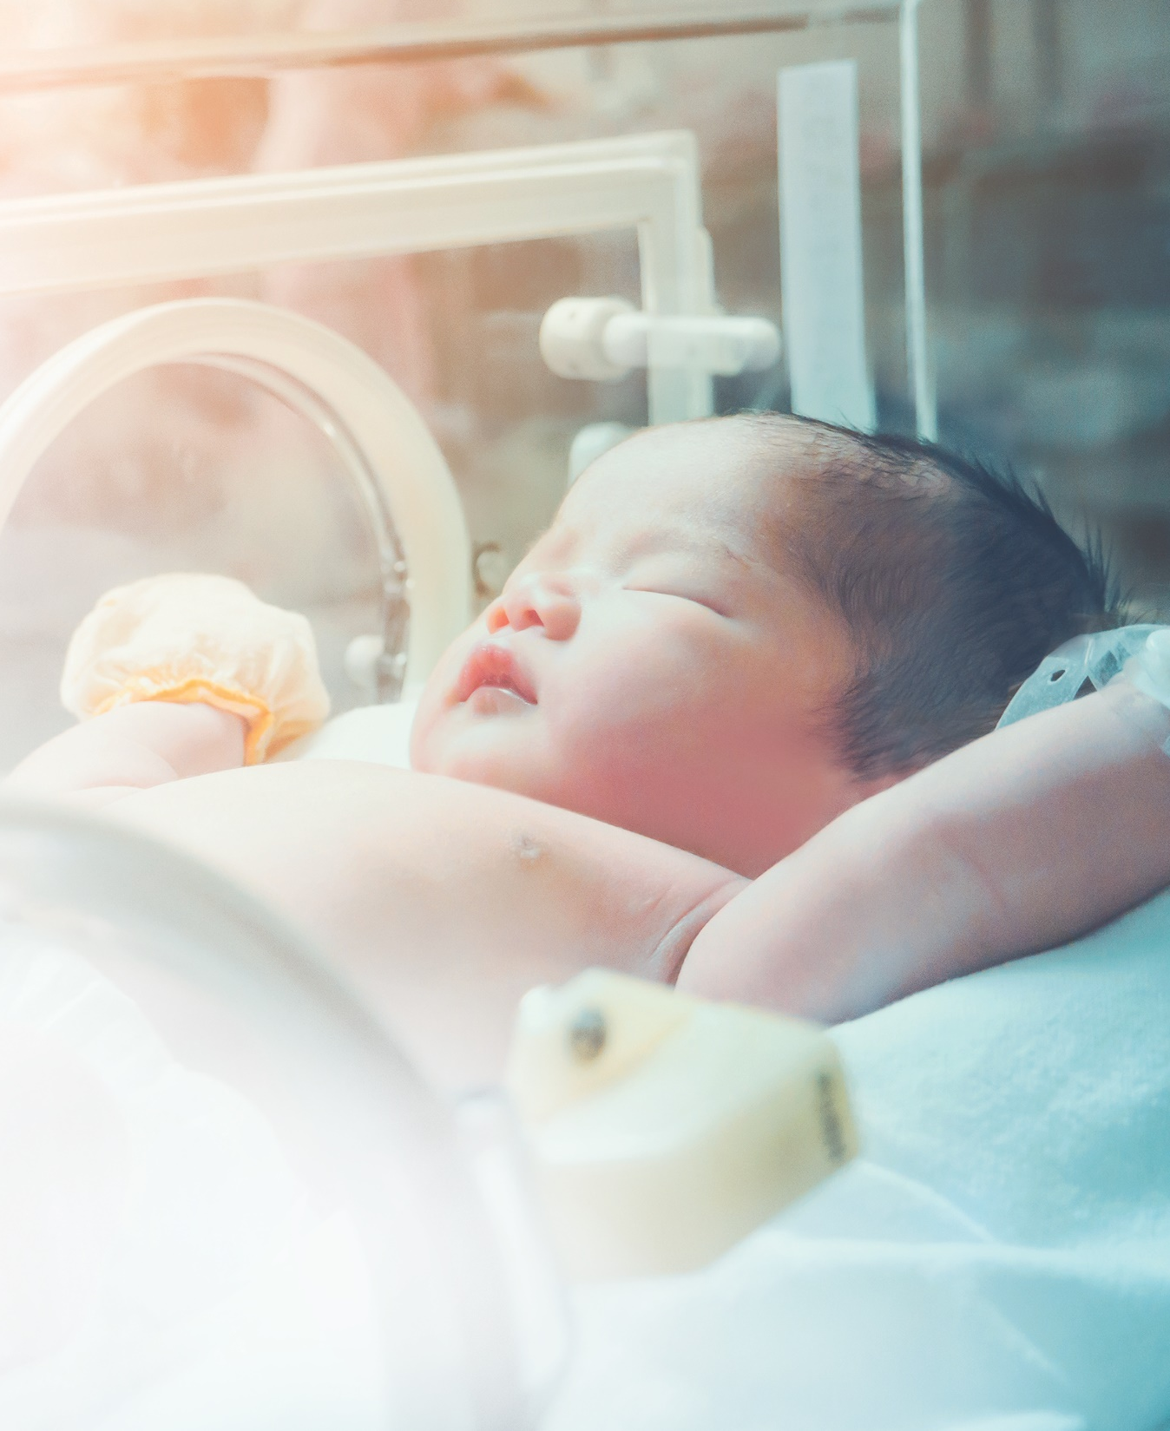
Pediatric patients receiving Omegaven vs. soybean oil-based ILE:
Achieved age-appropriate growth^{1,2}
Required fewer liver transplants^{2,3}
Experienced resolution of cholestasis^{2,3}
Were nourished for up to 2 years without clinical signs of EFAD¹
1. Omegaven Prescribing Information, Fresenius Kabi USA, LLC. 2020. 2. Gura KJ, Premkumar MH, Calkins KL, Puder M. Intravenous fish oil monotherapy as a source of calories and fatty acids promotes age-appropriate growth in pediatric patients with intestinal failure-associated liver disease. J Pediatr. 2020;219:98-105. 3. Gura KM, Premkumar MH, Calkins KL, Puder M. Fish oil emulsion reduces liver injury and liver transplantation in children with intestinal failure-associated liver disease: a multicenter integrated study. J Pediatr. 2021;230:46-54.e2.
Notes:
Speaker Notes:
Review slide summary
Pediatric patients receiving Omegaven vs. soybean oil-based ILE in observational trials with pair matched groups
References:
1. Omegaven Prescribing Information, Fresenius Kabi USA, LLC. 2020.
2. Gura KJ, Premkumar MH, Calkins KL, Puder M. Intravenous fish oil monotherapy as a source of calories and fatty acids promotes age-appropriate growth in pediatric patients with intestinal failure-
associated liver disease. J Pediatr. 2020;219:98-105.
3. Gura KM, Premkumar MH, Calkins KL, Puder M. Fish oil emulsion reduces liver injury and liver transplantation in children with intestinal failure-associated liver disease: a multicenter integrated study. J
Pediatr. 2021;230:46-54.e2.

Slide 23
Dosing and administration
Please see Brief Summary of Prescribing Information on Slides 36-41.
Notes:
Speaker Notes:
Let’s review dosing and administration of Omegaven

Slide 24
Omegaven dosing¹
Recommended Daily Dose/ Maximum Dose | Infusion Rate
1 g/kg/day | Initial rate of infusion not to exceed 0.05 mL/minute for the first 15 to 30 minutes
 | If tolerated, gradually increase to the required rate after 30 minutes
 | Maximum infusion rate not to exceed 1.5 mL/kg/hour, corresponding to 0.15 g/kg/hour
Initiate Omegaven dosing as soon as direct or conjugated bilirubin (DBil) levels are >2 mg/dL in pediatric patients who are expected to be PN-dependent for at least 2 weeks.
1. Omegaven Prescribing Information, Fresenius Kabi USA, LLC. 2020.
Notes:
Speaker Notes:
Review Omegaven dosing and duration
Reference:
1. Omegaven Prescribing Information, Fresenius Kabi USA, LLC. 2020.

Slide 25
Omegaven dosing duration¹
Duration
Administer Omegaven until direct or conjugated bilirubin levels are less than 2 mg/dL or until the patient no longer requires PN.
Patients in our clinical trials conducted at Boston Children’s Hospital and Texas Children’s Hospital received Omegaven for a median of 2.7 months and up to 8 years
1. Omegaven Prescribing Information, Fresenius Kabi USA, LLC. 2020.
Notes:
Speaker Notes:
Review the liver function tests
These labs should be monitored while on PN to assess any changes in liver function
Reference:
1. Omegaven Prescribing Information, Fresenius Kabi USA, LLC. 2020.

Slide 26
Innovating alternative ILEs for pediatric patients
SMOFlipid is the only ILE in the U.S. that delivers a blend of 4 oils to patients
at every age and stage who require PN.¹
SMOFlipid is approved for PN patients of all ages and is designed to provide a
source of calories and essential fatty acids for PN when oral or enteral nutrition
is not possible, insufficient, or contraindicated.¹
Omegaven is the first and only fish oil emulsion for pediatric patients with parenteral nutrition-associated cholestasis (PNAC) in the U.S.²
Omegaven patients receiving FOLE compared with SOLE achieved age-appropriate growth and experienced improvement in liver function parameters in clinical trials.^{2,3}
^{2,3}
1. SMOFlipid Prescribing Information, Fresenius Kabi USA, LLC. 2022. 2. Omegaven Prescribing Information, Fresenius Kabi USA, LLC. 2020. 3. Gura KJ, Premkumar MH, Calkins KL, Puder M. Intravenous fish oil monotherapy as a source of calories and fatty acids promotes age-appropriate growth in pediatric patients with intestinal failure-associated liver disease. J Pediatr. 2020;219:98-105.
Notes:
Speaker notes:
Say there are options for ILEs that contain fish oil
Mention that SMOFlipid is the only ILE in the U.S. that delivers a blend of 4 oils to patients at every age and stage who require PN¹
Mention patients at risk for PNAC Mention that Omegaven is the first and only fish oil emulsion for pediatric patients with PNAC in the U.S.²
End with the fact that patients receiving FOLE achieved age-appropriate growth and experienced improvement in liver function parameters in clinical trials^{2,3}
References:
SMOFlipid Prescribing Information, Fresenius Kabi USA, LLC. 2022.
Omegaven Prescribing Information, Fresenius Kabi USA, LLC. 2020.
Gura KJ, Premkumar MH, Calkins KL, Puder M. Intravenous fish oil monotherapy as a source of calories and fatty acids promotes age-appropriate growth in pediatric patients with intestinal failure-associated liver disease. J Pediatr. 2020;219:98-105.

Slide 27
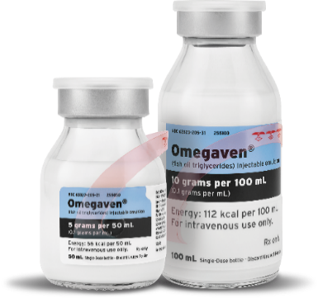
Ordering information
Bag Size | 100 mL | 250 mL | 500 mL | 1000 mL
NDC Code | 63323-820-00 | 63323-820-74 | 63323-820-50 | 63323-820-10
Bags/Case | 10 bags/case | 10 bags/case | 12 bags/case | 6 bags/case
Non-PVC
Non-DEHP
Not made with natural rubber latex
Recyclable material (made from multi-layer polyolefin)
Bottle Size | 50 mL single-dose glass bottle | 100 mL single-dose glass bottle
NDC Code | 63323-205-50 | 63323-205-00
Bottles/Carton | 10 bottles/carton | 10 bottles/carton
Notes:
Speaker Notes:
Review ordering information

Slide 28
Brief Summary of Prescribing Information SMOFlipid® Lipid Injectable Emulsion, USP 20%
This brief summary does not include all the information needed to use SMOFlipid safely and effectively. Please see full prescribing information for intravenous use at www.freseniuskabinutrition.com.
INDICATIONS AND USAGE
SMOFlipid is indicated in adult and pediatric patients, including term and preterm neonates, as a source of calories and essential fatty acids for parenteral nutrition (PN) when oral or enteral nutrition is not possible, insufficient, or contraindicated.
DOSAGE AND ADMINISTRATION
The recommended daily dosage in adults is 1 to 2 grams/kg per day and should not exceed 2.5 grams/kg per day. Pediatric dosage is in Table 1, and do not exceed an infusion rate of 0.15 g/kg/hour.
SMOFlipid 1000 mL is supplied as a Pharmacy Bulk Package for admixing only and is not for direct infusion. Prior to administration, transfer to a separate PN container for individual patient use. Use a non-vented, non-DEHP 1.2 micron in-line filter during administration. Protect the admixed PN solution from light.
Please see Brief Summary of Prescribing Information continued on next slide.
Notes:
Speaker Notes:
Review Brief Summary of Prescribing Information as seen on slide

Slide 29
Brief Summary of Prescribing Information SMOFlipid® Lipid Injectable Emulsion, USP 20%
Table 1: Recommended Pediatric Dosage
Pediatric Age group | Initial Dose | Maximum Dose | Duration of infusion
Birth to 2 years of age (including preterm and term neonates*) | 0.5 to 1 g/kg/day Increase the dose by 0.5 to 1 g/kg/day | 3 g/kg/day | 20 to 24 hours for preterm and term neonates 12 to 24 hours for patients 1 month to 2 years
2 to <12 years of age | 1 to 2 g/kg/day Increase the dose by 0.5 to 1 g/kg/day | 3 g/kg/day | 12 to 24 hours
12 to 17 years of age | 1 to 2 g/kg/day | 2.5 g/kg/day | 12 to 24 hours
* The neonatal period is defined as including term, post-term, and preterm newborn infants. The neonatal period for term and post-term infants is the day of birth plus 27 days. For preterm infants, the neonatal period is defined as the day of birth through the expected age of delivery plus 27 days (i.e., 44 weeks post-menstrual age).
Please see Brief Summary of Prescribing Information continued on next slide.
Notes:
Speaker Notes:
Review Brief Summary of Prescribing Information as seen on slide

Slide 30
Brief Summary of Prescribing Information SMOFlipid® Lipid Injectable Emulsion, USP 20%
CONTRAINDICATIONS
Known hypersensitivity to fish, egg, soybean, or peanut protein, or to any of the active ingredients or inactive ingredients in SMOFlipid.
Severe disorders of lipid metabolism characterized by hypertriglyceridemia (serum triglycerides > 1,000 mg/dL).
WARNINGS AND PRECAUTIONS
Risk of Parenteral Nutrition-Associated Liver Disease (PNALD) and Other Hepatobiliary Disorders: PNALD, or Intestinal failure associated liver disease (IFALD) can present as cholestasis or hepatic stenosis, and may progress to steatohepatitis with fibrosis and cirrhosis (possibly leading to chronic hepatic failure). The etiology of PNALD is multifactorial; however, intravenously administered phytosterols (plant sterols) contained in plant-derived lipid emulsions, including SMOFlipid, have been associated with development of PNALD.
In a randomized study of neonates and infants expected to be treated with PN for at least 28 days, parenteral nutrition-associated cholestasis (PNAC), a precursor to PNALD, developed less frequently in SMOFlipid-treated patients than in 100% soybean oil lipid emulsion-treated patients.
Monitor liver tests in patients treated with SMOFlipid and consider discontinuation or dosage reduction if abnormalities occur.
Other Hepatobiliary Disorders
Hepatobiliary disorders including cholecystitis and cholelithiasis have developed in some parenteral nutrition-treated patients without preexisting liver disease. Monitor liver tests when administering SMOFlipid. Patients developing signs of hepatobiliary disorders should be assessed early to determine whether these conditions are related to SMOFlipid use.
Death in Preterm Neonates: Deaths in preterm neonates after infusion of lipid injectable emulsions containing only soybean oil have been reported in the medical literature. Autopsy findings in these preterm neonates included intravascular lipid accumulation in the lungs. Preterm and small-for-gestational-age neonates have poor clearance of intravenous lipid emulsion and increased free fatty acid plasma levels following lipid emulsion infusion. This risk due to poor lipid clearance should be considered when administering intravenous lipid emulsions. Monitor patients receiving SMOFlipid for signs and symptoms of pleural or pericardial effusion.
Please see Brief Summary of Prescribing Information continued on next slide.
Notes:
Speaker Notes:
Review Brief Summary of Prescribing Information as seen on slide

Slide 31
Brief Summary of Prescribing Information SMOFlipid® Lipid Injectable Emulsion, USP 20%
Hypersensitivity Reactions: SMOFlipid contains soybean oil, fish oil, and egg phospholipids, which may cause hypersensitivity reactions. Cross reactions have been observed between soybean and peanut. SMOFlipid is contraindicated in patients with known hypersensitivity to fish, egg, soybean, peanut protein, or to any of the active or inactive ingredients in SMOFlipid. If a hypersensitivity reaction occurs, stop infusion of SMOFlipid immediately and initiate appropriate treatment and supportive measures.
Infections: Lipid emulsions, such as SMOFlipid, can support microbial growth and are an independent risk factor for the development of catheter-related bloodstream infections. To decrease the risk of infectious complications, ensure aseptic techniques are used for catheter placement, catheter maintenance, and preparation and administration of SMOFlipid. Monitor for signs and symptoms of infection including fever and chills, as well as laboratory test results that might indicate infection (including leukocytosis and hyperglycemia). Perform frequent checks of the intravenous catheter insertion site for edema, redness, and discharge.
Fat Overload Syndrome: This is a rare condition that has been reported with intravenous lipid emulsions, and is characterized by a sudden deterioration in the patient’s condition (e.g., fever, anemia, leukopenia, thrombocytopenia, coagulation disorders, hyperlipidemia, hepatomegaly, deteriorating liver function, and central nervous system manifestations such as coma). A reduced or limited ability to metabolize lipids, accompanied by prolonged plasma clearance (resulting in higher lipid levels), may result in this syndrome. Although fat overload syndrome has been most frequently observed when the recommended lipid dose or infusion rate was exceeded, cases have also been described when the lipid formulation was administered according to instructions.
If signs or symptoms of fat overload syndrome occur, stop SMOFlipid. The syndrome is usually reversible when the infusion of the lipid emulsion is stopped.
Refeeding Syndrome: Administering PN to severely malnourished patients may result in refeeding syndrome, which is characterized by the intracellular shift of potassium, phosphorus, and magnesium as patients become anabolic. Thiamine deficiency and fluid retention may also develop. To prevent these complications, closely monitor severely malnourished patients and slowly increase their nutrient intake.
Please see Brief Summary of Prescribing Information continued on next slide.
Notes:
Speaker Notes:
Review Brief Summary of Prescribing Information as seen on slide

Slide 32
Brief Summary of Prescribing Information SMOFlipid® Lipid Injectable Emulsion, USP 20%
Hypertriglyceridemia: The use of SMOFlipid is contraindicated in patients with hypertriglyceridemia with serum triglyceride concentrations >1,000 mg/dL.
Patients with conditions such as inherited lipid disorders, obesity, diabetes mellitus, or metabolic syndromes have a higher risk of developing hypertriglyceridemia with the use of SMOFlipid. In addition, patients with hypertriglyceridemia may have worsening of their hypertriglyceridemia with administration of SMOFlipid. Excessive dextrose administration may further increase such risk.
Evaluate patients’ capacity to metabolize and eliminate the infused lipid emulsion by measuring serum triglycerides before the start of infusion (baseline value) and regularly throughout treatment. If triglyceride levels are above 400 mg/dL in adults, stop the SMOFlipid infusion and monitor serum triglyceride levels to avoid clinical consequences of hypertriglyceridemia such as pancreatitis. In pediatric patients with hypertriglyceridemia, lower triglyceride levels (i.e., below 400 mg/dL) may be associated with adverse reactions. Monitor serum triglyceride levels to avoid potential complications with hypertriglyceridemia such as pancreatitis, lipid pneumonitis, and neurologic changes, including kernicterus.
To minimize the risk of new or worsening of hypertriglyceridemia, assess high-risk patients for their overall energy intake including other sources of lipids and dextrose, as well as concomitant drugs that may affect lipid and dextrose metabolism.
Aluminum Toxicity: SMOFlipid contains no more than 25 mcg/L of aluminum. Prolonged PN administration in patients with renal impairment may result in aluminum reaching toxic levels. Preterm infants are at greater risk because their kidneys are immature, and they require large amounts of calcium and phosphate solutions, which contain aluminum. Patients with impaired kidney function, including preterm infants, who receive parenteral levels of aluminum at greater than 4 to 5 mcg/kg/day can accumulate aluminum at levels associated with central nervous system and bone toxicity. Tissue loading may occur at even lower rates of administration.
Please see Brief Summary of Prescribing Information continued on next slide.
Notes:
Speaker Notes:
Review Brief Summary of Prescribing Information as seen on slide

Slide 33
Brief Summary of Prescribing Information SMOFlipid® Lipid Injectable Emulsion, USP 20%
Essential Fatty Acid Deficiency: Treatment-emergent cases of moderate or severe essential fatty acid deficiency (EFAD) (defined as the triene [Mead acid] to tetraene [arachidonic acid] ratio >0.2 and >0.4, respectively) were not observed in pediatric clinical trials of SMOFlipid up to 28 days. However, cases of EFAD have been reported in adults and pediatric patients in the postmarketing period with the use of SMOFlipid. The median time to onset was greater than 28 days among cases that reported time to onset. Monitor patients for laboratory evidence (e.g., abnormal fatty acid levels) and clinical symptoms of EFAD (e.g., skin manifestations and poor growth) because these signs may emerge before laboratory evidence of EFAD is confirmed. Laboratory testing using the triene to tetraene ratio may not be adequate to diagnose EFAD, and assessment of individual fatty acid levels may be needed. Ensure patients are receiving recommended dosages of SMOFlipid to prevent EFAD.
Monitoring/Laboratory Tests: Throughout treatment monitor serum triglycerides, fluid and electrolyte status, blood glucose, liver and kidney function, coagulation parameters, and complete blood count including platelets.
The lipids contained in SMOFlipid may interfere with some laboratory blood tests (e.g., hemoglobin, lactate dehydrogenase [LDH], bilirubin, and oxygen saturation) if blood is sampled before lipids have cleared from the bloodstream. Conduct these blood tests at least 6 hours after stopping the infusion. SMOFlipid contains vitamin K that may counteract anticoagulant activity.
ADVERSE REACTIONS
Most common adverse drug reactions >1% of adult patients who received SMOFlipid from clinical trials were nausea, vomiting, hyperglycemia, flatulence, pyrexia, abdominal pain, increased blood triglycerides, hypertension, sepsis, dyspepsia, urinary tract infection, anemia and device-related infection.
Less common adverse reactions in ≤ 1% of adult patients who received SMOFlipid were dyspnea, leukocytosis, diarrhea, pneumonia, cholestasis, dysgeusia, increased blood alkaline phosphatase, increased gamma-glutamyltransferase, increased C-reactive protein, tachycardia, liver function test abnormalities, headache, pruritis, dizziness, rash and thrombophlebitis.
The most common adverse drug reactions in >1% of pediatric patients who received SMOFlipid anemia, vomiting, gamma-glutamyltransferase increased, nosocomial infection, cholestasis, pyrexia, C-reactive protein increased, hyperbilirubinemia, abdominal pain, bilirubin conjugated increased, diarrhea, tachycardia, thrombocytopenia, hyperglycemia, sepsis.
Please see Brief Summary of Prescribing Information continued on next slide.
Notes:
Speaker Notes:
Review Brief Summary of Prescribing Information as seen on slide

Slide 34
Brief Summary of Prescribing Information SMOFlipid® Lipid Injectable Emulsion, USP 20%
Less common adverse reactions in ≤1% of pediatric patients who received SMOFlipid were decreased hematocrit, metabolic acidosis, increased blood triglycerides, infection, increased blood alkaline phosphatase, increased alanine aminotransferase, fluid overload, hypertension, hypertriglyceridemia, and rash.
The following adverse reactions have been identified during post-approval use of SMOFlipid in countries where it is registered. Cardiac disorders: palpitations; General disorders and administration site conditions: chills, chest pain, malaise; Hepatobiliary disorders: cholestasis; Infections and Infestations: infection; Metabolism and nutrition disorders: fatty acid deficiency; Respiratory, Thoracic and Mediastinal Disorders: dyspnea; Skin and subcutaneous tissue disorders: hyperhidrosis; Vascular disorders: phlebitis.
To report SUSPECTED ADVERSE REACTIONS, contact Fresenius Kabi USA, LLC at 1-800-551-7176, option 5, or FDA at 1-800-FDA-1088 or www.fda.gov/medwatch.
DRUG INTERACTIONS
Soybean and olive oils in SMOFlipid contain vitamin K₁ which may counteract the anticoagulant activity of vitamin K antagonists such as warfarin. In patients who receive concomitant SMOFlipid and warfarin, increase monitoring of laboratory parameters for anticoagulant activity.
USE IN SPECIFIC POPULATIONS
• Pregnancy and Lactation: Administration of the recommended dose of SMOFlipid is not expected to cause major birth defects, miscarriage, or other adverse maternal or fetal outcomes. No animal reproduction studies have been conducted with SMOFlipid. Administration of the recommended dose of SMOFlipid is not expected to cause harm to a breastfed infant. There are no data on the presence of SMOFlipid in human or animal milk or its effects on milk production.
Please see Brief Summary of Prescribing Information continued on next slide.
Notes:
Speaker Notes:
Review Brief Summary of Prescribing Information as seen on slide

Slide 35
Brief Summary of Prescribing Information SMOFlipid® Lipid Injectable Emulsion, USP 20%
Pediatric Use: The safety and effectiveness of SMOFlipid have been established as a source of calories and essential fatty acids for parenteral nutrition when oral or enteral nutrition is not possible, insufficient, or contraindicated in pediatric patients, including term and preterm neonates. Use of SMOFlipid in neonates is supported by evidence from short-term (i.e., 1- to 4- week) studies, and one study following neonates beyond 4 weeks [see Clinical Studies (14.2)]. Use of SMOFlipid in older pediatric patients is supported by evidence from a short-term (i.e., <28 days) study in pediatric patients 28 days to 12 years of age and additional evidence from studies in adults [see Clinical Studies (14)]. The most common adverse reactions in SMOFlipid-treated pediatric patients were anemia, vomiting, gamma-glutamyltransferase increased, and nosocomial infection [see Adverse Reactions (6.1)]. PNALD, also referred to as IFALD, has been reported in pediatric patients who received SMOFlipid for more than 2 weeks. PNAC (a precursor to PNALD) was reported less frequently in SMOFlipid- treated patients compared to soybean oil lipid emulsion-treated patients in Pediatric Study 1 [see Warnings and Precautions (5.1) and Adverse Reactions (6.1)]. Although clinically significant cases of EFAD were not observed during short-term use in pediatric clinical studies, cases of EFAD have been reported with the use of SMOFlipid in the postmarketing setting [see Warnings and Precautions (5.9), Adverse Reactions (6.1)]. Monitor pediatric patients for laboratory evidence of EFAD because they may be particularly vulnerable to neurologic complications if adequate amounts of essential fatty acids are not provided [see Warnings and Precautions (5.9)]. Deaths in preterm infants after infusion of lipid injectable emulsions containing only soybean oil have been reported in medical literature [see Warnings and Precautions (5.2)]. Because of immature renal function, preterm infants receiving prolonged treatment with SMOFlipid may be at risk for aluminum toxicity [see Warnings and Precautions (5.8)].
OVERDOSAGE
In the event of an overdose, fat overload syndrome may occur. Stop the SMOFlipid infusion until triglyceride levels have normalized and symptoms have abated. The effects are usually reversible by stopping the lipid infusion. If medically appropriate, further intervention may be indicated. Lipids are not dialyzable from plasma.
Notes:
Speaker Notes:
Review Brief Summary of Prescribing Information as seen on slide

Slide 36
Brief Summary of Prescribing Information Omegaven (fish oil triglycerides) injectable emulsion, for intravenous use
This brief summary does not include all the information needed to use Omegaven safely and effectively. Please see full prescribing information for Omegaven (fish oil triglycerides) injectable emulsion for intravenous use at www.freseniuskabinutrition.com.
INDICATIONS AND USAGE
Omegaven is indicated as a source of calories and fatty acids in pediatric patients with parenteral nutrition-associated cholestasis (PNAC).
Limitations of Use
Omegaven is not indicated for the prevention of PNAC. It has not been demonstrated that Omegaven prevents PNAC in parenteral nutrition (PN)-dependent patients.
It has not been demonstrated that the clinical outcomes observed in patients treated with Omegaven are a result of the omega-6: omega-3 fatty acid ratio of the product.
DOSAGE AND ADMINISTRATION
Protect the admixed PN solution from light. Prior to administration, correct severe fluid and electrolyte disorders and measure serum triglycerides to establish a baseline level. Initiate dosing in PN-dependent pediatric patients as soon as direct or conjugated bilirubin levels are 2 mg/dL or greater. The recommended daily dose (and the maximum dose) in pediatric patients is 1 g/kg/day. Administer Omegaven until direct or conjugated bilirubin levels are less than 2 mg/dL or until the patient no longer requires PN.
CONTRAINDICATIONS
Omegaven is contraindicated in patients with known hypersensitivity to fish or egg protein or to any of the active ingredients or excipients, severe hemorrhagic disorders due to a potential effect on platelet aggregation, severe hyperlipidemia or severe disorders of lipid metabolism characterized by hypertriglyceridemia (serum triglyceride concentrations greater than 1,000 mg/dL).
Please see Brief Summary of Prescribing Information continued on next slide.
Notes:
Speaker Notes:
Review Brief Summary of Prescribing Information as seen on slide

Slide 37
Brief Summary of Prescribing Information Omegaven (fish oil triglycerides) injectable emulsion, for intravenous use
WARNINGS AND PRECAUTIONS
Risk of Death in Preterm Infants due to Pulmonary Lipid Accumulation: Deaths in preterm infants after infusion of soybean oil-based intravenous lipid emulsions have been reported in medical literature. Autopsy findings in these preterm infants included intravascular lipid accumulation in the lungs. The risk of pulmonary lipid accumulation with Omegaven is unknown. Preterm and small-for-gestational-age infants have poor clearance of intravenous lipid emulsion and increased free fatty acid plasma levels following lipid emulsion infusion. This risk due to poor lipid clearance should be considered when administering intravenous lipid emulsions. Monitor patients receiving Omegaven for signs and symptoms of pleural or pericardial effusion.
Hypersensitivity Reactions: Omegaven contains fish oil and egg phospholipids, which may cause hypersensitivity reactions. Signs or symptoms of a hypersensitivity reaction may include: tachypnea, dyspnea, hypoxia, bronchospasm, tachycardia, hypotension, cyanosis, vomiting, nausea, headache, sweating, dizziness, altered mentation, flushing, rash, urticaria, erythema, fever, or chills. If a hypersensitivity reaction occurs, stop infusion of Omegaven immediately and initiate appropriate treatment and supportive measures.
Risk of Infections: The risk of infection is increased in patients with malnutrition-associated immunosuppression, long-term use and poor maintenance of intravenous catheters, or immunosuppressive effects of other conditions or concomitant drugs. To decrease the risk of infectious complications, ensure aseptic technique in catheter placement and maintenance, as well as in the preparation and administration of Omegaven. Monitor for signs and symptoms of early infections including fever and chills, laboratory test results that might indicate infection (including leukocytosis and hyperglycemia), and frequently inspect the intravenous catheter insertion site for edema, redness, and discharge.
Fat Overload Syndrome: A reduced or limited ability to metabolize lipids accompanied by prolonged plasma clearance may result in this syndrome, which is characterized by a sudden deterioration in the patient's condition including fever, anemia, leukopenia, thrombocytopenia, coagulation disorders, hyperlipidemia, hepatomegaly, deteriorating liver function, and central nervous system manifestations (e.g., coma).
Refeeding Syndrome: Administering PN to severely malnourished patients may result in refeeding syndrome, which is characterized by the intracellular shift of potassium, phosphorus, and magnesium as the patient becomes anabolic. Thiamine deficiency and fluid retention may also develop. To prevent these complications, closely monitor severely malnourished patients and slowly increase their nutrient intake.
Please see Brief Summary of Prescribing Information continued on next slide.
Notes:
Speaker Notes:
Review Brief Summary of Prescribing Information as seen on slide

Slide 38
Brief Summary of Prescribing Information Omegaven (fish oil triglycerides) injectable emulsion, for intravenous use
Hypertriglyceridemia: Impaired lipid metabolism with hypertriglyceridemia may occur in conditions such as inherited lipid disorders, obesity, diabetes mellitus, and metabolic syndrome. Serum triglyceride levels greater than 1,000 mg/dL have been associated with an increased risk of pancreatitis. To evaluate the patient’s capacity to metabolize and eliminate the infused lipid emulsion, measure serum triglycerides before the start of infusion (baseline value), and regularly throughout treatment. If hypertriglyceridemia (triglycerides greater than 250 mg/dL in neonates and infants or greater than 400 mg/dL in older children) develops, consider stopping the administration of Omegaven for 4 hours and obtain a repeat serum triglyceride level. Resume Omegaven based on new result as indicated.
Aluminum Toxicity: Aluminum may reach toxic levels with prolonged parenteral administration if kidney function is impaired. Preterm infants are particularly at risk because their kidneys are immature, and they require large amounts of calcium and phosphate solutions, which contain aluminum. Patients with impaired kidney function, including preterm infants, who receive parenteral levels of aluminum at greater than 4 to 5 mcg/kg/day accumulate aluminum at levels associated with central nervous system and bone toxicity. Tissue loading may occur at even lower rates of administration.
Monitoring and Laboratory Tests: Routine Monitoring: Monitor serum triglycerides, fluid and electrolyte status, blood glucose, liver and kidney function, coagulation parameters, and complete blood count including platelets throughout treatment. Essential Fatty Acids: Monitoring patients for laboratory evidence of essential fatty acid deficiency (EFAD) is recommended. Laboratory tests are available to determine serum fatty acids levels. Reference values should be consulted to help determine adequacy of essential fatty acid status.
Interference with Laboratory Tests: The lipids contained in Omegaven may interfere with some laboratory blood tests (e.g., hemoglobin, lactate dehydrogenase, bilirubin, and oxygen saturation) if blood is sampled before lipids have cleared from the bloodstream. Lipids are normally cleared after a period of 5 to 6 hours once the lipid infusion is stopped.
ADVERSE REACTIONS The most common adverse drug reactions (>15%) are: vomiting, agitation, bradycardia, apnea and viral infection.
Please see Brief Summary of Prescribing Information continued on next slide.
Notes:
Speaker Notes:
Review Brief Summary of Prescribing Information as seen on slide

Slide 39
Brief Summary of Prescribing Information Omegaven (fish oil triglycerides) injectable emulsion, for intravenous use
Clinical Trials Experience
The safety database for Omegaven reflects exposure in 189 pediatric patients (19 days to 15 years of age) treated for a median of 14 weeks (3 days to 8 years) in two clinical trials.
Adverse reactions that occurred in more than 5% of patients who received Omegaven and with a higher incidence than the comparator group are: vomiting, agitation, bradycardia, apnea, viral infection, erythema, rash, abscess, neutropenia, hypertonia and incision site erythema. Patients had a complicated medical and surgical history prior to receiving Omegaven treatment and the mortality was 13%. Underlying clinical conditions prior to the initiation of Omegaven therapy included prematurity, low birth weight, necrotizing enterocolitis, short bowel syndrome, ventilator dependence, coagulopathy, intraventricular hemorrhage, and sepsis.
Twelve (6%) Omegaven-treated patients were listed for liver transplantation (1 patient was listed 18 days before treatment, and 11 patients after a median of 42 days [range: 2 days to 8 months] of treatment); 9 (5%) received a transplant after a median of 121 days (range: 25 days to 6 months) of treatment, and 3 (2%) were taken off the waiting list because cholestasis resolved.
One hundred thirteen (60%) Omegaven-treated patients reached DBil levels less than 2 mg/dL and AST or ALT levels less than 3 times the upper limit of normal, with median AST and ALT levels for Omegaven-treated patients at 89 and 65 U/L, respectively, by the end of the study.
Median hemoglobin levels and platelet counts for Omegaven-treated patients at baseline were 10.2 g/dL and 173 × 10⁹/L, and by the end of the study these levels were 10.5 g/dL and 217 × 10⁹/L, respectively. Adverse reactions associated with bleeding were experienced by 74 (39%) of Omegaven-treated patients.
Median glucose levels at baseline and the end of the study were 86 and 87 mg/dL for Omegaven-treated patients, respectively. Hyperglycemia was experienced by 13 (7%) Omegaven-treated patients.
Median triglyceride levels at baseline and the end of the study were 121 mg/dL and 72 mg/dL for Omegaven-treated patients respectively. Hypertriglyceridemia was experienced by 5 (3%) Omegaven-treated patients.
Please see Brief Summary of Prescribing Information continued on next slide.
Notes:
Speaker Notes:
Review Brief Summary of Prescribing Information as seen on slide

Slide 40
Brief Summary of Prescribing Information Omegaven (fish oil triglycerides) injectable emulsion, for intravenous use
The triene:tetraene (Mead acid:arachidonic acid) ratio was used to monitor essential fatty acid status in Omegaven-treated patients only in Study 1 (n = 123). The median triene:tetraene ratio was 0.02 (interquartile range: 0.01 to 0.03) at both baseline and the end of the study. Blood samples for analysis may have been drawn while the lipid emulsion was being infused and patients received enteral or oral nutrition.
Postmarketing Experience The following adverse reaction has been identified with use of Omegaven in another country. Life-threatening hemorrhage following a central venous catheter change was reported in a 9‑month-old infant with intestinal failure who received PN with Omegaven as the sole lipid source; he had no prior history of bleeding, coagulopathy, or portal hypertension.
To report SUSPECTED ADVERSE REACTIONS, contact Fresenius Kabi USA, LLC, at 1-800-551-7176, option 5, or FDA at 1-800-FDA-1088 or www.fda.gov/medwatch.
DRUG INTERACTIONS Prolonged bleeding time has been reported in patients taking antiplatelet agents or anticoagulants and oral omega-3 fatty acids. Periodically monitor bleeding time in patients receiving Omegaven and concomitant antiplatelet agents or anticoagulants.
USE IN SPECIFIC POPULATIONS
Pregnancy: There are no available data on Omegaven use in pregnant women to establish a drug-associated risk of major birth defects, miscarriage, or adverse maternal or fetal outcomes. Animal reproduction studies have not been conducted with fish oil triglycerides. The estimated background risk of major birth defects and miscarriage in the indicated population is unknown. All pregnancies have a background risk of birth defect, loss, or other adverse outcomes. In the US general population, the estimated background risk of major birth defects and miscarriage in clinically recognized pregnancies is 2% to 4% and 15% to 20%, respectively.
Please see Brief Summary of Prescribing Information continued on next slide.
Notes:
Speaker Notes:
Review Brief Summary of Prescribing Information as seen on slide

Slide 41
Brief Summary of Prescribing Information Omegaven (fish oil triglycerides) injectable emulsion, for intravenous use
Lactation: No data available regarding the presence of fish oil triglycerides from Omegaven in human milk, the effects on the breastfed infant, or the effects on milk production. Lactating women receiving oral omega-3 fatty acids have been shown to have higher levels of omega-3 fatty acids in their milk. The developmental and health benefits of breastfeeding should be considered along with the mother’s clinical need for Omegaven, and any potential adverse effects of Omegaven on the breastfed infant.
Pediatric Use: The safety of Omegaven was established in 189 pediatric patients (19 days to 15 years of age). The most common adverse reactions in Omegaven-treated patients were vomiting, agitation, bradycardia, apnea and viral infection.
Geriatric Use: Clinical trials of Omegaven did not include patients 65 years of age and older.
OVERDOSAGE In the event of an overdose, fat overload syndrome may occur. Stop the infusion of Omegaven until triglyceride levels have normalized and any symptoms have abated. The effects are usually reversible by stopping the lipid infusion. If medically appropriate, further intervention may be indicated. Lipids are not dialyzable from serum.
Notes:
Speaker Notes:
Review Brief Summary of Prescribing Information as seen on slide

Slide 42
Thank you!
Questions?

